Slide 1
Environmentally
Responsible
Packaging
and
Products

Slide 2
Three Year Discussion
SIX PUBLIC MEETINGS
11/13/18
11/1/2018
9/27/2018
6/14/2018
10/13/2016
5/12/2016

Slide 3
Why
This ordinance protects:
Natural environment and marine life
Tourism economy and organizations that benefit from tourism
Livability of City
Human health
Remove commonly picked up plastics from environment

Slide 4


Slide 5
Brief Summary
Regulations on:
Single-use plastic bags
Polystyrene/plastic foam products
Plastic straws
Exemptions:
Consistent with other local ordinances
Request an exemption any time
Effective Date:
One-year grace period for transition
Request additional year

Slide 6
2016 Survey
Nearly 5,000 Respondents
Business Results
222 Businesses responded
Citizen Results
4,733 Citizens responded
Overall, businesses and citizens strongly support a ban

Slide 7
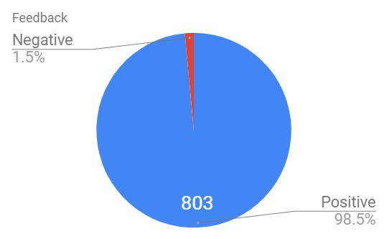
2018 Survey
Feedback | Responses
Positive | 803
Negative | 12
 | 815
113 Businesses, (110 positive)
Results as of 11/13/18

Slide 8
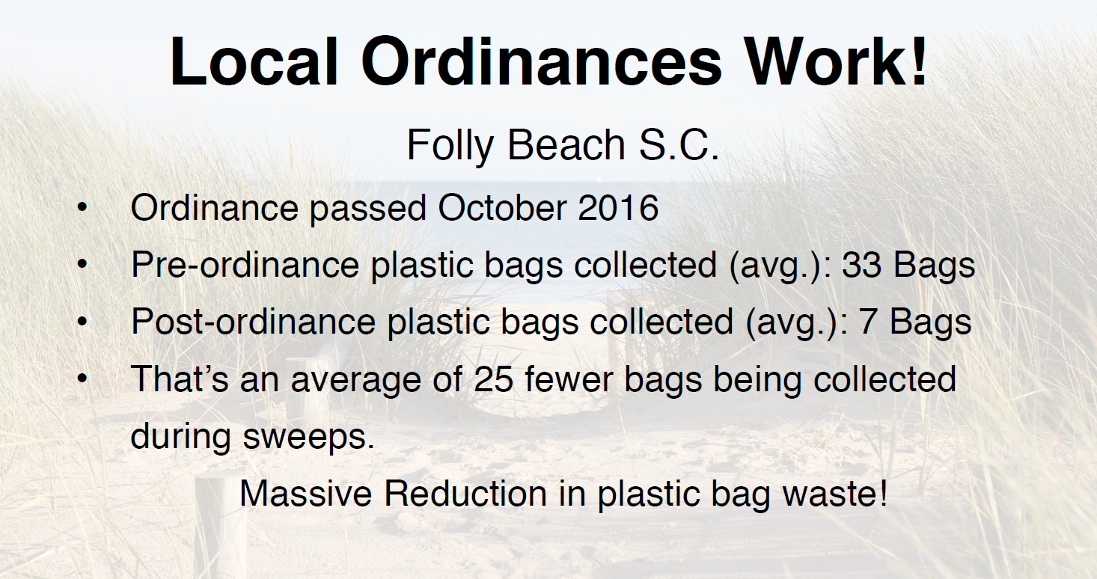

Slide 9
Transition Period
One Year Transition Period to continue stakeholder engagement
Many organizations are offering resources to help in transition
Option to request another year or modify ordinance

Slide 10
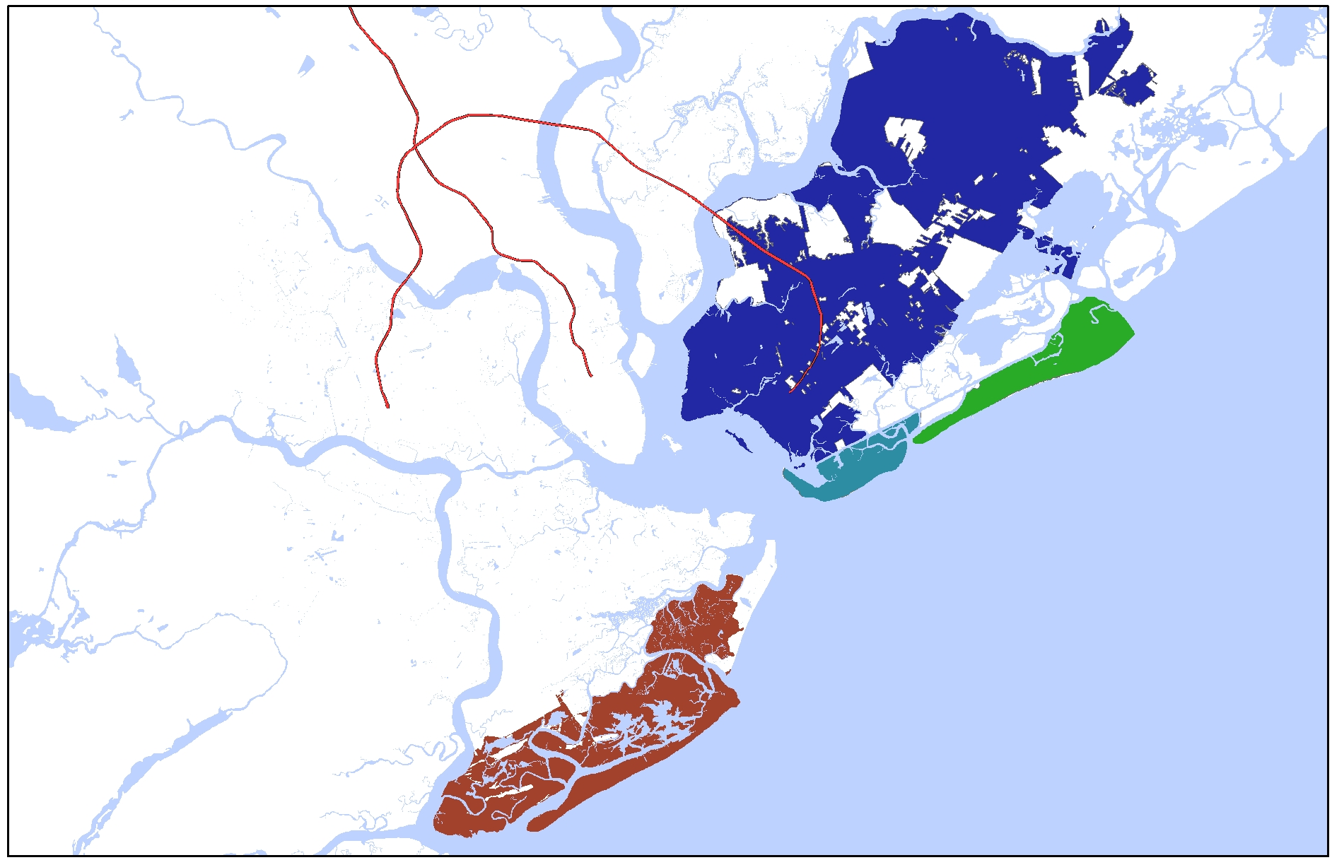
Nearby Actions
2018: Mount Pleasant
2018: Surfside Beach
2018: Hilton Head
2018: Bluffton
2018: Beaufort
2018: Port Royal
2018: Beaufort County
2018: Sullivan’s Island considering
2016: Folly Beach
2015: Isle of Palms

