Slide 1
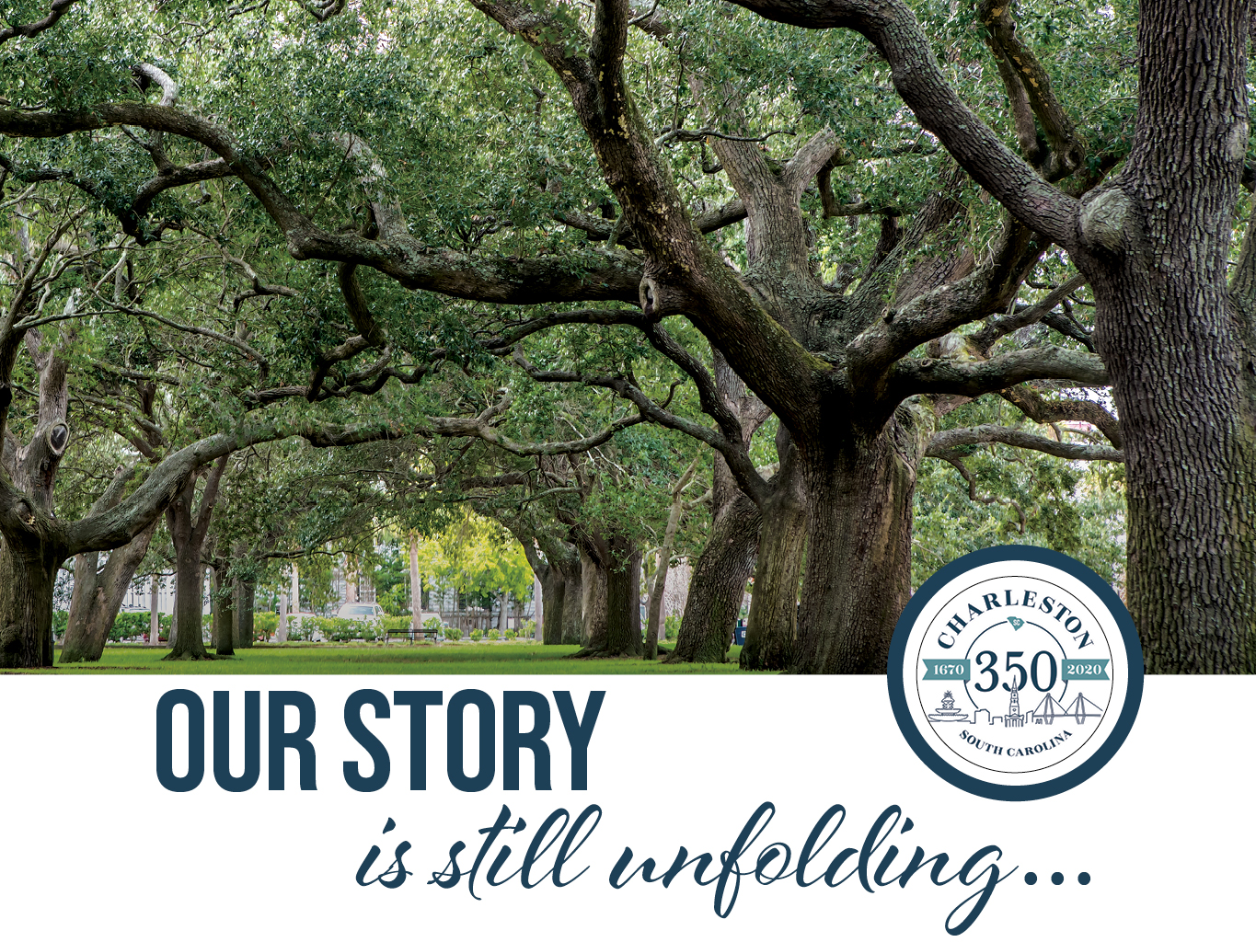

Slide 2

MISSION
In 2020, the City of Charleston will commemorate the 350th anniversary of the historic founding at Charles Towne (1670) by engaging the community and the state of South Carolina to honor the city's rich heritage, unique customs, and diverse cultures in a manner that examines its past and present, setting the course for its future as a 21st century global city.

Slide 3
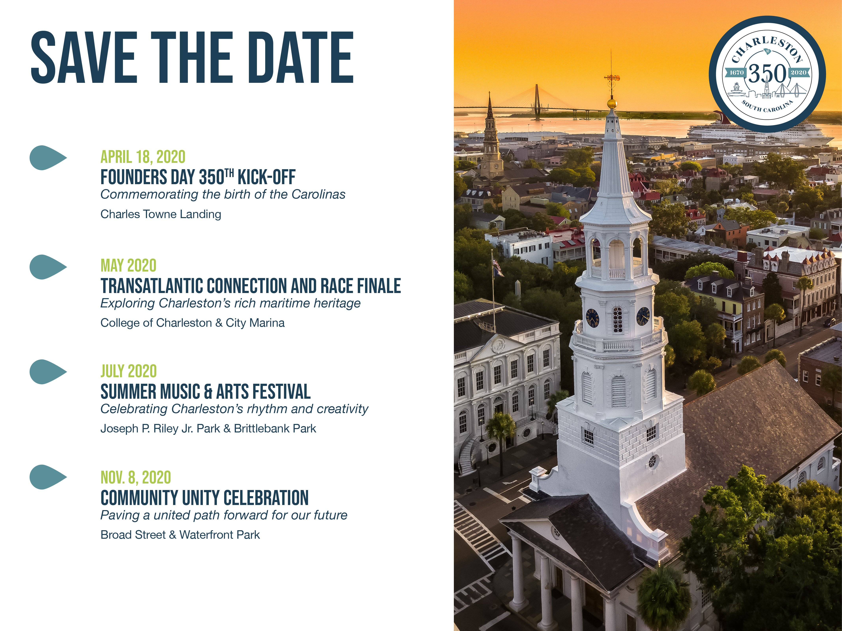

Slide 4
KEY ELEMENTS
Leadership
Partnering Events
Community Involvement
Charleston 350 Commemoration Fund
Supporters (Sponsors & Volunteers)
Commitment to our legacy and sharing our full and accurate story!

Slide 5

PARTNERING EVENTS
Heart and soul of this Commemoration
Which historical topic(s) does your event cover?
What generational timeframe?
How does it support the Charleston 350 Commemoration mission?

Slide 6
PARTNERING EVENTS
Use of the official Charleston 350 Commemoration seal
Inclusion on the Charleston 350 Commemoration website and calendar of events
Promotion on Charleston 350 Commemoration social media channels
Inclusion in Charleston 350 Commemoration promotional e-blasts
Official Charleston 350 Commemoration press release template to support publicity efforts
Window decal to display at place of business
Exposure to a community-wide audience

Slide 7


