Slide 1


City of Charleston
Central business district improvement commission
FRIDAY, SEPTEMBER 25, 2020

Slide 2
Updates
Police Department

Slide 3
The To Do List*
Safety & Appearance
Strategic Vision
Trash Collection
Public Infrastructure Maintenance
Sidewalk Obstruction and Pedestrian Crowding
COVID-19
Physical Cleanliness & Appearance
Panhandling & Aggressive Sales
Public Safety
Wayfinding
Unlicensed Palmetto Rose Peddlers
Parking & Garage Management
Lack of Seating
Lack of Local/Affordable/M&WBE Shops
Vacancies
Holiday Decorations
Decreased Foot Traffic & Events
Lease Prices
Gaps In Use Mix
Beautification
*These are ranked by difficulty score.

Slide 4
Responsible Parties
CBDI Commission
Council
Staff
Property Owners
Vendors
Nonprofits & Institutions
Public Value
Welcoming to All
Beautiful & Clean
Positive Experience
Sense of Place
Successful Business District
Safe
Notes:
JACOB: CVB, Riley Center

Slide 5
The To Do List Updates
Public Infrastructure Maintenance
  Bluestone Repairs & Maintenance Walk
COVID-19
  COVID-19 Signage
Physical Cleanliness & Appearance
  Power washing schedule
Panhandling & Aggressive Sales
  Updating Trespassing Ordinance & Forms
  Taliah Rice Door to Door Campaign
Public Safety
  Increased staffing; requesting overtime
Wayfinding
  Grant submitted!
Strategic Vision
  Apple
  Holiday decorations & beautification
  Food trucks
  Riley Center

Slide 6
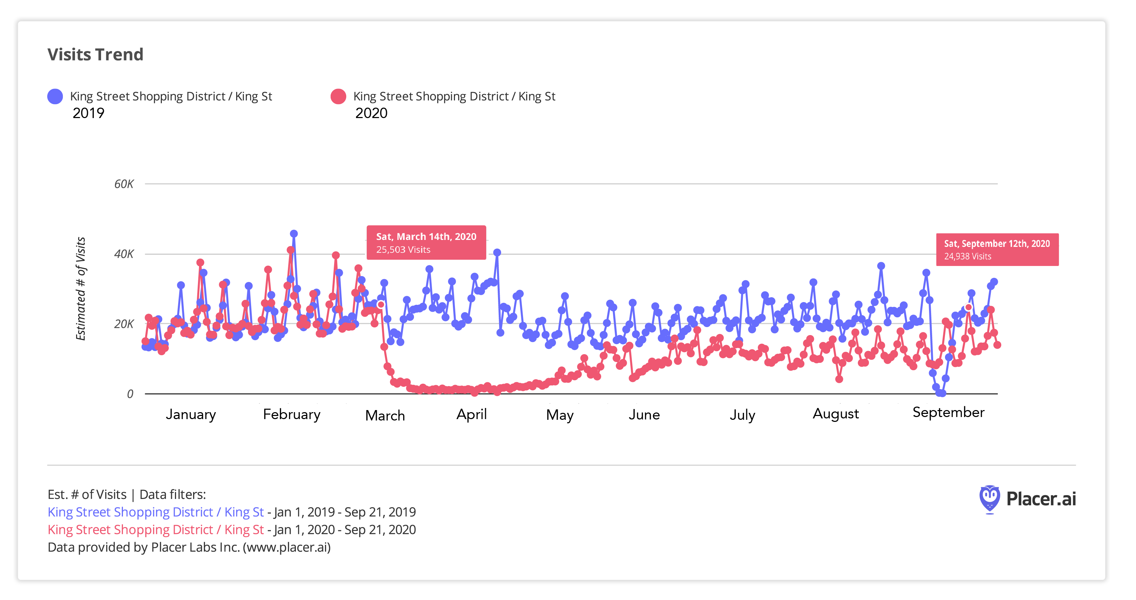

Slide 7
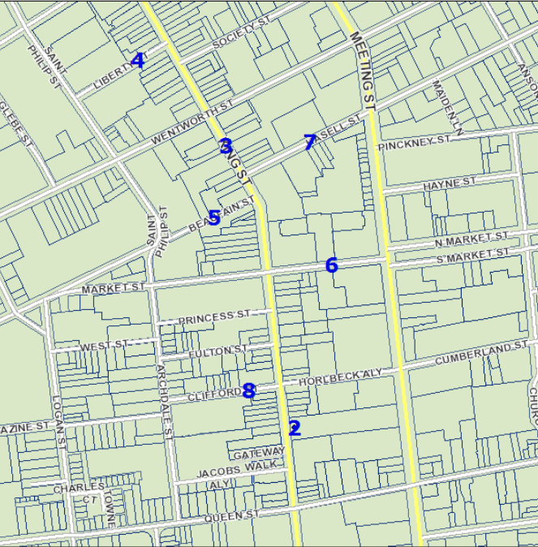
Potential Food Truck Sites
Site # | Location | Public or Private | Owner | Impact Score | Full or Partial Closure
1 | VRTC Lot (367 Meeting St) | Private | City | 5 | N/A
2 | Dominion Lot (174 King Street) | Private | Dominion | 5 | N/A
3 | King Street Square (Wentworth to Hasell) | Public | SCDOT | 4 | Partial
4 | Liberty Street (King to St. Philip) | Public | City | 3 | Either
5 | Beaufain Street (King to Archdale) | Public | City | 2 | Full
6 | Market Street (King to Meeting) | Public | City | 2 | Partial
7 | Hasell Street (King to Meeting) | Public | SCDOT | 2 | Full
8 | Clifford Street (King to Archdale) | Public | City | 1 | Full

Slide 8
Today’s Discussion
Beauty
Holiday Decorations
Beautification
Lack of Seating
Explore Charleston
Doug Warner

Slide 9
Today’s Discussion
Strategic Vision
College of Charleston Riley Center for Livable Communities
Dr. Kendra Stewart

Slide 10
Next Steps
User Concerns
Parking & Garage Management
Decreased Foot Traffic & Events
Safety & Appearance Report

