Slide 1


City of Charleston
Central business district improvement commission
FRIDAY, OCTOBER 9, 2020

Slide 2
Boards+ Profiles
Brittany Pinckney, Mayor’s Office
pinckneyb@charleston-sc.gov | (843) 724-3737
http://charlestonsc.iqm2.com/Citizens/Board/Vacant
Central Business District Improvement Commission
Apply
Apply Now (top right)
Sign-up for an Account
Application Form (name, address, contact info, bio)
Submit Application

Slide 3
Updates
Police Department
King Street Speed Limit Change
Holiday Task Force
Ordinances:
No Samplings Proposal
No Trespass Change

Slide 4
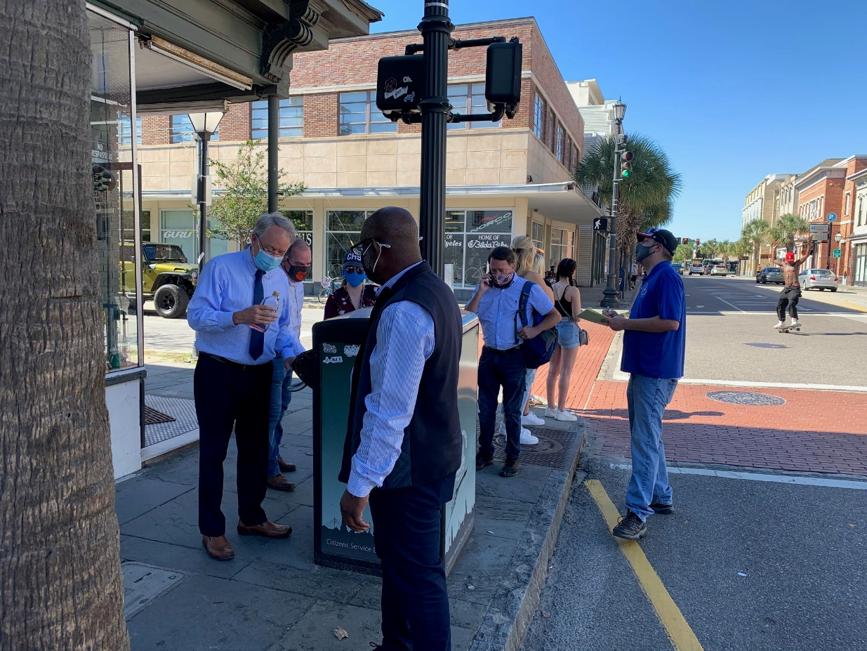
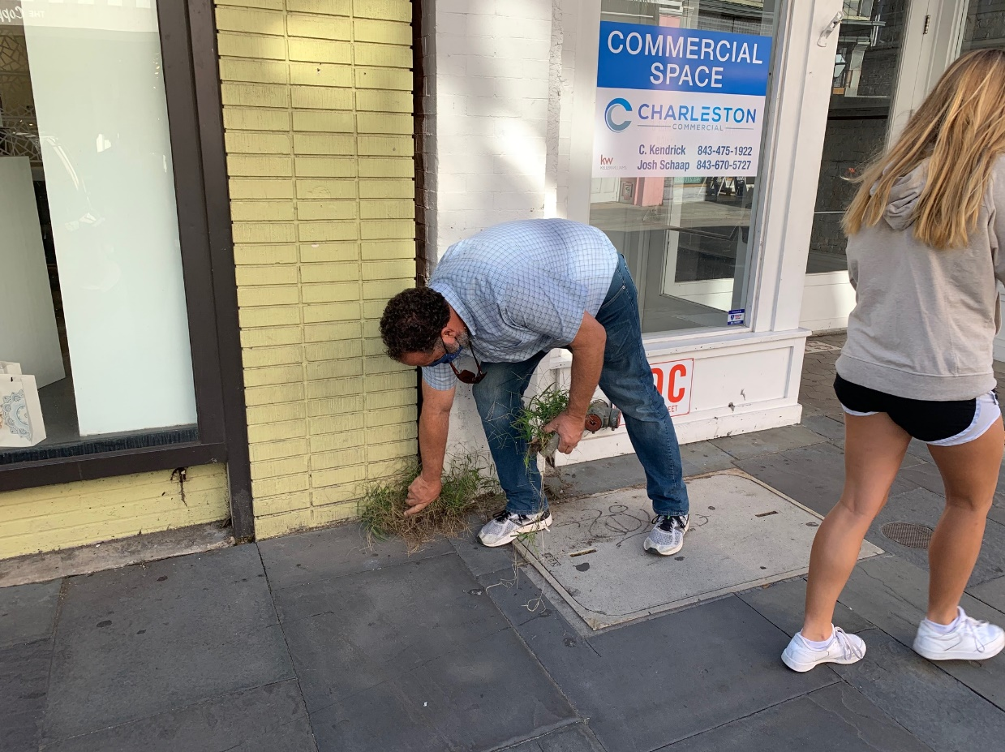
Maintenance Walk

Slide 5
Maintenance Walk Report

Slide 6
Maintenance Walk Follow Ups
Updated markings and addressed signals.
Contractor will start at Society St to re-paint the light poles to Spring St. New pole # tags will be installed. Ordered new base covers that will hopefully come next week. These need to be fabricated, and some older styles will take a little longer.
Graffiti, sticker, & litter abatement began that evening. Notifying property owners and continuing to identify others. CBD & Maintenance Officers conducting daily patrols to address trash disposal, litter and overgrowth, graffiti and mask violations.
Explore requiring power washing post utility work.
Clean bike racks.

Slide 7
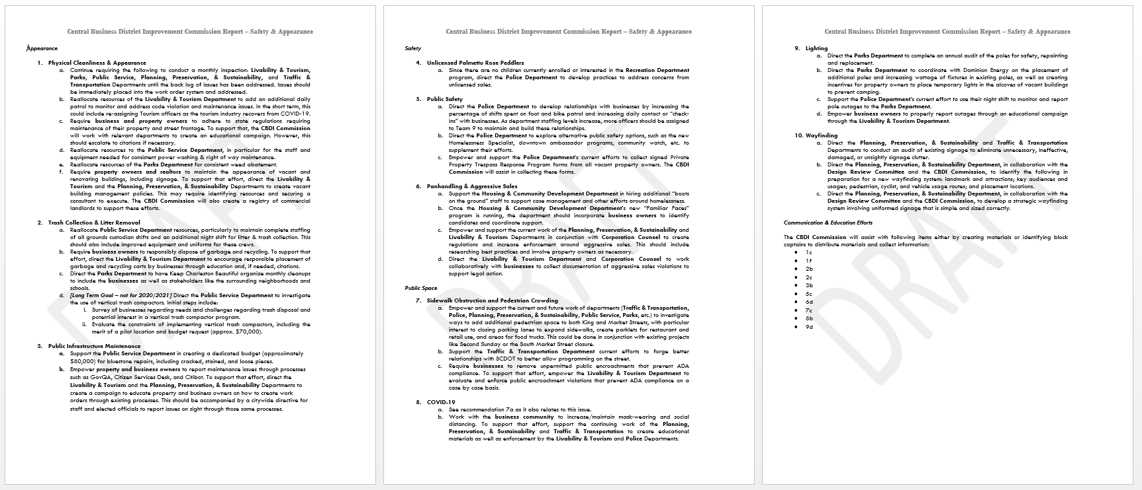
Safety & Appearance Report

Slide 8
Key Themes & Next Steps
Themes
Address the back log.
Get more eyes on the street.
Be proactive.
Get everyone involved.
Role for the Commission in communication & education efforts
Next Steps
Review with relevant department heads & Mayor.
Report to City Council on October 27 Meeting.

Slide 9
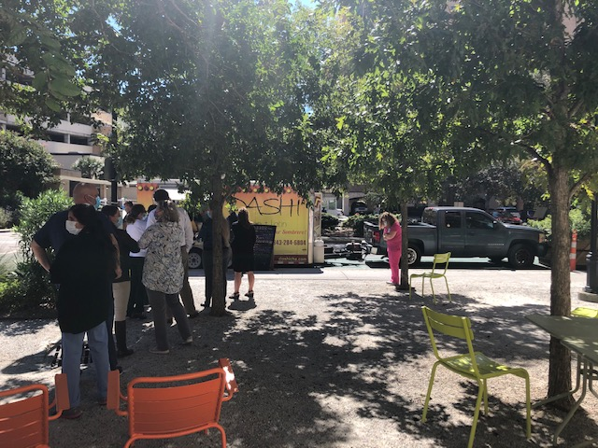
Mobile Food Vendors
Research: MUSC Greenway (pictured), Farmers Market, & Meeting Street Eats
Considerations:
Recruitment & Scheduling
Equipment: power sources vs generators, tables, chairs, tents, trash & storage
Staff & Programming: onboarding, licensing, cross-departmental, program coordinator
Marketing: flyers, signage, social media
COVID-19
Costs/Fees/Revenue: space, maintenance, marketing, staff & rentals

Slide 10
Potential Sites
VRTC Lot
Liberty Street
Privately-owned parking lot at 367 Meeting St. Set-up food trucks & dining when least utilized. Opportunity for partnership with CVB.
Highest Foot Traffic: Saturdays, 6 – 10PM & Thursday thru Sunday, 6 PM – 10PM
Opportunities: Charleston Visitors Bureau, Wragg Park, Charleston School of Law, Music Farm, Music Hall, The Charleston Digital Corridor, Deco Nightclub, Dudley’s, Hampton Inn, Parking Garages & Bus Stops.
Competing B&M: The Brick, Genuine Saigon coffee, JohnKing, Rue De Jean, COAST Bar & Grill, Basil.
City-owned street. Closed to through traffic, bag meters, and install pedestrian barriers. Opportunity to incorporate B&M alongside food trucks.
Highest Foot Traffic: Friday thru Sunday, 11 AM – 5 PM.
Opportunities: CofC (Residence Hall, School of Business & Wells Fargo Auditorium), Parking Garage, Willow Salon, Quicksilver, Apple Store, Gangi Courtyard
Competing B&M: CofC Liberty Fresh Food, Fire Grill Asian Fusion, Leyla's Lebanese Cuisine

Slide 11
Potential Next Steps
Determine whether to move forward with either or both.
If so:
Survey the surrounding area to determine buy-in from community and businesses.
Determine funding.
Designate management to specific department (Liberty St) and/or partnership agreement with the CVB (VRTC Lot).
Develop program procedures, signage and other materials that can be replicated.

Slide 12
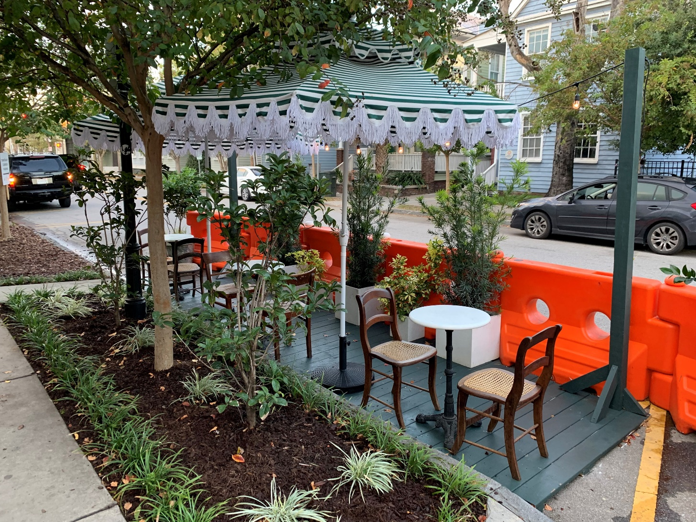
Parklets
Pilot: Babas on Cannon, 11 Cannon St. (pictured)
Requests in Progress:
Republic, El Jefe, & Rarebit (east side of King St., between Mary & Ann Sts.)
Cutty’s (corner of Bogard & St. Philip Sts.)

