Slide 1


City of Charleston
Central business district improvement commission
FRIDAY, OCTOBER 23, 2020

Slide 2
Updates
Police Department
Market Street Overtime Detail: Approved through January 1. 7 days per week, 2 shifts per day. 1 officer per shift Monday - Friday, & 2 on Saturday & Sunday.
King Street Road Safety Audit
Trident United Way Day of Caring on Nov. 20

Slide 3
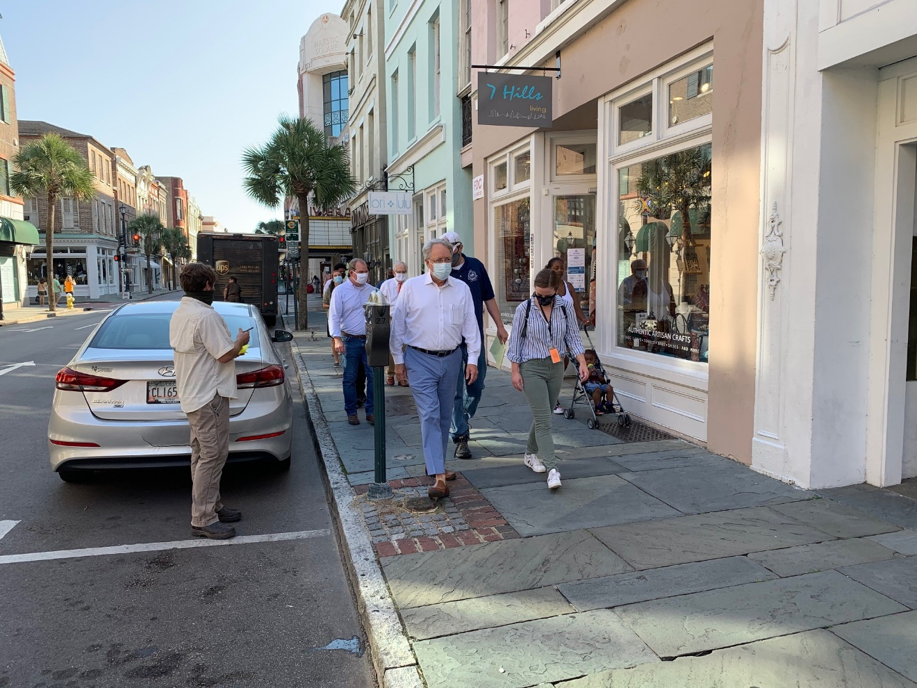
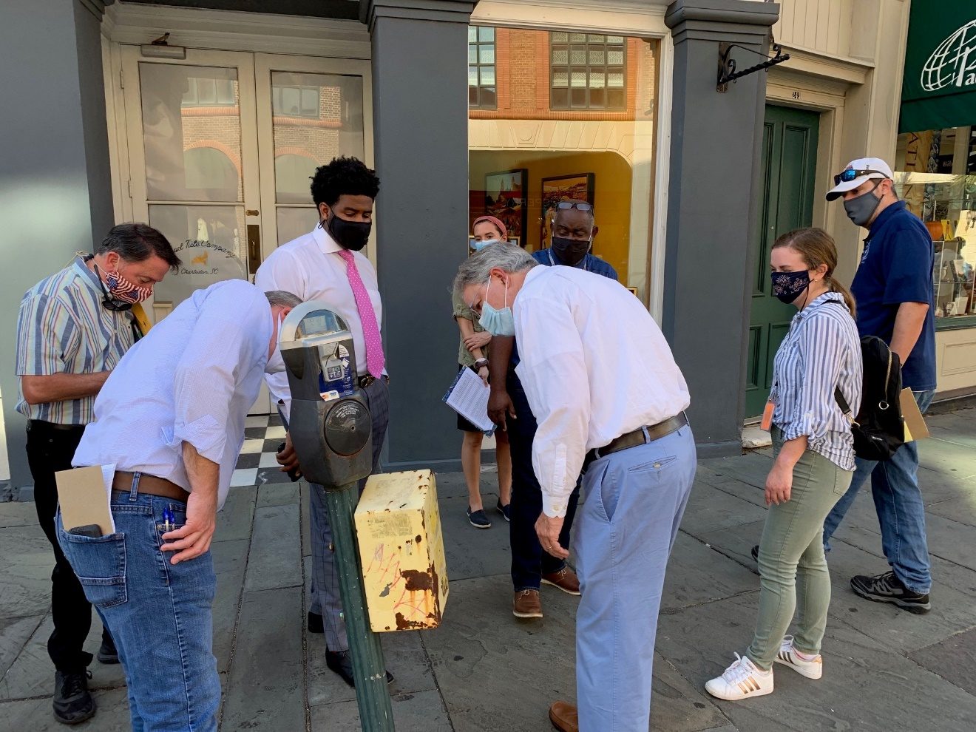
King Street Maintenance Walk

Slide 4
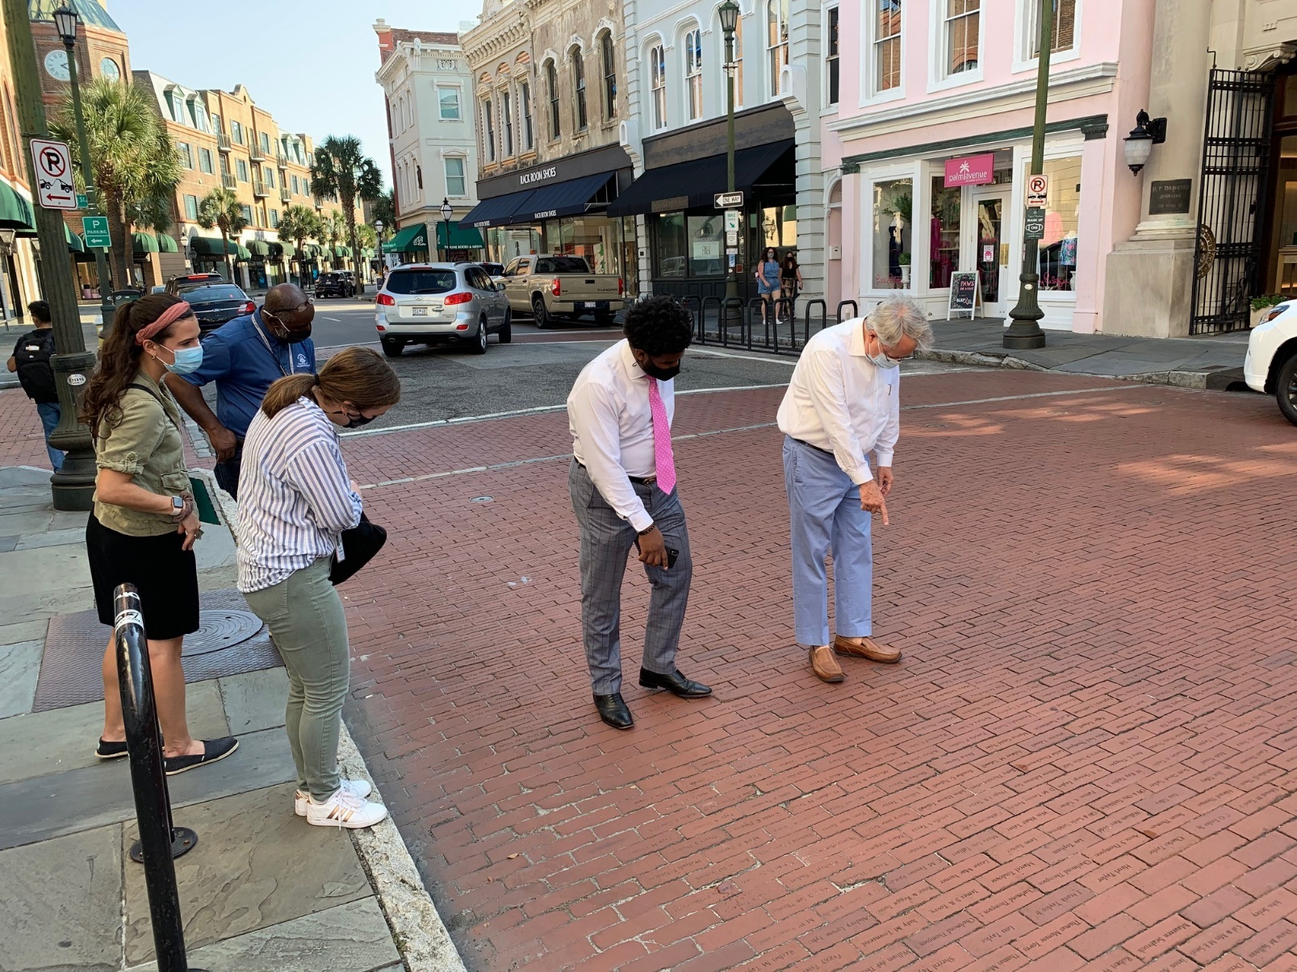
King Street Maintenance Walk

Slide 5
King Street Maintenance Walk

Slide 6
King Street Maintenance Walk Report

Slide 7
Maintenance Walk Follow Ups
Livability & Tourism has also addressed 26 other items:
Painting plywood
Unpermitted activity
Inappropriate trash/debris disposal
Abandoned bikes
Illegal signage
Human waste

Slide 8
Maintenance Walk Follow Ups
Traffic & Transportation:
All street markings were refreshed/replaced along Upper King Street.
Traffic/parking signs were replaced/cleaned. Posts were straightened.
All parking meters were checked & repaired.
Additional work to be scheduled:
Replacement of signs with stickers or removal of stickers.
Replacement of older/damaged stop signs on intersecting streets.
Refresh/replacement of crosswalk markings.
Sign posts with graffiti will also be replaced/painted.
Stickers placed on meters will be removed as much as possible.

Slide 9
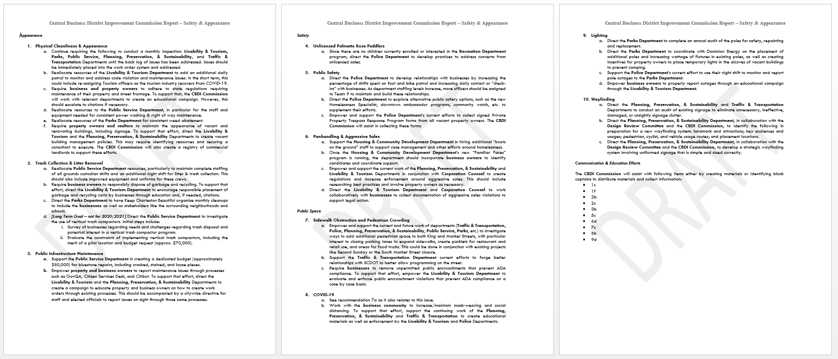
Safety & Appearance Report

Slide 10
Parking Minimums
Savannah, GA adopted a new zoning ordinance last year that reduced parking requirements in its historic downtown as well as setting up a fee in lieu system to build shared parking and mobility resources. They used their recent parking study as justification.
Beaufort, SC does not have parking requirements in its historic downtown area except for accommodations uses.
Columbia, SC has not had parking requirements in its Main Street District for almost 50 years. In 2016 & 2019, North Charleston approved amendments removing parking requirements for areas that were developed at a time when buildings were often constructed observing near zero lot lines and where on-street parking was typical.

Slide 11
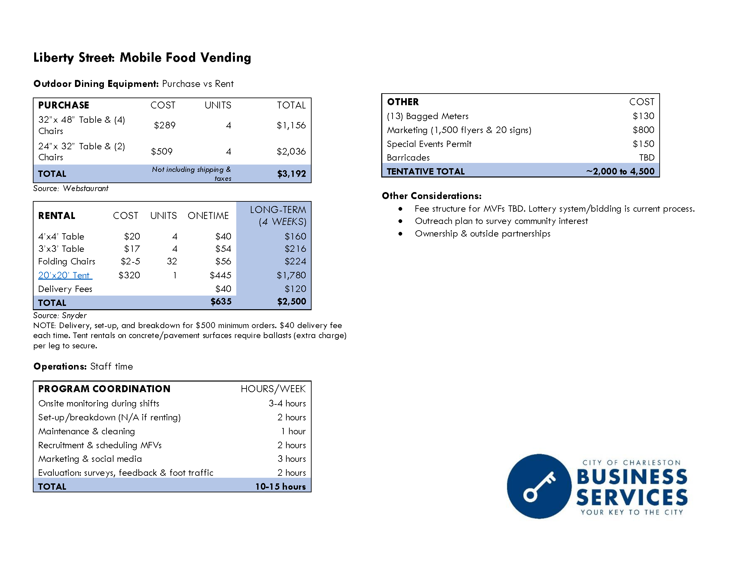

Slide 12
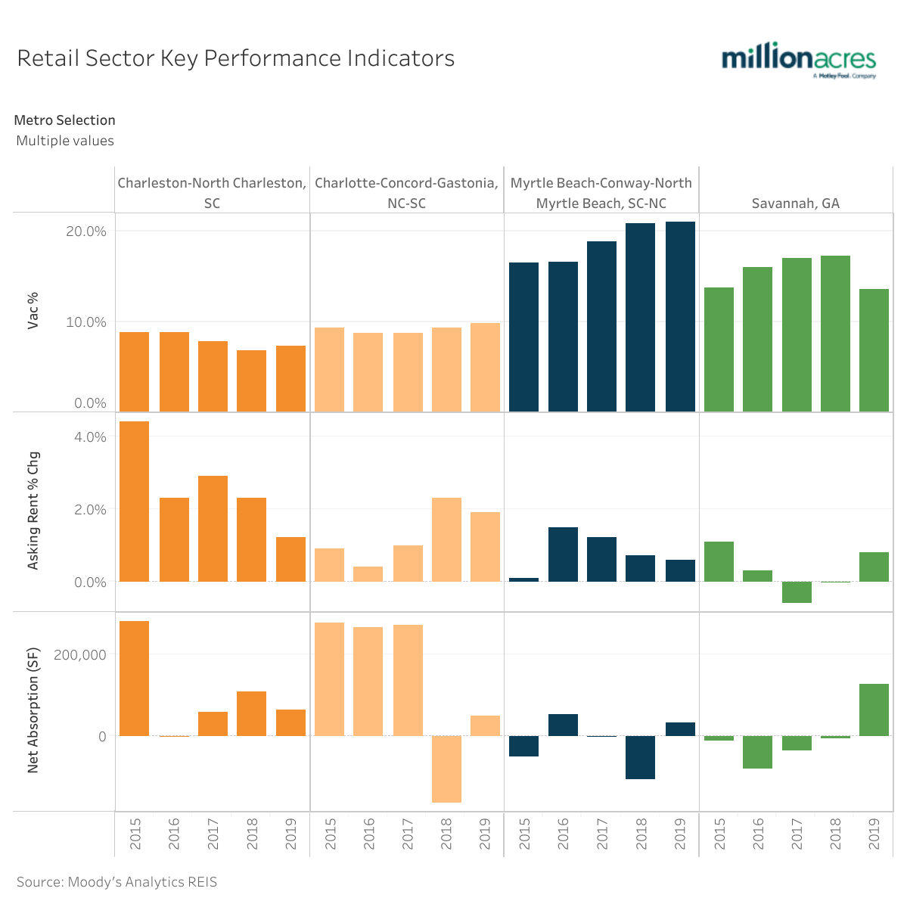
Metros with Greatest Industry Exposure to Pandemic
With neither vacancy rates nor rent growth in 2019 reaching pre-recession levels, the retail sector was already on shaky ground before the pandemic hit.
While the sector recovered with the rest of the economy after 2012, completions, net absorption, and asking rent growth have consistently slowed since 2017, thanks mostly to ecommerce.
The 10.2% vacancy rate in 2019 changed very little since it topped out at 11% in 2010 and is nowhere near its pre-recession low of 6.4%. In light of COVID-19, 2020 forecast is a vacancy rate of 13.5% attended by a 3.7% decline in asking rents.

Slide 13
King Street Occupancy Rates
Date | Street | Upper | Middle | Lower
January 2016 | 91% | 85% | 94% | 94%
July 2017 | 92% | 89% | 93% | 97%
October 2019 | 88% | 82% | 90% | 96%
January 2020 | 89% | 80% | 90% | 97%
June 2020 | 85% | 80% | 85% | 93%
September 2020 | 83% | 79% | 82% | 90%

Slide 14
King Street Occupancy Rates

Slide 15
Vacant Properties

Slide 16
Vacancy Initiatives
Long Term:
Incentives & Penalties
Short Term:
Pop-Ups Proposal
Window Decals

