Slide 1


City of Charleston
Central business district improvement commission
TUESDAY, OCTOBER 27, 2020

Slide 2
Mission
The Central Business District Improvement Commission shall work to assure the long-term economic vitality of the King Street and surrounding commercial area, also known as the Central Business District.
The Commission will consider and recommend policy and program changes to City Council that will balance the local economy with tourism needs and create a vibrant hub for commerce.
Notes:
Mayor

Slide 3
Commission Members
Mayor John Tecklenburg
Councilmember Mike Seekings
Councilmember Robert Mitchell
Lauren Ellison Fox (Chair)
Lamar Bonaparte
Bob Siegel
Stacy Smallwood
Andy Birlant Slotin
Marty Wall
Helen Hill
Tom Stockdale
Tyrone Wilson
Tim Muller

Slide 4
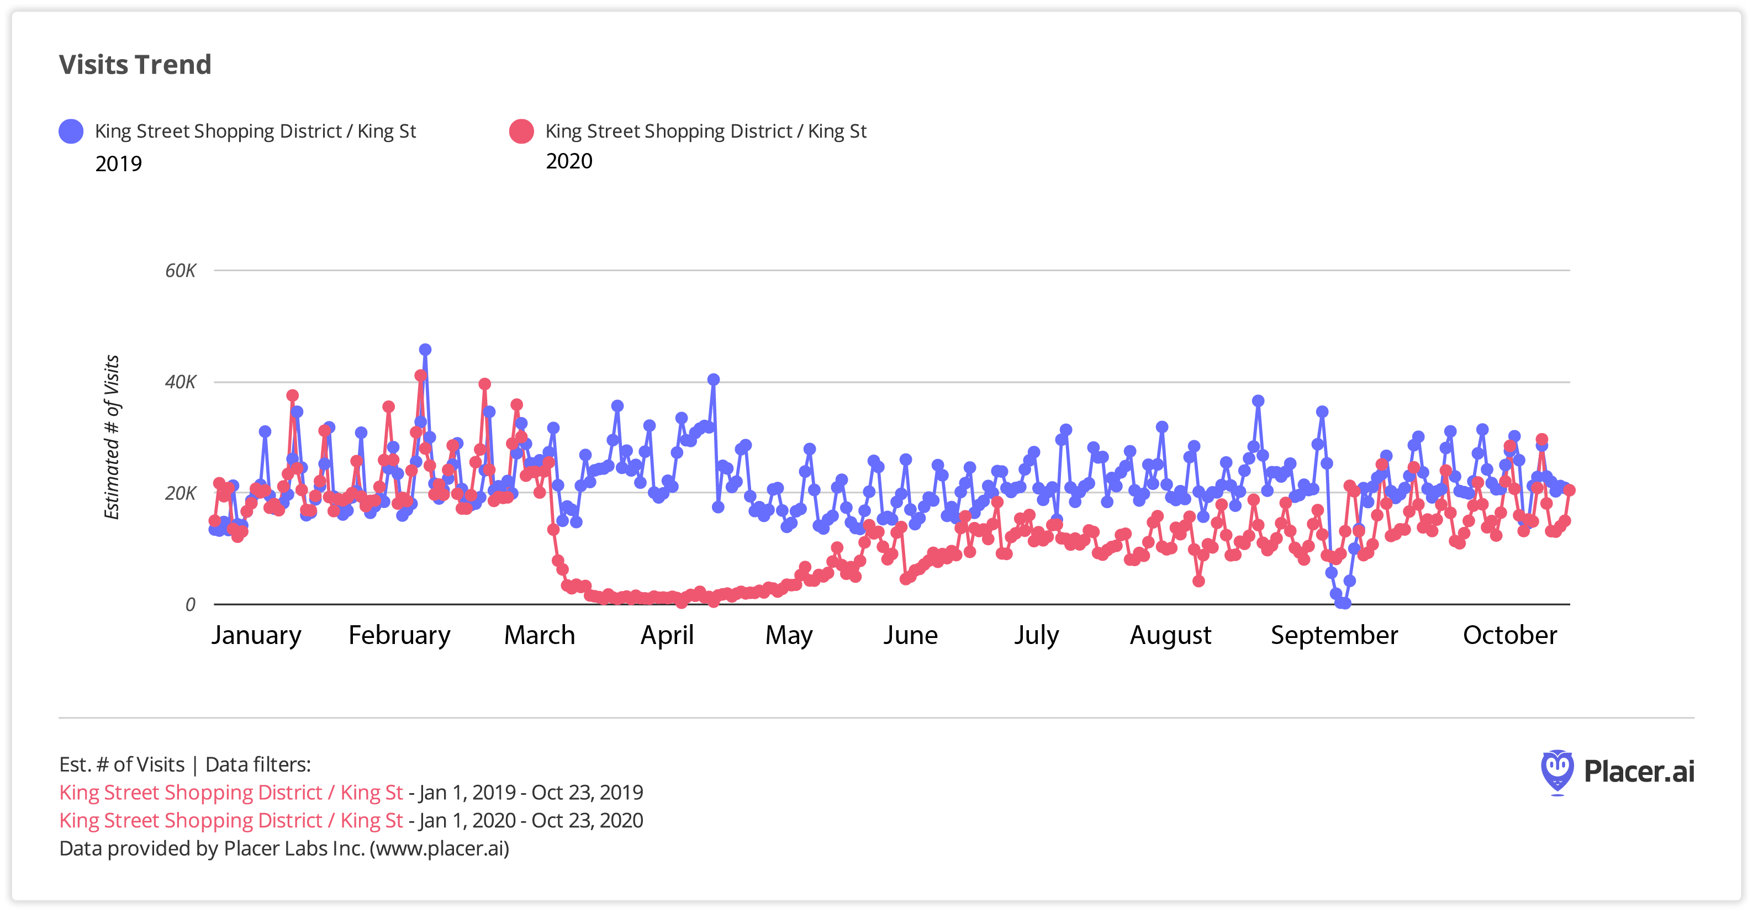
Unique Visits to King Street

Slide 5
Commission Timeline
Develop Work Plan
Summer - Fall 2020
Winter 2020 – Early 2021
2021
Execute Work Plan
Assess the Success of the Work Plan
Projects in Place for Holiday Season
Notes:
Meg

Slide 6
The To Do List
Safety & Appearance
Strategic Vision
Trash Collection
Public Infrastructure Maintenance
Sidewalk Obstruction and Pedestrian Crowding
COVID-19
Physical Cleanliness & Appearance
Panhandling & Aggressive Sales
Public Safety
Wayfinding
Unlicensed Palmetto Rose Peddlers
Lighting
Parking & Garage Management
Lack of Seating
Lack of Local/Affordable/M&WBE Shops
Vacancies
Holiday Decorations
Decreased Foot Traffic & Events
Lease Prices
Gaps In Use Mix
Beautification

Slide 7
Understanding the To-Do List
Understand Constraints
Get Responsible Parties Onboard
Secure Required Resources
Implement Response
Define the Problem
We’ve done this!
This is what we’re working on now.

Slide 8
Safety & Appearance Report
Key Departments:
Corporation Counsel
Housing & Community Development
Livability & Tourism
Parks
Planning, Preservation, & Sustainability
Police
Public Service
Recreation
Traffic & Transportation
Plus: Dominion Energy, Explore Charleston, & College of Charleston Riley Center for Livable Communities
Key Requests:
Budget:
Bluestone Repair Budget
HCD Staff Request

Slide 9
Progress So Far
Public Infrastructure Maintenance
Bluestone Repairs & Maintenance Walks
COVID-19
COVID-19 Signage
Physical Cleanliness & Appearance
New Power Washing Schedule
Day of Caring & Maintenance Walks
Panhandling & Aggressive Sales
No Sampling Ordinance
Updating Trespassing Ordinance & Forms
Homeless Coordinator Door to Door Campaign
Public Safety
Increased staffing; Approved overtime
Strategic Vision
Farmers Market Return
Free Parking Vouchers
Holiday Decorations/Beautification
Parklets & Food Trucks
Riley Center

