Slide 1


City of Charleston
Central business district improvement commission
FRIDAY, NOVEMBER 6, 2020

Slide 2
Updates
Police Department
Samplings Ordinance
Trespass Ordinance
Market Maintenance Walk
Parking Minimums
Wayfinding Grant
Liberty Street
CVB:
  King Street Dining Map
  Holiday Marketing

Slide 3
CBDIC Powers & Duties
Study and recommend financial and organizational techniques, such as business improvement districts, to effectuate the continued health and vitality of Central Business District by the joint efforts of public and private entities;
Evaluate and implement early action improvements for the Central Business District as identified by the Commission and the Business and Neighborhood Services Division of the Department of Planning, Preservation, and Sustainability, especially in the areas of public safety, cleanliness, beautification, and occupancy;
Study and recommend methods to incubate, launch, recruit and sustain businesses in the Central Business District, paying special attention to small, local, and minority and women-owned businesses; and,
Consult with subject matter experts to guide and inform the Commission’s recommendations.

Slide 4
The To Do List
Safety & Appearance
Strategic Vision
Trash Collection
Public Infrastructure Maintenance
Sidewalk Obstruction and Pedestrian Crowding
COVID-19
Physical Cleanliness & Appearance
Panhandling & Aggressive Sales
Public Safety
Wayfinding
Unlicensed Palmetto Rose Peddlers
Lighting
Parking & Garage Management
Lack of Seating
Lack of Local/Affordable/M&WBE Shops
Vacancies
Holiday Decorations
Decreased Foot Traffic & Events
Lease Prices
Gaps In Use Mix
Beautification

Slide 5
Work Groups
Responsible Parties
CBDI Commission
Council
Staff
Property Owners
Vendors
Nonprofits & Institutions
Public Value
Welcoming to All
Beautiful & Clean
Positive Experience
Sense of Place
Successful Business District
Safe
2021 Holiday Decorations
Safety & Appearance Outreach
Pop-Up Shops

Slide 6
King Street Occupancy Rates
Please note that staff found an error in the November data after the 11/06/20 meeting and these slides show that correction.
Date | Street | Upper | Middle | Lower
January 2016 | 91% | 85% | 94% | 94%
July 2017 | 92% | 89% | 93% | 97%
October 2019 | 88% | 82% | 90% | 96%
January 2020 | 89% | 80% | 90% | 97%
June 2020 | 85% | 80% | 85% | 93%
September 2020 | 83% | 79% | 82% | 90%
November 2020 | 82% | 81% | 82% | 86%

Slide 7
King Street Occupancy Rates
Please note that staff found an error in the November data after the 11/06/20 meeting and these slides show that correction.

Slide 8
Vacant Properties
Please note that staff found an error in the November data after the 11/06/20 meeting and these slides show that correction.

Slide 9
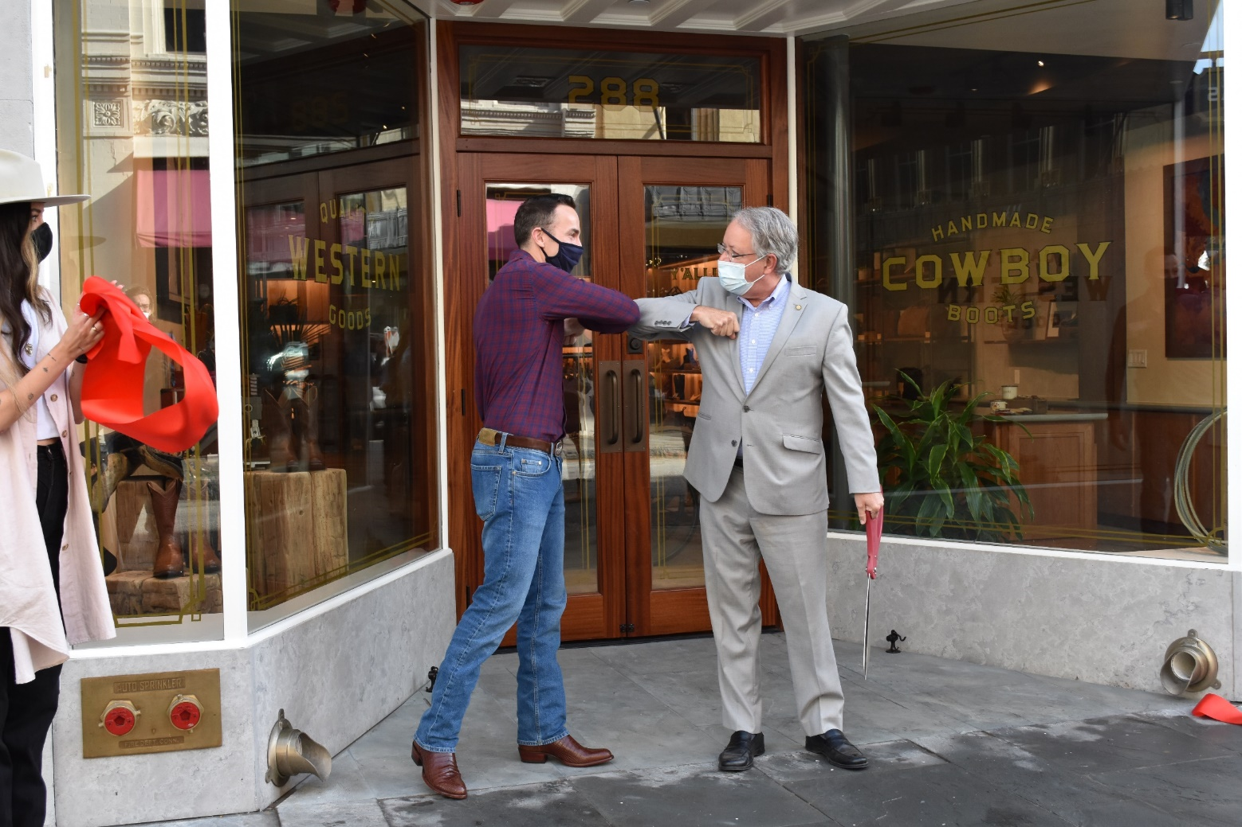
New King Street Stores since September
Upper
  570: 1st Place Premium Sports Pub
  550: Girl Tribe Co
  522: Something About Me
  415: Warby Parker
  409: Old Whaling Co
Middle
  363: Magnifique
  288: Tecovas
Lower
  154: Salisbury & Manus

Slide 10
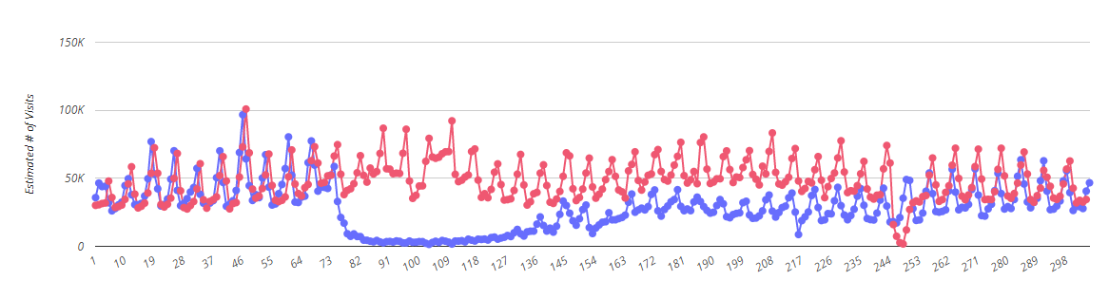
Rent & Foot Traffic
Average downtown rent is $42.79/square foot (Avison Young)
Asking rent for retail & restaurant space in CBD is $39.71/square foot (Carolina One)
Central Business District Foot Traffic January – October 2019 & 2020
Data from Placer.ai
2020 Foot Traffic
2019 Foot Traffic

Slide 11
Vacancy Initiatives
Short Term:
  Pop-Ups Proposal
  Window Decals
Long Term:
  Incentives
  Deterrents

Slide 12
Vacancy Deterrents
Vacancy Registration Programs
  Examples: Columbia & San Francisco
  Increasing renewal fees
  Whole building or just storefront
Option: Vacant Storefront Registration
  Fee based on store frontage; must be significant enough to be effective
  Increase fees with each renewal
  New workflow for staff
  Determine what the fee would fund

Slide 13
Economic Development Strategies
Tax Incentives
  Tend to benefit property owners, not tenants
  Federal & State Historic Building Rehabilitation Incentives
  Five-Year Property Tax Abatement
    Only allowed for certain uses – not retail or restaurant
    Property taxes are levied through the County
Programs (Funding Required)
  Rent Subsidies (Orlando, FL)
  Central Business District Manager
    Proactively recruit businesses

Slide 14
Action Items
Responsible Parties
CBDI Commission
Council
Staff
Property Owners
Vendors
Nonprofits & Institutions
Public Value
Welcoming to All
Beautiful & Clean
Positive Experience
Sense of Place
Successful Business District
Safe
Commissioners:
  2021 Holiday Decorations
  Safety & Appearance Outreach
  Pop-Up Shops
Staff:
  Identify Wayfinding Funding
  Parking Minimums
  Ordinances
  Vacancy Initiatives Research

