Slide 1


City of Charleston
Central business district improvement commission
FRIDAY, NOVEMBER 20, 2020

Slide 2
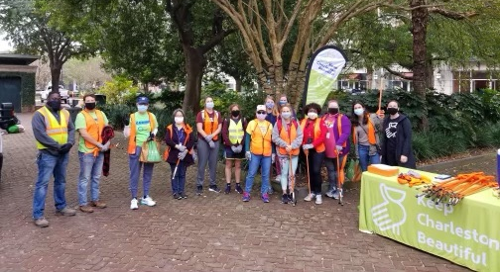
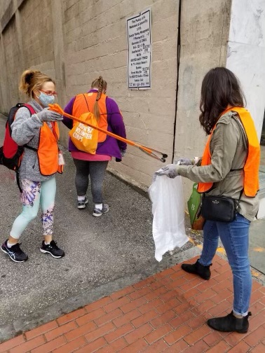
Updates
Police Department
Day of Caring
Holiday Parking Voucher
Paint Refresh Project
Riley Center Update

Slide 3

King Street Strategic Plan Update

Slide 4
Three- Phase Process
Research
  Data collection
  In-depth interviews & focus groups
ULI Technical Assistance Panel
  $25,000
Professional consultants
  Final report and recommendations

Slide 5
Areas of focus
Analyze and advise about the retail mix in different blocks of King Street and recommend tools the city can use to achieve this ideal mix
Advise about upper-floor usage of space and tools to optimize this usage
Provide strategies and a tool kit for dealing with retail vacancies
Provide guidance and strategies on attracting diverse businesses and business owners, forging collaborative partnerships and building capacity for local partners
Advise about street events and street closures

Slide 6
Areas of focus cont’d
Advise on best practice for retail main streets and the management of downtown retail districts
Advise on the physical condition and design of streetscape
Observe and analyze right-of-way elements and how the street functions with regards to traffic movement and other modes of travel throughout corridor and recommend best practices
Advise on strategy for creating and implementing a Business Improvement District for the area

Slide 7
Questions or Comments?
Kendra Stewart
Director
The Joseph P. Riley, Jr. Center for Livable Communities
  stewartk@cofc.edu
  (843) 953-6691

Slide 8
Sampling Ordinance Update
General requirements:
  Individuals who offer samples must have and produce identification upon request.
  No more than one individual may offer samples or solicit from a business establishment at a time.
Upon receiving 2 violations in a year, business must apply for quarterly permit:
  Install a video surveillance system capable of capturing all sampling activities.
  Pay permit fee of $100 per quarter.
  Post a refundable performance bond of at least $1,087 to insure that public property is restored and cleaned of litter, encourage non-aggressive sales tactics, and ensure compliance.
  Permit may be denied because of incomplete information, outstanding fees, etc.
Permit may be suspended due to violations, triggering a business license review and potential revocation of license. Decisions can be appealed through the Business License Committee.

Slide 9
King Street Road Safety Audit

Slide 10
Action Items
Responsible Parties
CBDI Commission
Council
Staff
Property Owners
Vendors
Nonprofits & Institutions
Public Value
Welcoming to All
Beautiful & Clean
Positive Experience
Sense of Place
Successful Business District
Safe
Commissioners:
  2021 Holiday Decorations
  Safety & Appearance Outreach
  Pop-Up Shops
Staff:
  Identify Wayfinding Funding
  Ordinances
    Parking Minimums, Sampling
  Vacancy Initiatives
    Storefront Registry
    Connecting with Commercial Realtors
      Pop-ups

