Slide 1


City of Charleston
Central business district improvement commission
FRIDAY, DECEMBER 18, 2020

Slide 2
Updates
Police Department
Sampling Ban Ordinance Passed
Commercial Realtor Meeting
King Street RSA Feedback

Slide 3
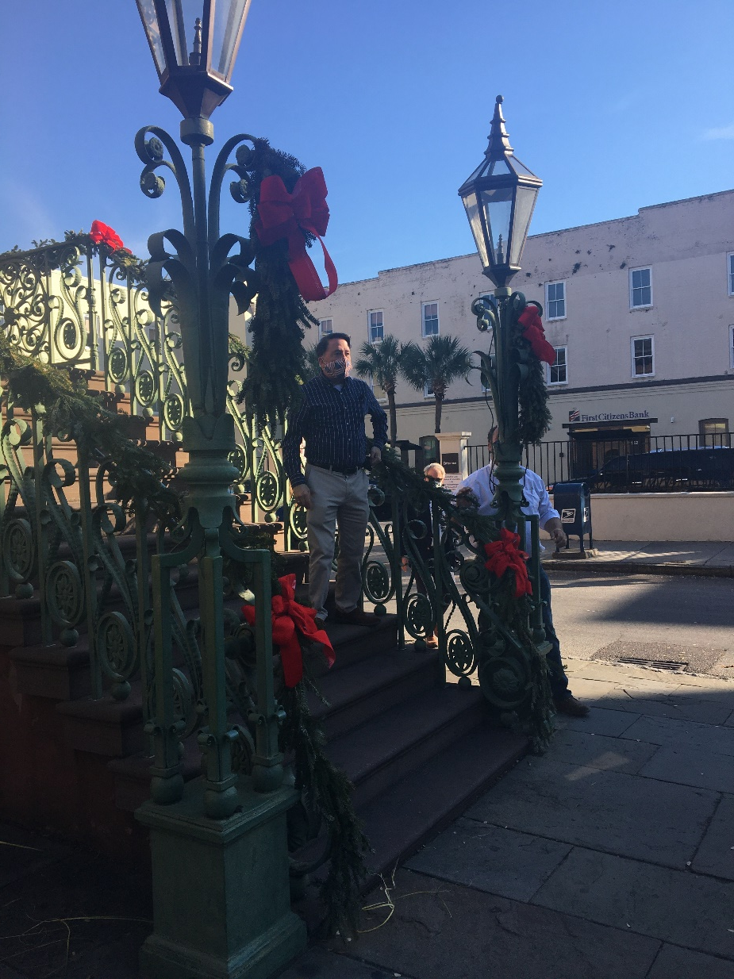
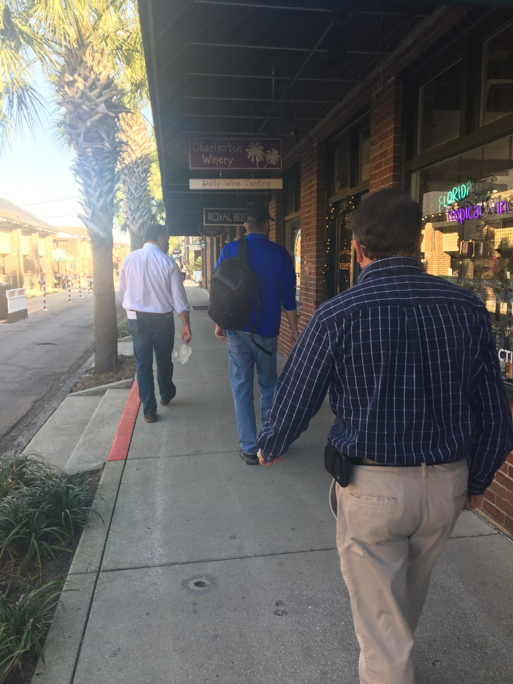
Market Street Maintenance Walk
Getting quote to paint the decorative light poles
Refreshed all pavement markings
Replaced one sign damaged with graffiti
Corrected the barricades for South Market closure
Checked parking meters
Removed/painted over graffiti & marketing stickers

Slide 4
Lowcountry Lowline

Slide 5
2021
Responsible Parties
CBDI Commission
Council
Staff
Property Owners
Vendors
Nonprofits & Institutions
Public Value
Welcoming to All
Beautiful & Clean
Positive Experience
Sense of Place
Successful Business District
Safe
Meeting Schedule
Riley Center & BID
Safety & Appearance
  Staff Update
  Work Groups:
    Outreach & Materials
    Wayfinding
Strategic Vision

Slide 6
Strategic Vision
Parking & Garage Management
  Holiday Parking Voucher thru Jan. 1
  2021 Parking Meter Enforcement
Lack of Seating
Lack of Local/Affordable/M&WBE Shops
  Pop-Up Initiative (Work Group)
Vacancies
  Parking Minimums Proposal
  Storefront Registration
Holiday Decorations
  Work Group
Decreased Foot Traffic & Events
  Holiday Market
  SEWE & Spoleto Returning
Lease Prices
Gaps In Use Mix
Beautification
  Flower Basket Sponsorships

