Slide 1


City of Charleston
Central business district improvement commission
FRIDAY, FEBRUARY 19, 2020

Slide 2
Updates
Police Department Update
King Street Profile
Business Improvement District Planning

Slide 3
ULI/Riley Center Technical Assistance Panel
World class retail districts the world over employ a variety of strategies to support thriving downtowns. What are the key policy, regulatory, and organizational tools that the CDA, the City, and other stakeholders should have in our “downtown toolbox”?
How can we all work together to support local businesses, curtail vacancies, encourage business retention and expansion, and enhance the safety, security, cleanliness and the beauty of downtown?
What strategic actions will lay strong foundations for economic stability and vitality to help us weather financial downturns, market fluctuations, changes in leadership, and other challenges in a post-pandemic economy?

Slide 4
ULI/Riley Center Technical Assistance Panel
Charleston’s Central Business District, focused in and around the King Street Corridor, offers a distinct and special experience for a variety of residents and visitors—from elsewhere in the Charleston region as well as global visitors. In addition to approximately x,000 fulltime residents, downtown Charleston also includes a variety of workers (office, F&B, retail),four higher learning institutions (College of Charleston, The Citadel, Charleston School of Law, and MUSC), and attendant nightlife hot spots.
How can the CDA and other stakeholders better understand the diverse (and sometimes divergent) needs of all these “people types” so that we can be intentional about creating a safe and harmonious downtown experience for all?

Slide 5
ULI/Riley Center Technical Assistance Panel
What are key strategies for enhancing the public realm and highlighting Charleston’s beautiful historic context? How can we improve wayfinding, traffic flow, parking, mobility, and safety for all types of users?
How we can better communicate King Street’s “market position” within the region and convey its central importance as the cultural and economic heart of the region?

Slide 6
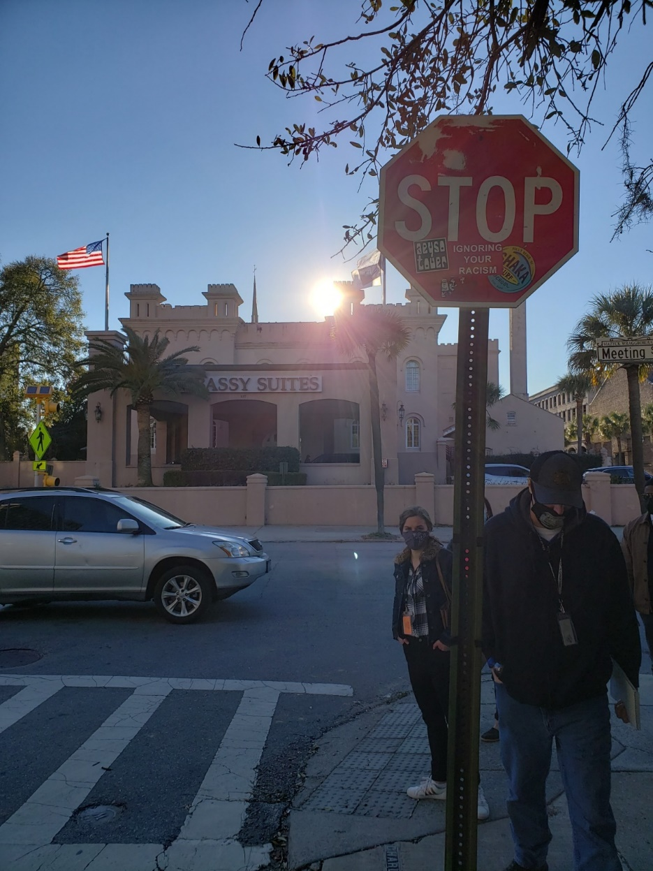
Meeting Street Maintenance Walk Pt 1 (Line to Calhoun)
Parks
Replacing missing street lights & baseplates; tightening loose poles
Noted empty tree wells for future plantings & stumps for removal
Cleaning up around Marion Square
Removing remnant anchor bolts & guide wires
Remove metal drum trash can from Wragg Square
Fencing around Marion Square scheduled to come down 2/8
Traffic & Transportation
Replace stop sign on Charlotte Street at Meeting Street
Replace Star Gospel Mission directional sign Remove stickers from back of CARTA sign
Working with the SCDOT as part of their on-call contract to replace pavement markings.
Public Service
7 concrete sidewalk repairs
3 bluestone repairs
6 misc. repairs

Slide 7
The To Do List
Safety & Appearance
Strategic Vision
Trash Collection
Public Infrastructure Maintenance
Sidewalk Obstruction and Pedestrian Crowding
COVID-19
Physical Cleanliness & Appearance
Panhandling & Aggressive Sales
Public Safety
Wayfinding
Unlicensed Palmetto Rose Peddlers
Lighting
Parking & Garage Management
Lack of Seating
Lack of Local/Affordable/M&WBE Shops
Vacancies
Holiday Decorations
Decreased Foot Traffic & Events
Lease Prices
Gaps In Use Mix
Beautification

Slide 8
Work Groups
Responsible Parties
CBDI Commission
Council
Staff
Property Owners
Vendors
Nonprofits & Institutions
Public Value
Welcoming to All
Beautiful & Clean
Positive Experience
Sense of Place
Successful Business District
Safe
Safety & Appearance Outreach & Materials
Marty Wall & Lauren Fox
Wayfinding Signage
Stacy Smallwood & Tim Mueller
Pop Up Shop Initiative
Tom Stockdale & Tyrone Wilson
2021 Holiday Decorations
Helen Hill & Andy Birlant
Programs (Food Trucks, etc.)
Bob Siegel & Lamar Bonaparte

Slide 9
Today’s Discussion
Livability & Tourism Department
Dan Riccio, Director
Niki Ohlandt, Special Events Manager
Strategic Vision
6. Decreased Foot Traffic & Events
Special Events

Slide 10
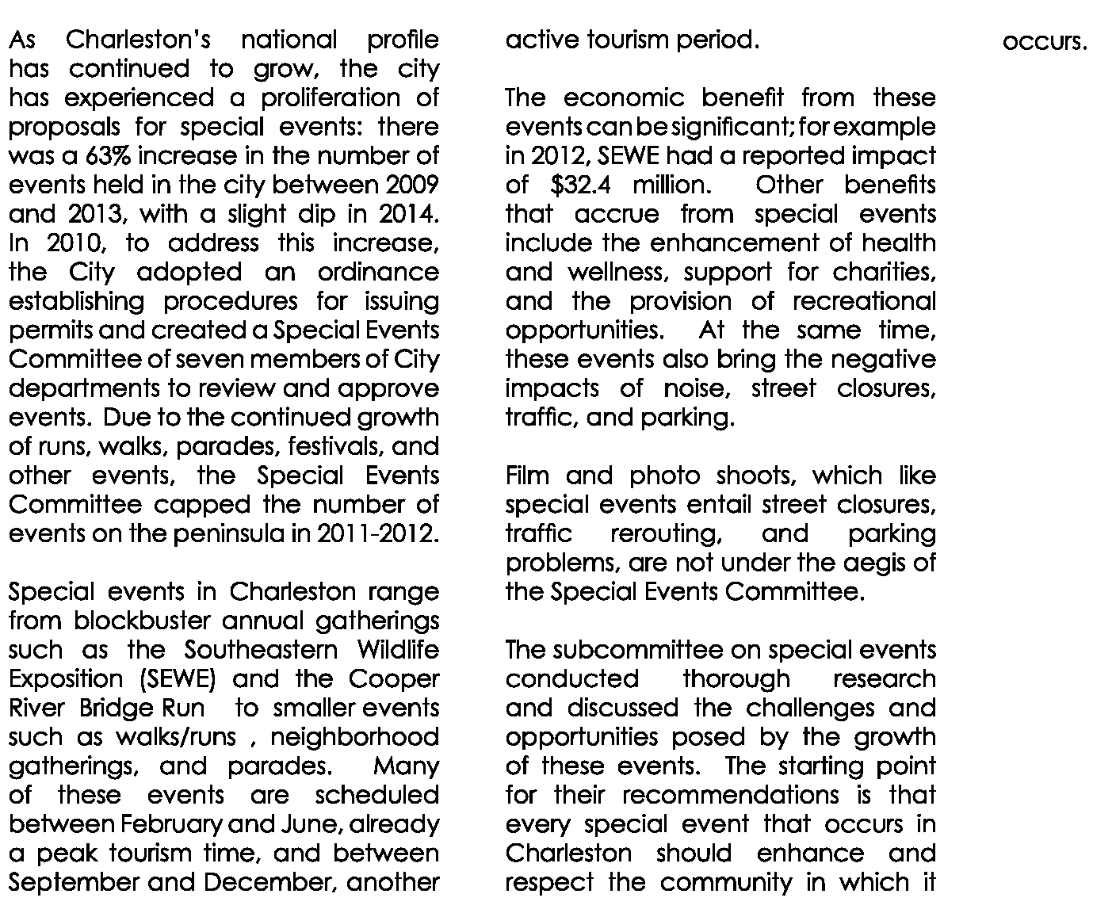
2015 Tourism Management Plan Special Event Recommendations
Goal: Ensure that special events enhance & respect the community.

Slide 11
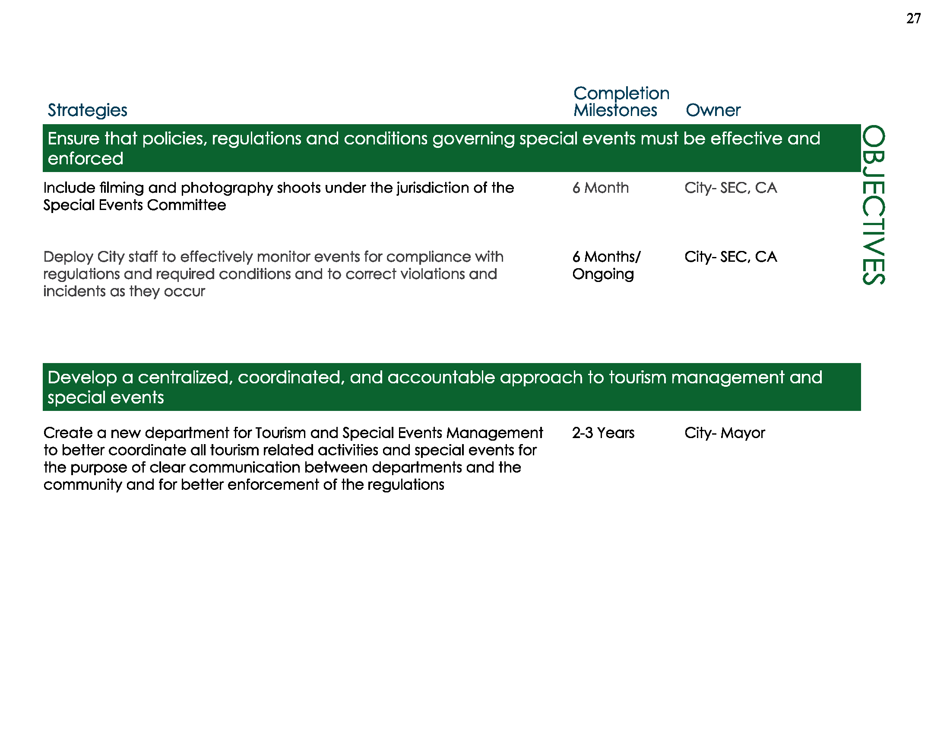
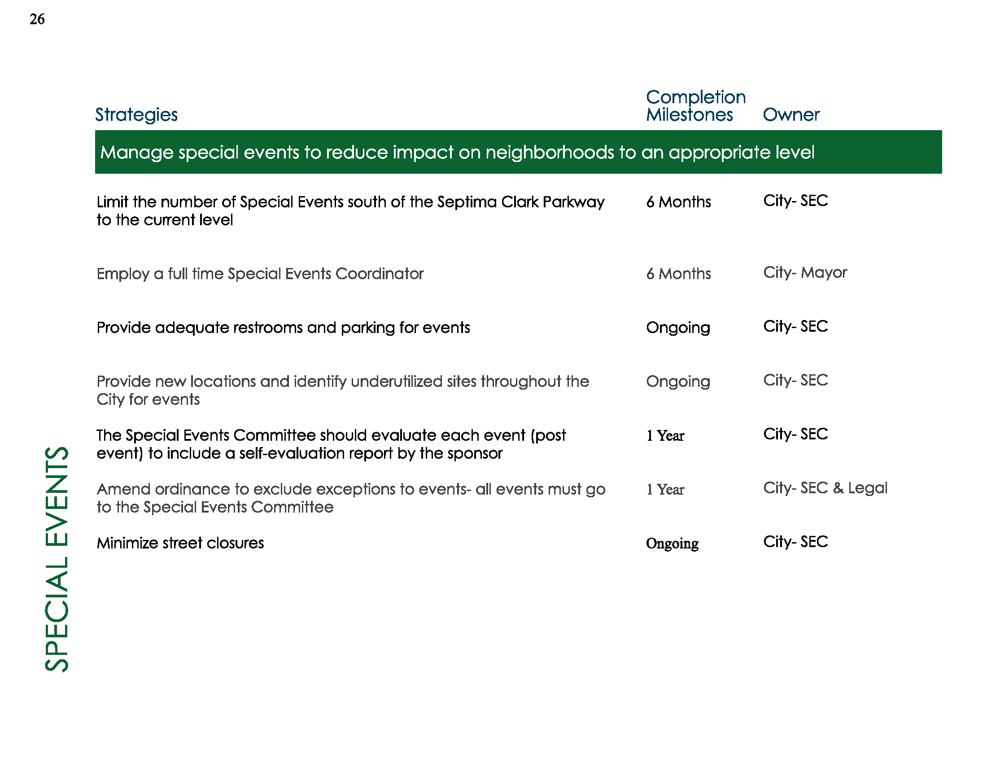
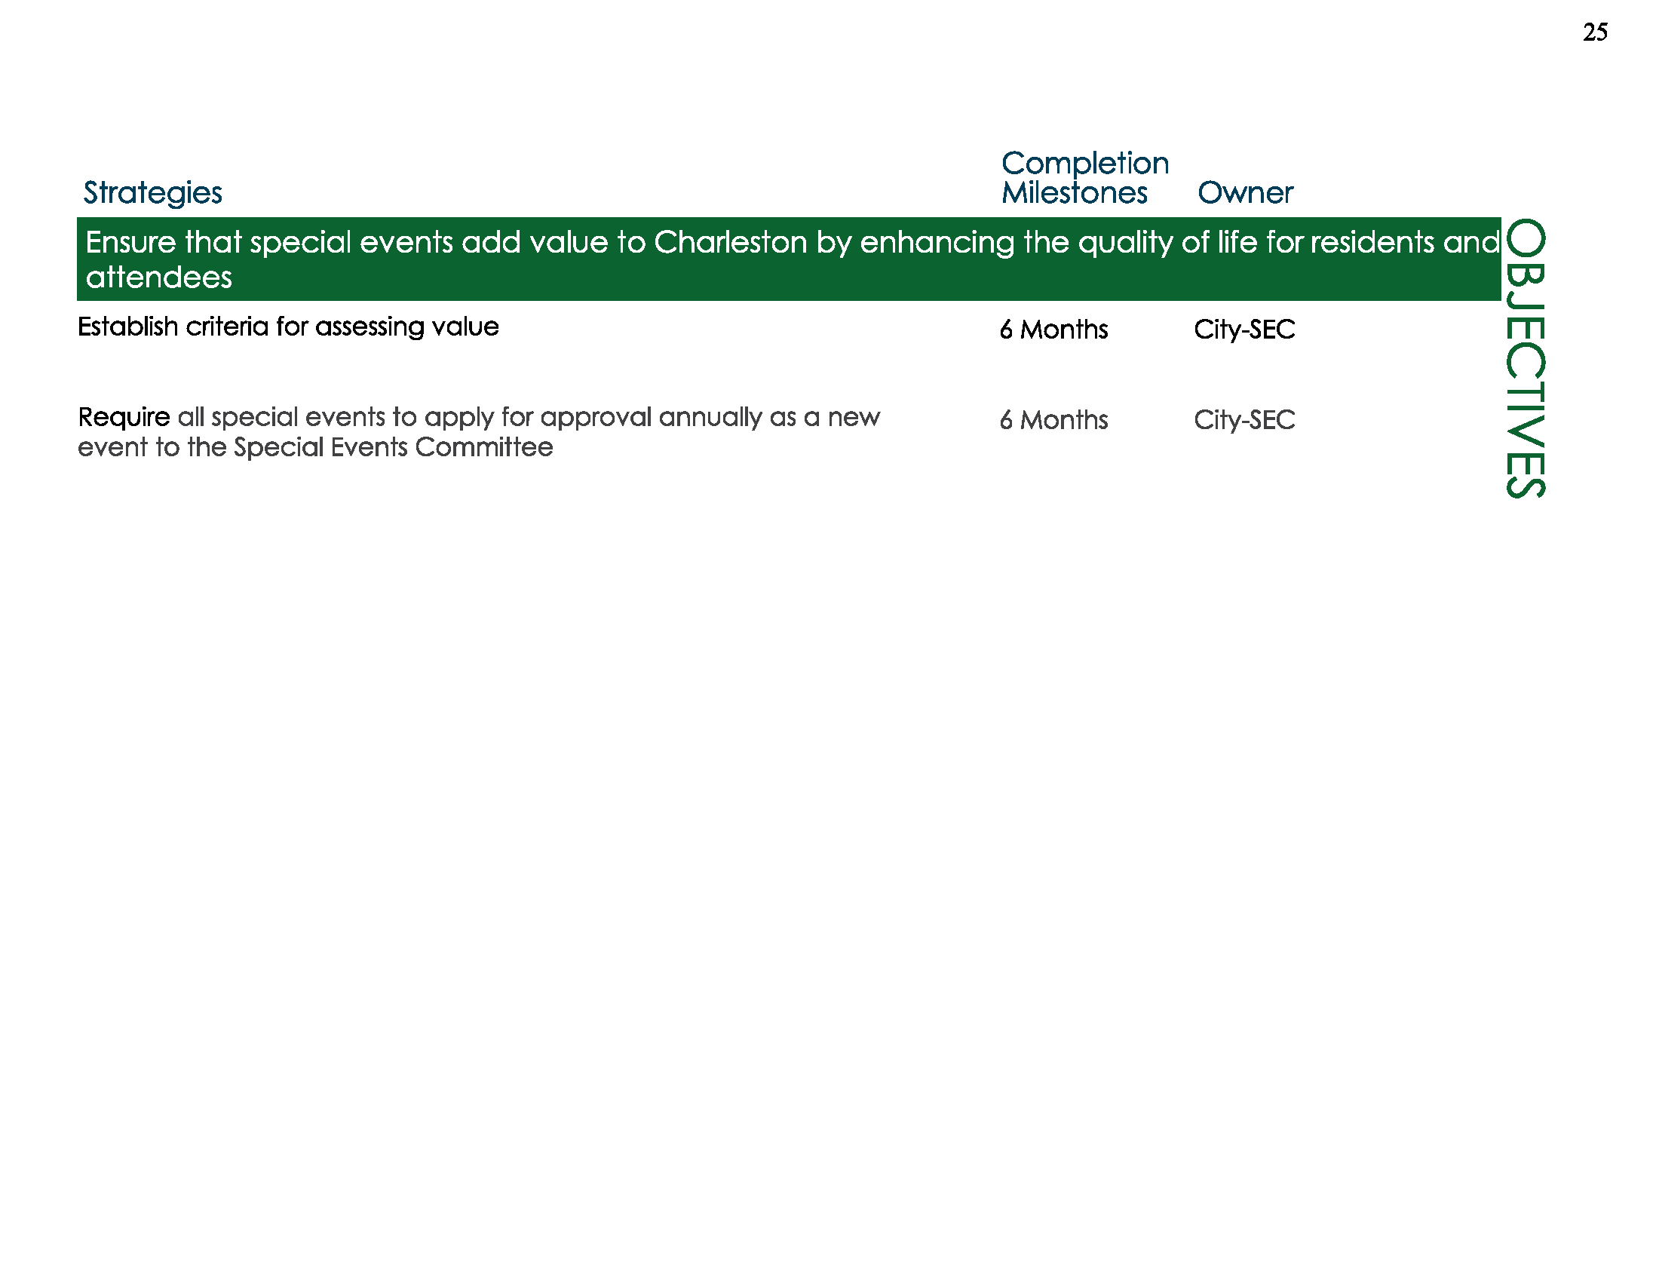
2015 Tourism Management Plan Special Event Recommendations
Special Events Application

Slide 12
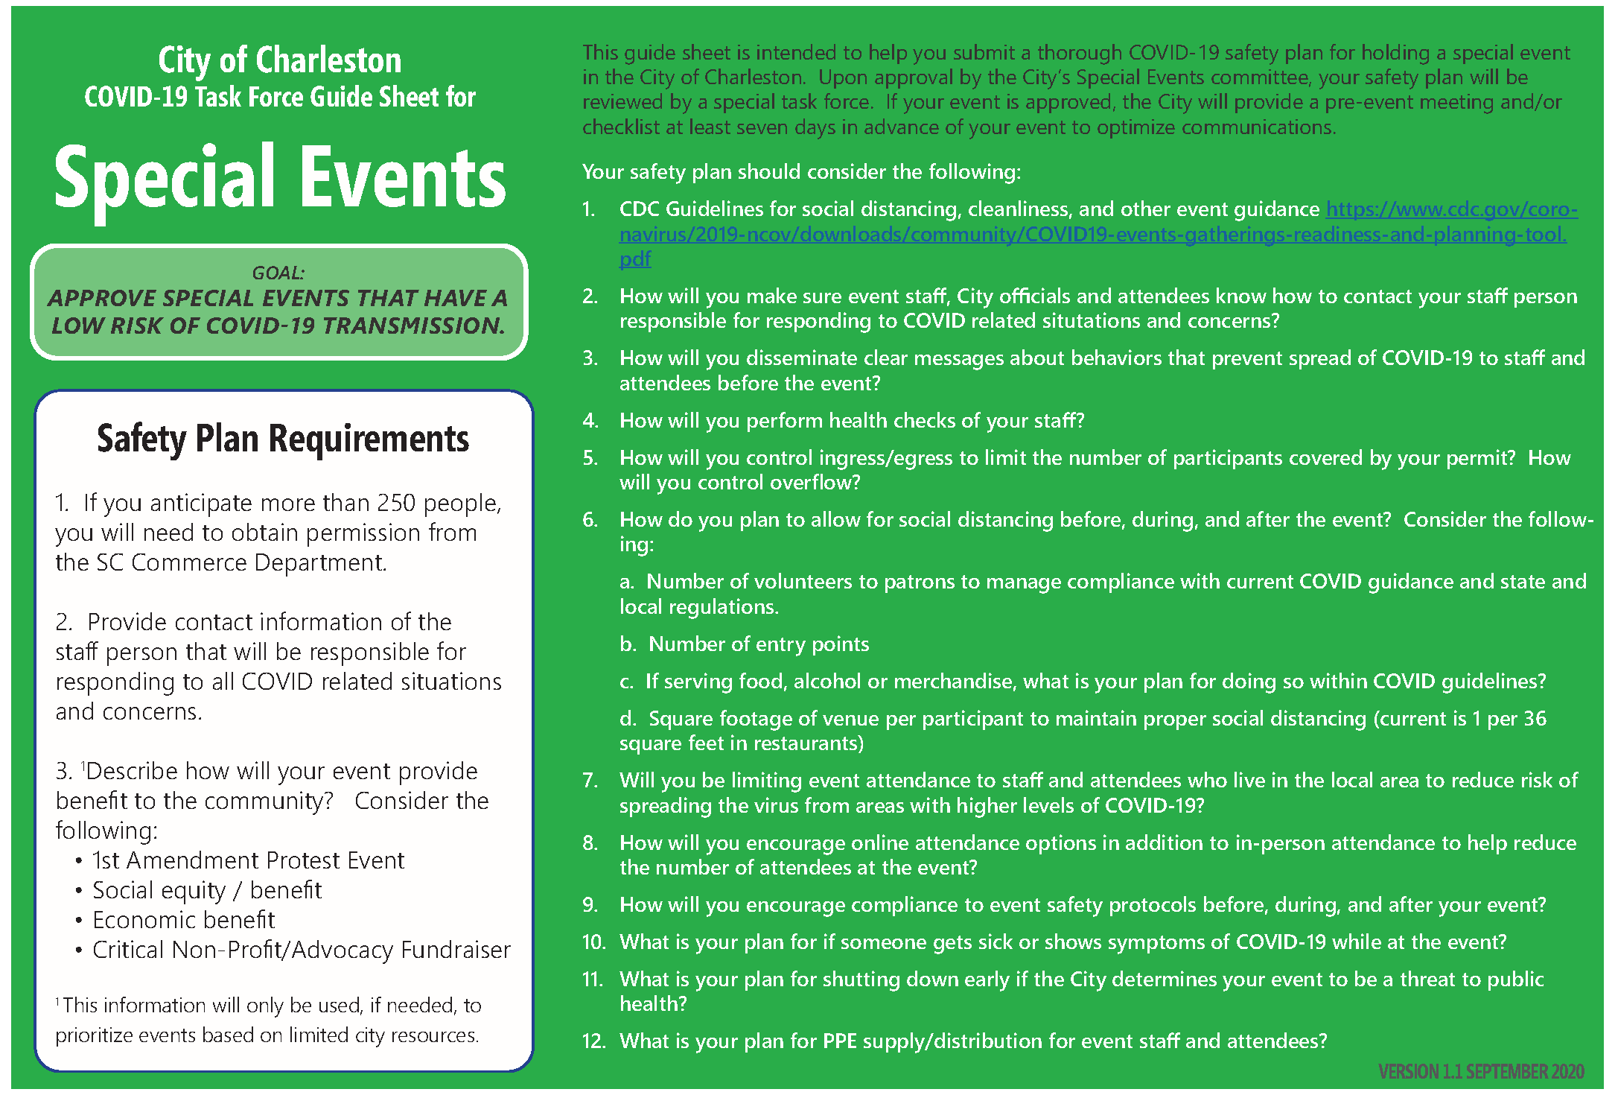

Slide 13
2021 Special Events
Legend:
Virtual, Canceled,
(Tentatively) In Person, Unknown
January
Emancipation Proclamation Parade
MLK Parade
February
SEWE
2nd Sunday
April
Hat Ladies Promenade
March
2nd Sunday
Charleston Marathon
WLI Memorial March
St. Patrick’s Day Parade
Recognition Day
2nd Sunday
Farmers Market
2nd Sunday
May
June
Gibbes on the Street
Spoleto
Farmers Market
2nd Sunday
Carolina Day
Carifest Parade
Farmers Market
2nd Sunday
Wine + Food
July
Farmers Market
August
First Day Festival
Farmers Market
September
Pride Parade
MOJA Parade
October
November
December
2nd Sunday
Farmers Market
2nd Sunday
Farmers Market
2nd Sunday
Veterans Day Parade
Turkey Day Run
Fam Jam
Farmers Market
2nd Sunday
Holiday Parade
Holiday Market
Reindeer Run
2nd Sunday
Bridge Run

Slide 14
Next Steps
Responsible Parties
CBDI Commission
Council
Staff
Property Owners
Vendors
Nonprofits & Institutions
Public Value
Welcoming to All
Beautiful & Clean
Positive Experience
Sense of Place
Successful Business District
Safe
Next Meeting: Friday, March 19 at 3:30 PM
Work Groups Updates
Staff Updates
King Street Profile
TAP Recap
BID Consultant RFP Update
Meeting St. Walk Pt. 2
Upper King St. Maintenance Progress Check
To Do List Topic: ???

