Slide 1


City of Charleston
Central business district improvement commission
FRIDAY, MARCH 19, 2020

Slide 2
Updates
Police Department Update
Business Improvement District Consultant RFP
POSTED!; Responses due April 9
ULI/Riley Center Technical Assistance Panel Debrief
Full Report Released in 6-8 weeks
Vision Statement Exercise
Vacant Storefront Registry Progressing

Slide 3
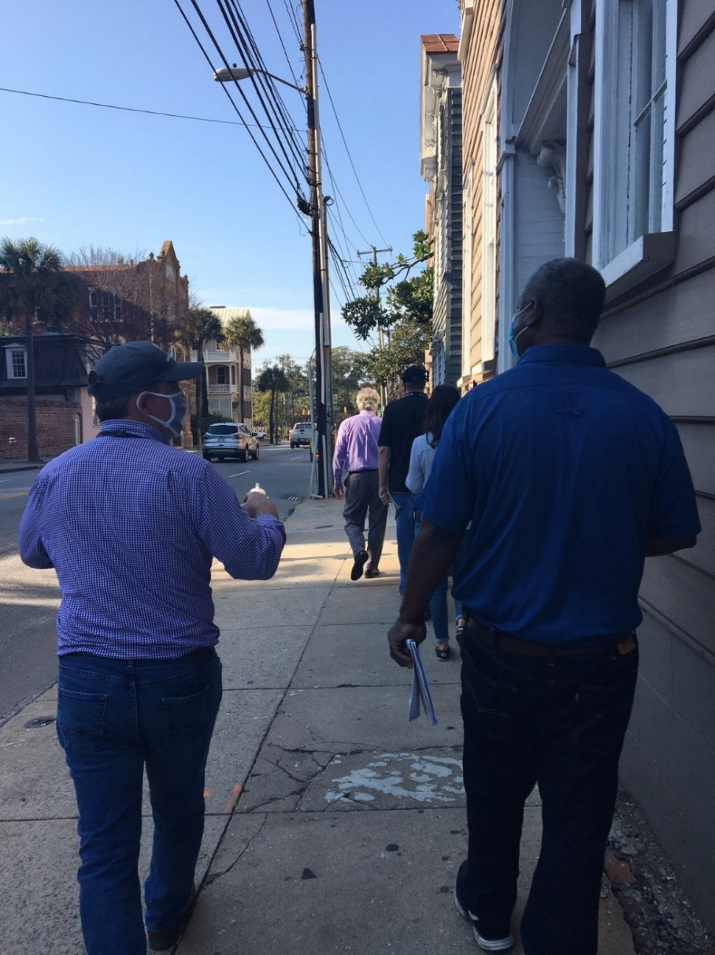
Meeting Street Maintenance Walk Pt 2 (Calhoun to Broad)
Parks
5 tree wells to have stumps removed and/or replanted
Light poles reported to Dominion for correction/replacement
Traffic & Transportation
Sticker removal on signs
Clean/replace damaged signs as needed
Straighten sign posts
Remove remnant signage & posts
Replace pedestrians inserts
Replace green street lamps & bases at intersections
Public Service
Bluestone repairs
Livability & Tourism
Graffiti & litter removal

Slide 4
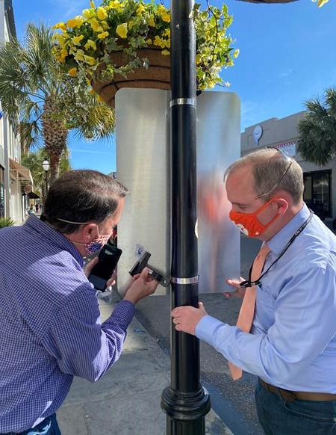
Upper King Street Maintenance Walk (Spring to Calhoun)
Significant progress since October 2020!
Parks
7 light poles to be replaced
Traffic & Transportation
Replace traffic signal plates
Repair pedestrian push buttons
Removing extraneous signs (related: wayfinding inventory)
Public Service
Bluestone repairs
Livability & Tourism
Graffiti & litter removal

Slide 5
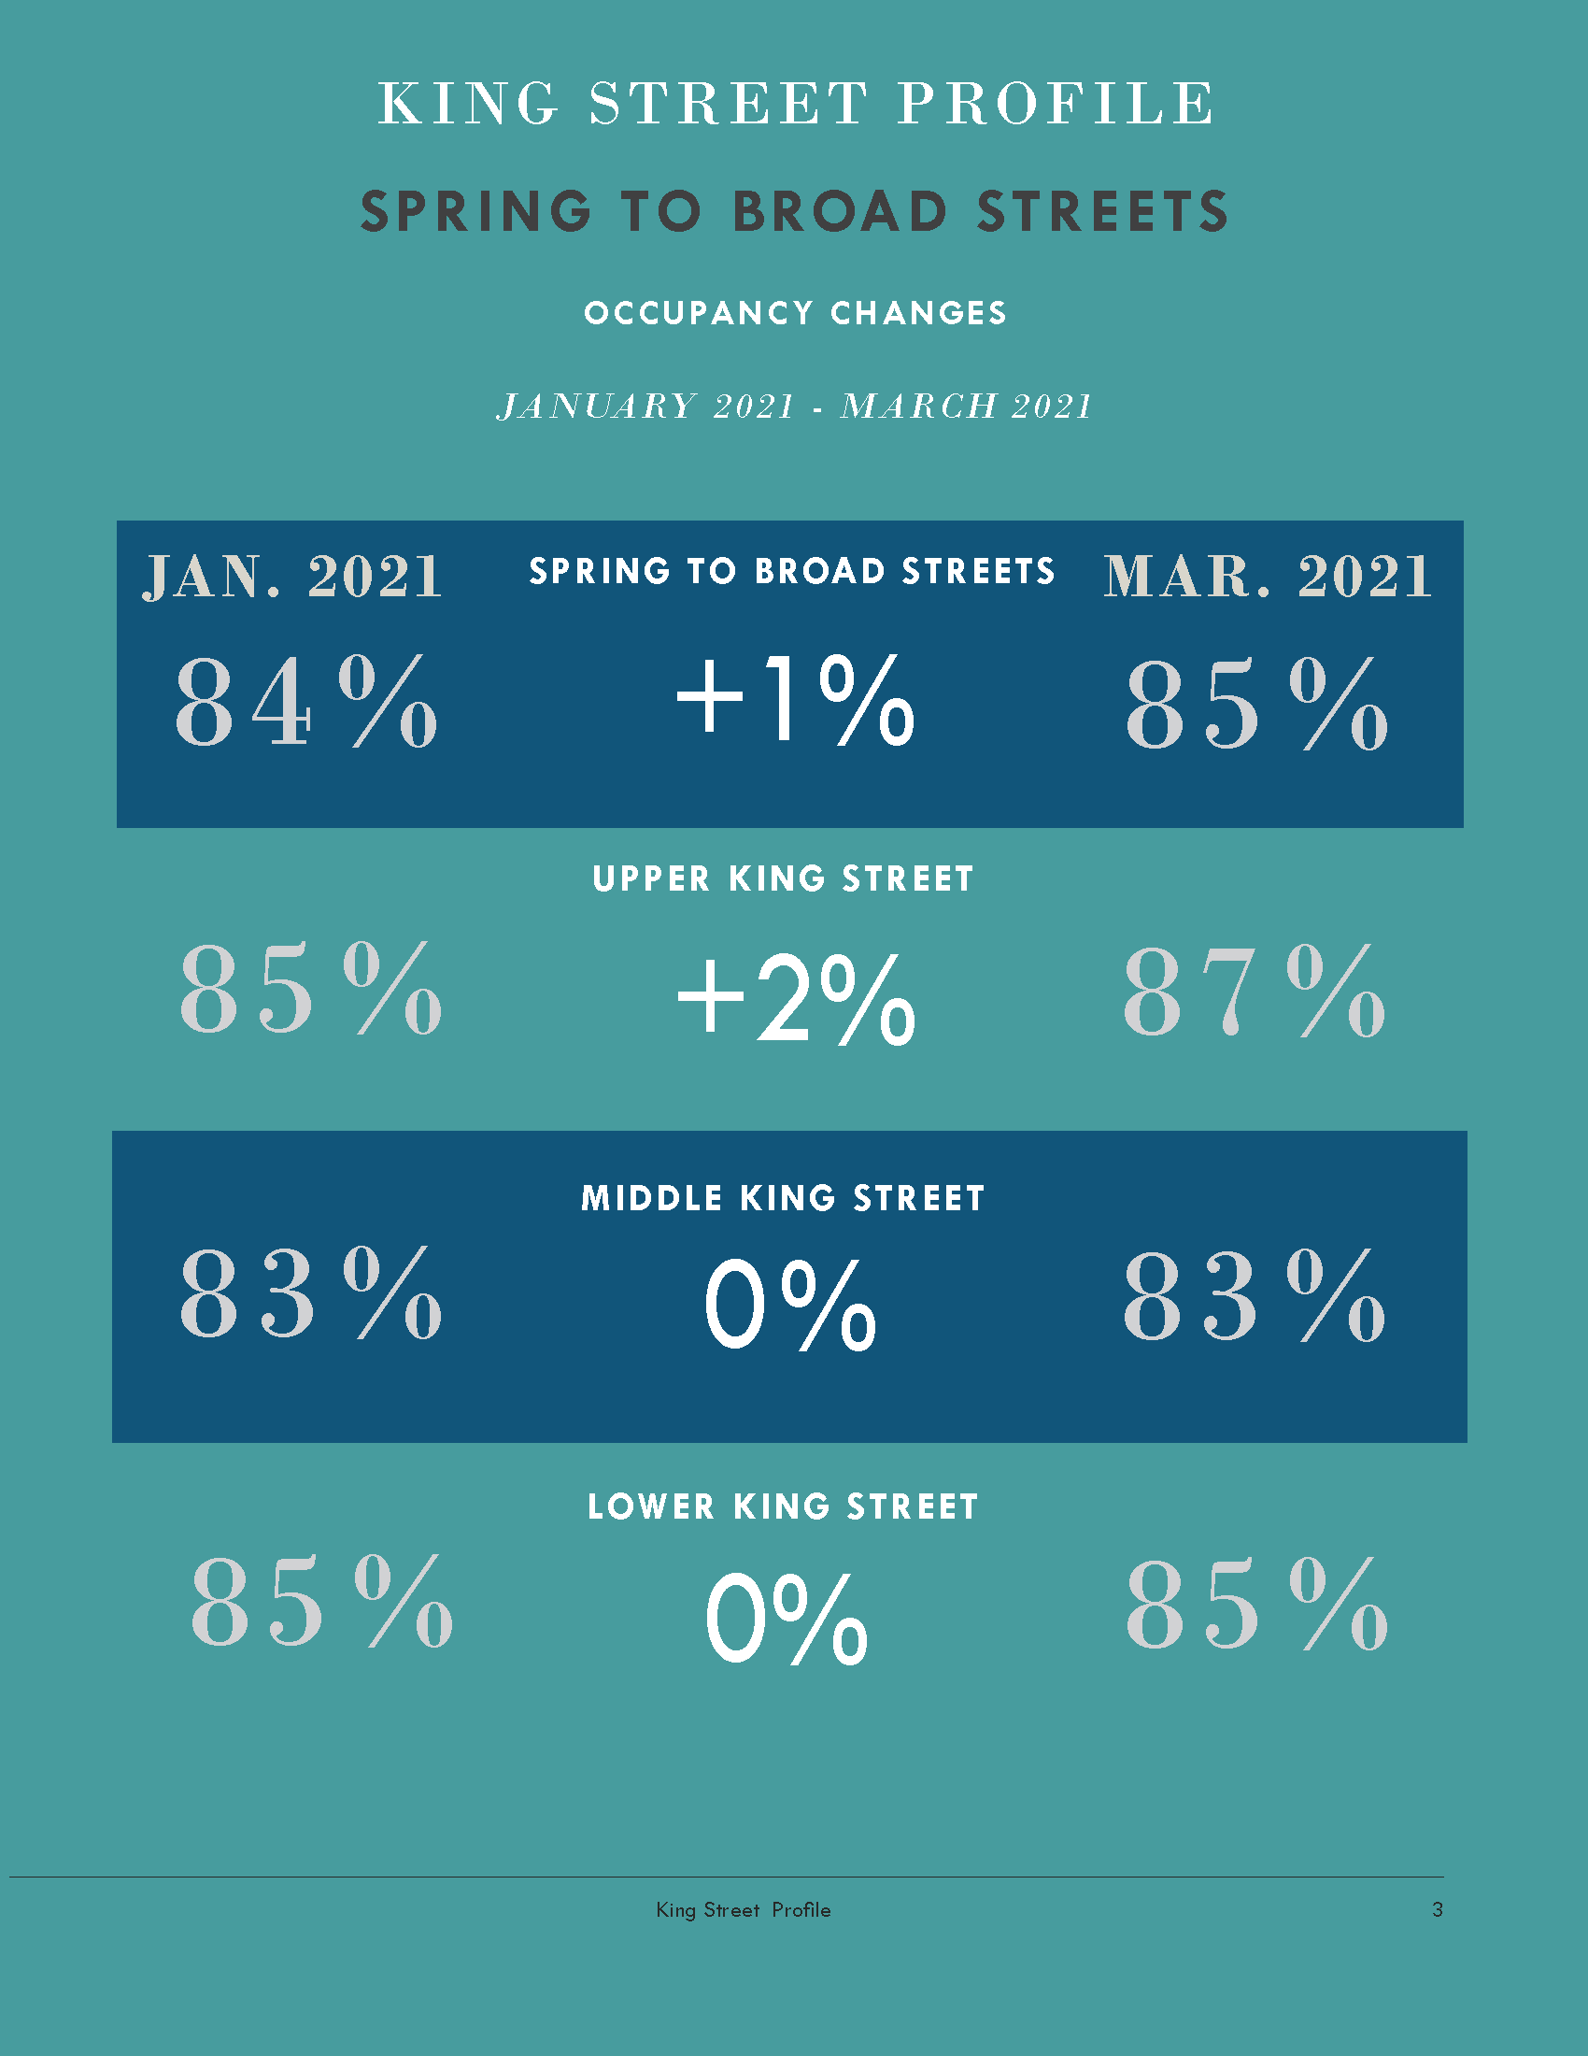
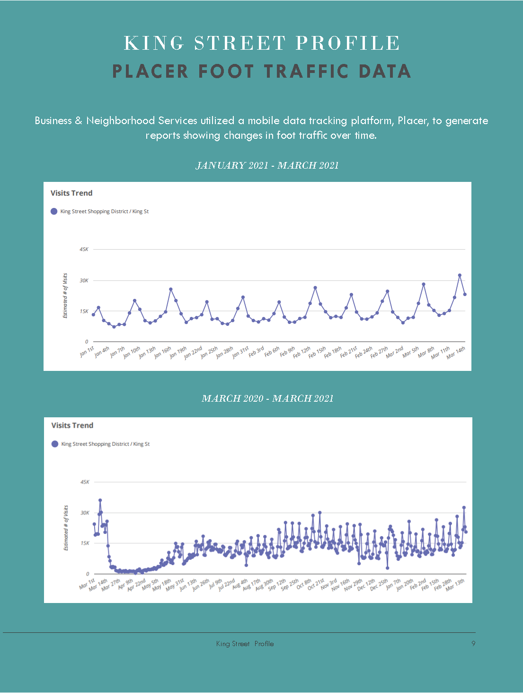

Slide 6
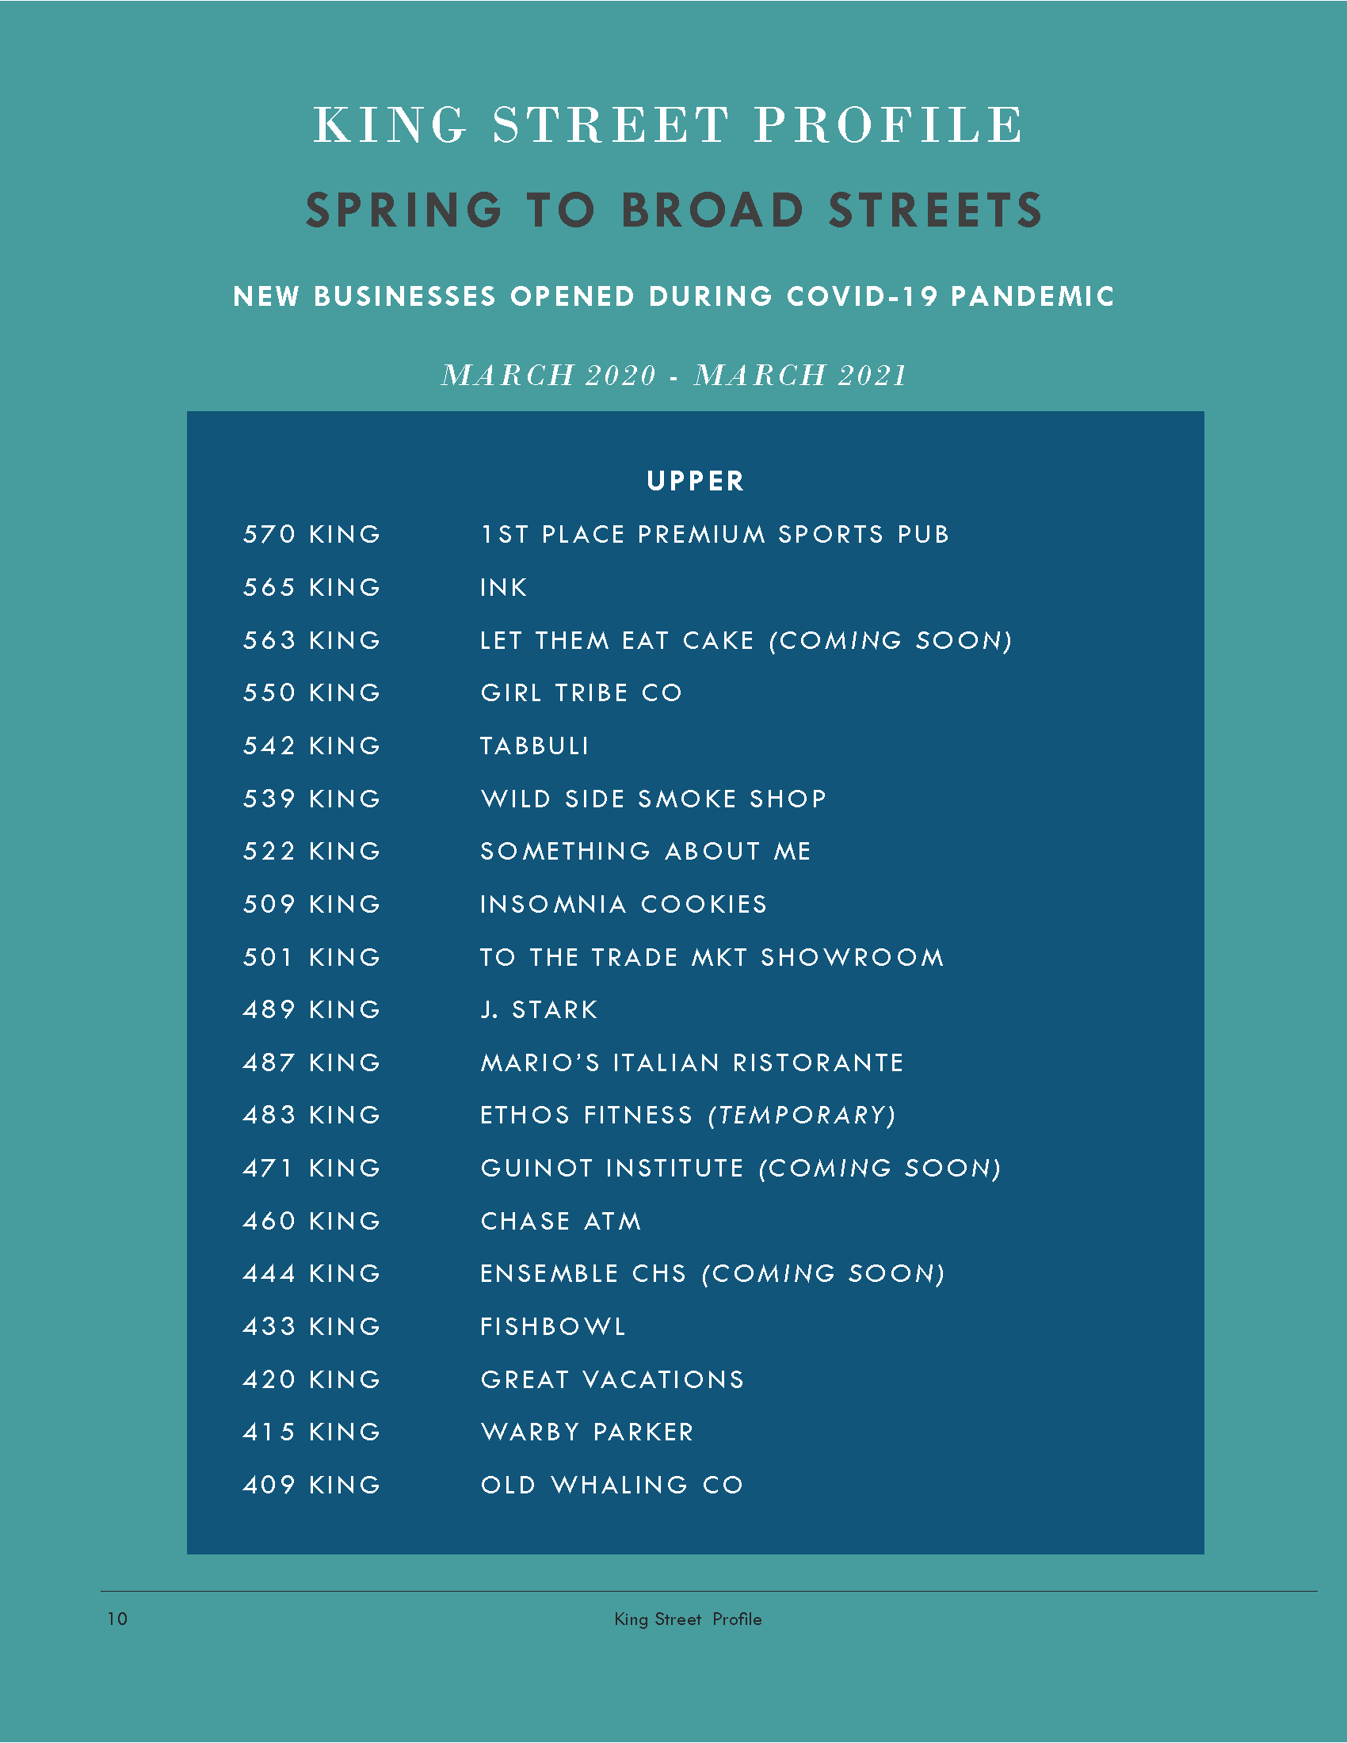
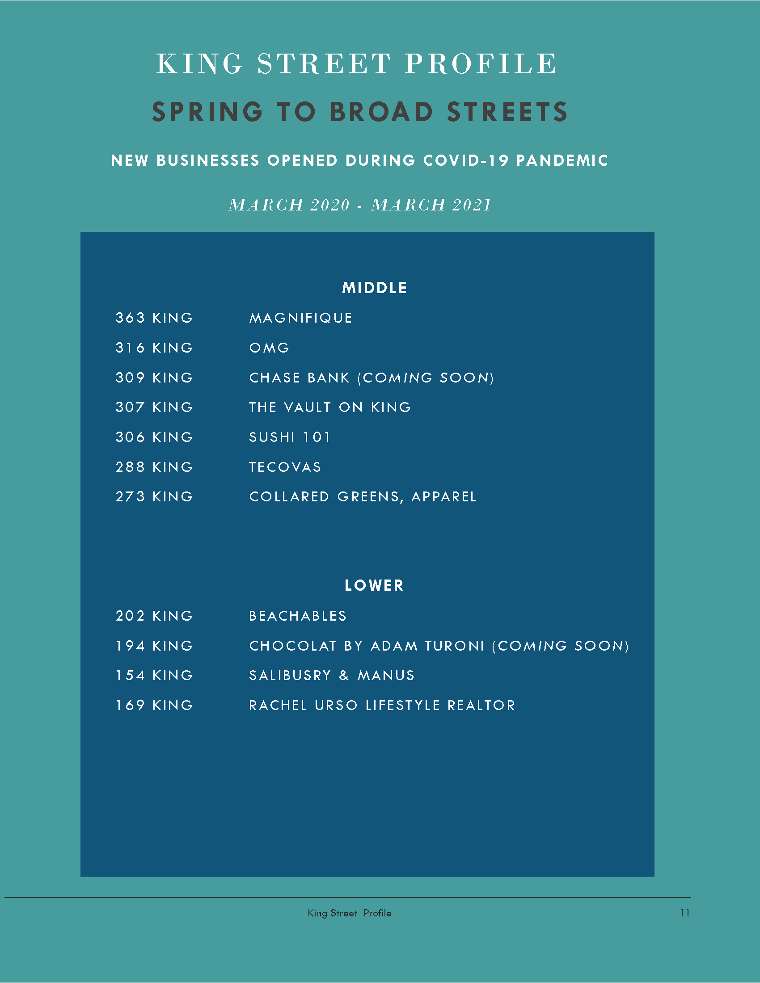

Slide 7
King Street Occupancy

Slide 8
Work Groups
Responsible Parties
CBDI Commission
Council
Staff
Property Owners
Vendors
Nonprofits & Institutions
Public Value
Welcoming to All
Beautiful & Clean
Positive Experience
Sense of Place
Successful Business District
Safe
Safety & Appearance Outreach & Materials
Marty Wall & Lauren Fox
Wayfinding Signage
Stacy Smallwood & Tim Mueller
Pop Up Shop Initiative
Tom Stockdale & Tyrone Wilson
2021 Holiday Decorations
Helen Hill & Andy Birlant
Programs & Events
Lamar Bonaparte

Slide 9
Next Steps
Responsible Parties
CBDI Commission
Council
Staff
Property Owners
Vendors
Nonprofits & Institutions
Public Value
Welcoming to All
Beautiful & Clean
Positive Experience
Sense of Place
Successful Business District
Safe
Next Meeting: Friday, April 16 at 3:30 PM
Work Groups Updates
Staff Updates
BID Consultant RFP Update
Middle & Lower King St. Maintenance Progress Check
To Do List Topic: Safety & Appearance Report Update

