Slide 1


City of Charleston
Central business district improvement commission
FRIDAY, JUNE 18, 2021

Slide 2
Staff Updates
Police Department Update
ULI/Riley Center Technical Assistance Panel Update
Recap of CBDIC Accomplishments

Slide 3
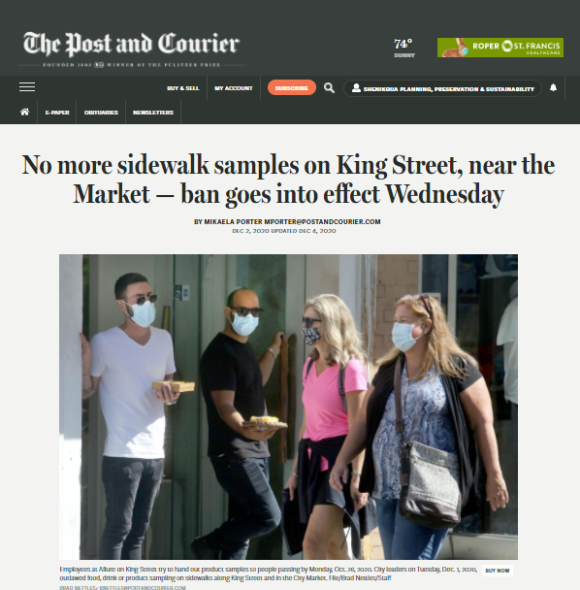
Accomplishments
No samplings ordinance.
Parking minimums ordinance.
Additional staffing from CPD, especially on weekends & late nights.
Increased participation in No Trespass program.
Collaboration with CVB on hanging flower baskets on King Street.
Kicked off staff efforts regarding wayfinding and vacant storefront registry programs.

Slide 4
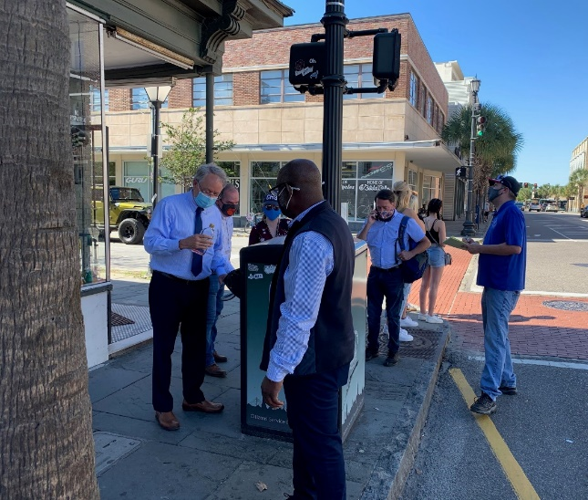
Accomplishments
Maintenance walks of key CBD corridors by the Mayor & City staff – leading to additional work orders and code enforcement.
Drafted and received responses to Safety & Appearance Report, which has renewed staff focus on the district.

Slide 5
Accomplishments
Responsible Parties
CBDI Commission
Council
Staff
Property Owners
Vendors
Nonprofits & Institutions
Public Value
Welcoming to All
Beautiful & Clean
Positive Experience
Sense of Place
Successful Business District
Safe
Vacancies have decreased on King Street between Spring & Broad Streets:
Summer 2020: over 60 vacancies
Spring 2021: approximately 40, with many new stores opening soon.
Other stakeholders engaged:
Late night business community
Commercial realtors
Charleston Downtown Alliance

Slide 6
Next Steps: Business Improvement District
A Business Improvement District (BID) would allow a voluntary assessment of property owners to provide improvements and to encourage development within the boundaries of the district. A BID could further the work the commission started by providing funding and dedicated staffing to support the efforts around enhanced services such as maintenance, cleanliness, beautification, safety, recruitment, marketing, and special events/programming.
Develop Interest
Plan & Budget
Complete Petition
Pass Public Hearing
Present to City Council
Provide Notice
Assess via Tax Roll
Collect & Spend

Slide 7
Next Steps: Business Improvement District
In Progress:
BID Consultant RFP
MOU/Partnership with Charleston Downtown Alliance
As the initial CBDIC members’ one year terms come to a close and the work has shifted to focusing on the creation of a BID, the commission will end to allow staff and stakeholders to focus on those efforts.

