Slide 1


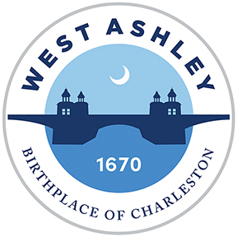
City of Charleston
MASC Retail Recruitment Training Report
Christina Auth - Project Coordinator, Business & Neighborhood Services

Slide 2
Traditional Economic Development
Industry & Corporate Recruitment
Attract Manufacturing, Corporate Office
Bigger, Stronger Local Workforce
Increased Demand
Residential Development
Retail Follows Rooftops
Workforce Education & Development
Industrial Parks & Mega Sites (“Chasing Smokestacks”)
Notes:
The traditional economic development path is what the County and most city officials are used to considering.
In that model the government “lures” in potential large sector employers with incentives which then opens up new opportunities for employment.
The work force grows and with it grows the residential components and then retail follows along afterwards.
Boeing and Volvo are examples in our area of this type of economic development. We can see the impacts it has had in Berkeley County and North Charleston.

Slide 3
Modern Economic Development
certain retailers look for other competitors or benchmarks
Modern Economic Development
Increased Demand for Residential Development
Bigger, Stronger Local Workforce
Industry & Corporate Recruitment
Amenities that improve quality of life
Retail Development
direct communication and/or incentives
educational and cultural resources, bikeways, trails, water access
training and population with education attainment
more units and rooftops will bring different tiers of commercial operations
Notes:
With the shift to information and digital economy a different approach is now taking form.
Instead of government luring in companies with the promises of large amount of land and reduced taxes, another method is to create the type of environment that companies want for their employees.
This means having established retail and workforces that are set up for the companies to come into and thrive.
West Ashley has much of the needed components and we are working to assemble them in a way to market to the companies. An area that we are looking to improve upon this year is a renewed focus on retail and commercial operations.
We have been working closely with shopping center management companies and building relationships with property owners to try an play a more active role in retail recruitment world.

Slide 4
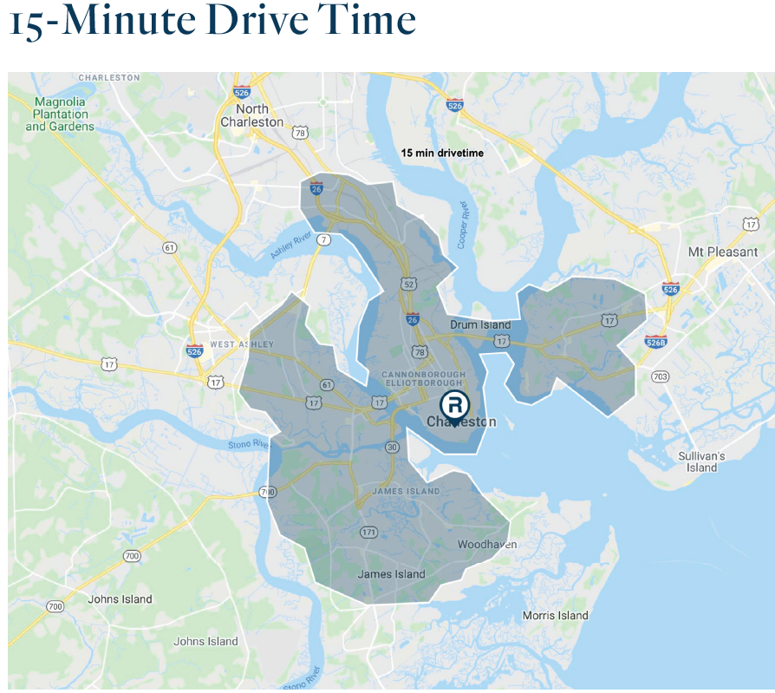
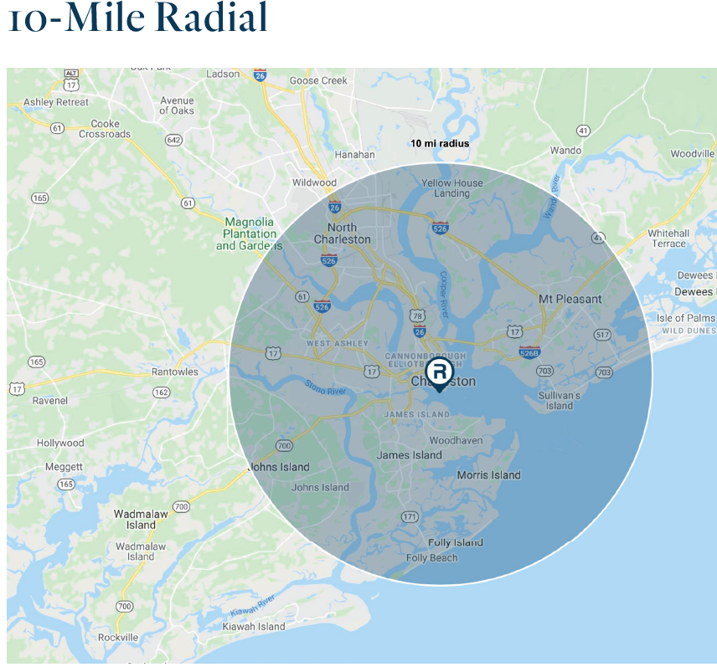
Retail Trade Area Analysis
Notes:
There are two methods for retailers to look at a geographic area.
One is by drive time and the other by mileage.
In our area the drive time will generally be smaller than the mileage due to the placement of rivers and bridges.
Both have their advantages and disadvantages, but when put together can create a good idea of the general population for an area.

Slide 5
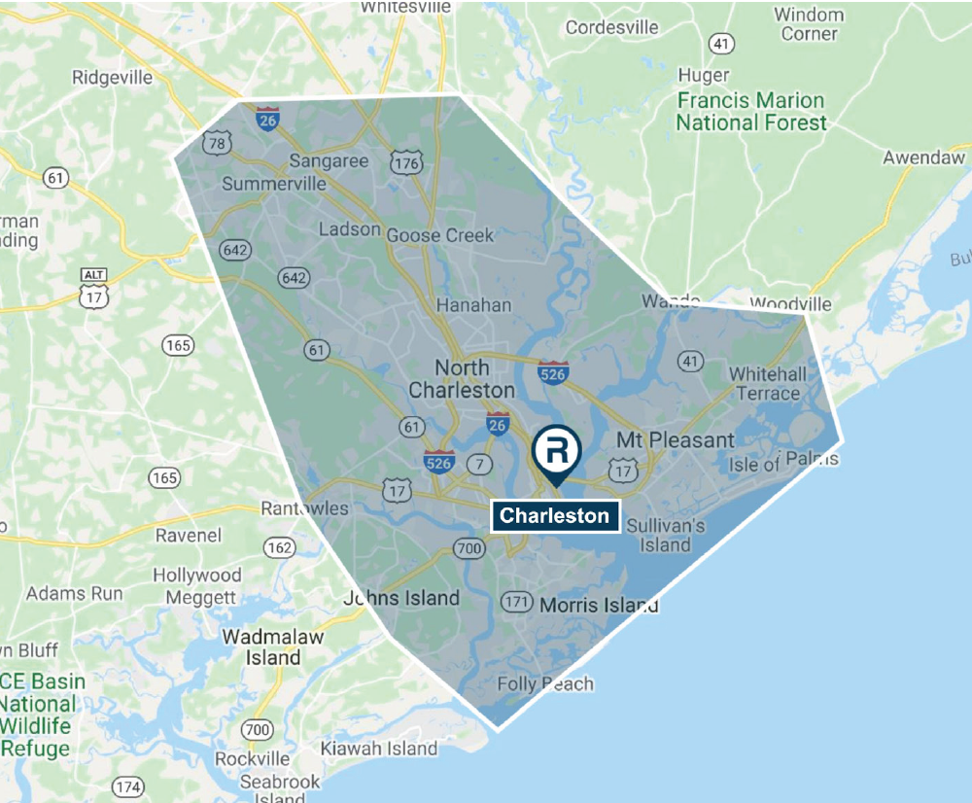
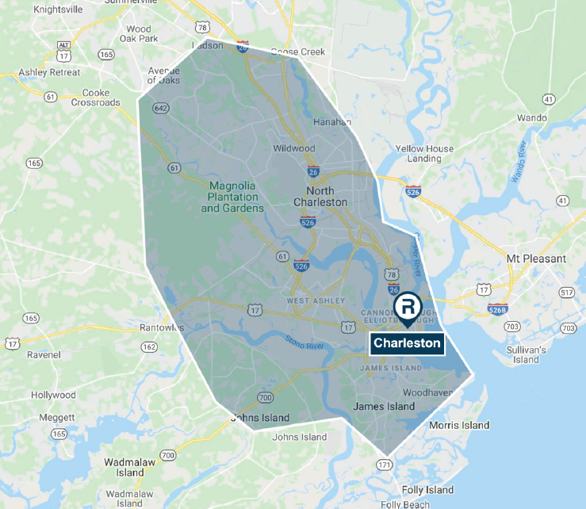
Retail Trade Area Analysis
Notes:
These are the retail trade areas that were generated for us by Retail Coach for the Charleston Peninsula and West Ashley.
The West Ashley area on the right side tightens up due to how transportation networks cross, the main draws for the area are from the Peninsula, James Island, Johns Island, and North Charleston.
Other areas such as Folly Beach, Kiawah, and Wadmalaw would be satellite areas but do not contribute to the economy of West Ashley.

Slide 6
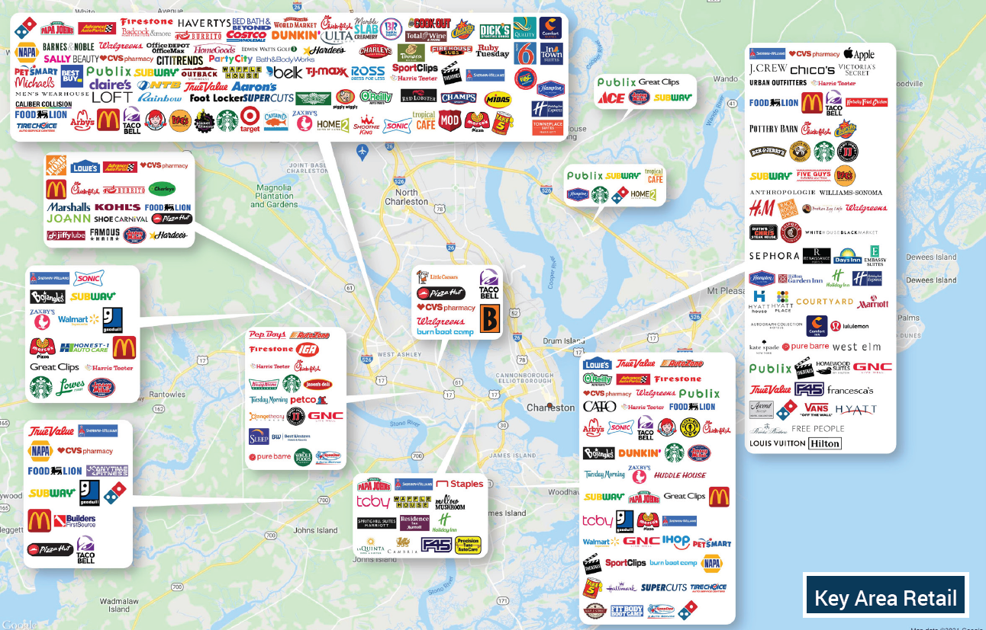
Retail Trade Area Analysis
Notes:
When researching an area retail developers and companies will look for what comparable companies that are already located in the area.
Some even choose to locate within close proximity to competitors, think of Walgreens and CVS. They will choose to locate close to similar stores with the same target demographics so they can provide options for customers in the area.
On this map you can see that the central part of West Ashley has the most variety of stores for the City of Charleston. Representation from most major chains and starting to show some more boutique.

Slide 7
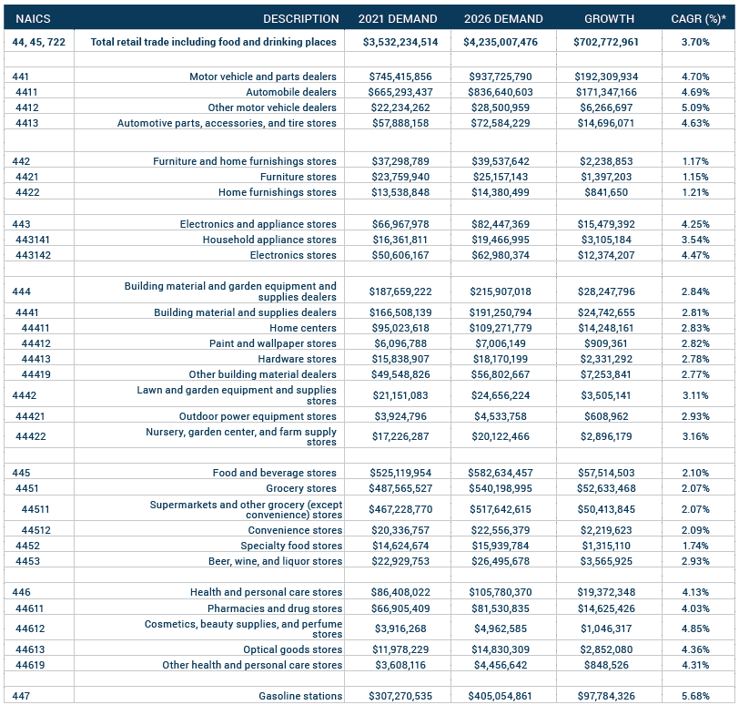
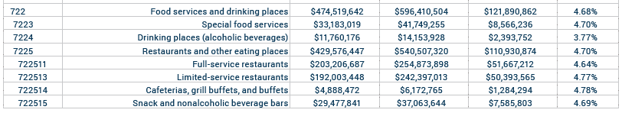
West Ashley Retail Trade Area - Retail Demand Outlook
The higher the Compound Annual Growth Rate (CAGR) shows greater demand and higher ROI
Notes:
Retail Demand Outlook is pulled from ESRI Business Analyst and looks at different sources of data to review current demands and project future demands for the area.
These are the types of metrics that commercial developers and retail real estate offices look to for safe investments into communities.
The dollar amounts are compared and a compound annual growth rate (CAGR) is created.
The three highlighted areas are what we have seen for growth in West Ashley, it follows the pattern that is projected by the data collected.

Slide 8
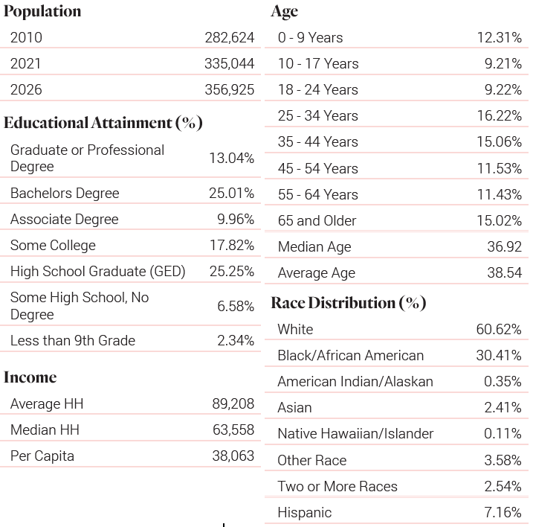
West Ashley Retail Trade Area Retail Market Profile
Notes:
The Retail Market Profile looks at the demographics of those considered within the Retail Trade area.
This data includes people that are in North Charleston, James Island, and Johns Island. These metrics are looked at by brands to see if their target customers are within the trade area.
This is where not having more of Mount Pleasant or James Island within the Trade Area come in to hurt how West Ashley looks on paper.
We can see a wide difference between Average and Median (middle # better average for extreme outliers) household incomes, implying that the range between them is dramatic as well.
Per capita is the measure of the amount of money per person in a geographic area, can show quality of life/standards of living
This will lead certain retailers to look at other locations. Working in West Ashley’s favor is the population growth, education attainment and age ranges.

Slide 9
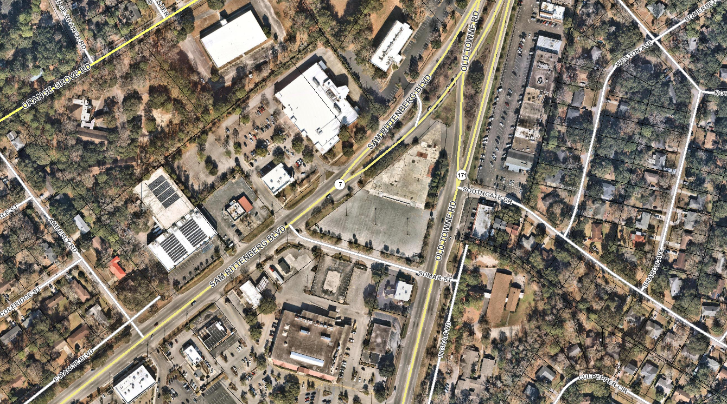
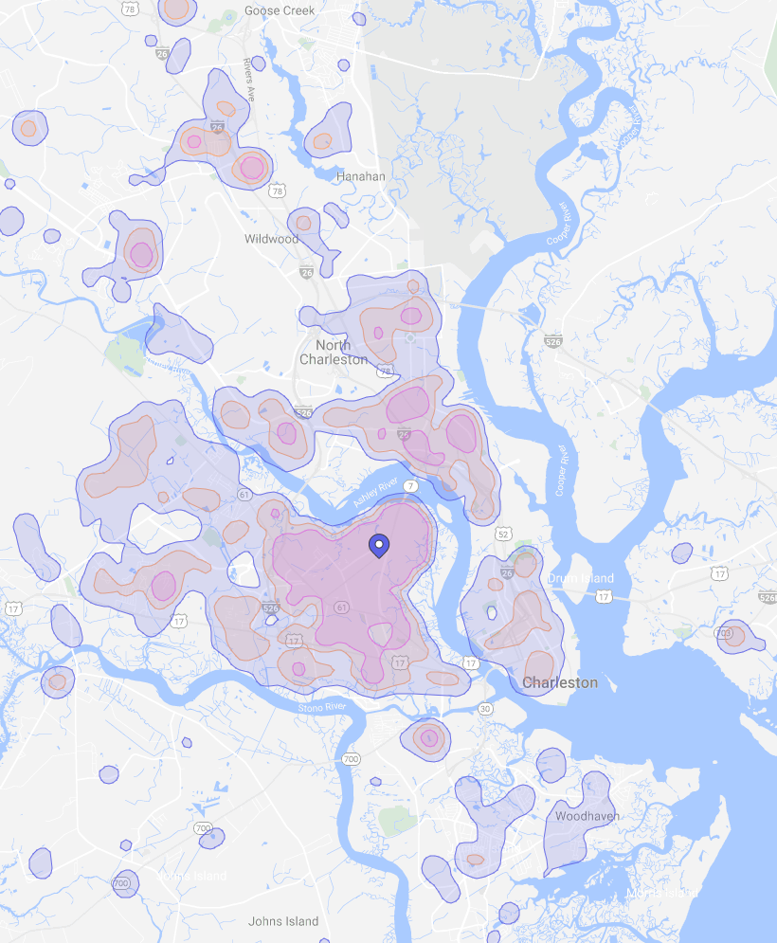
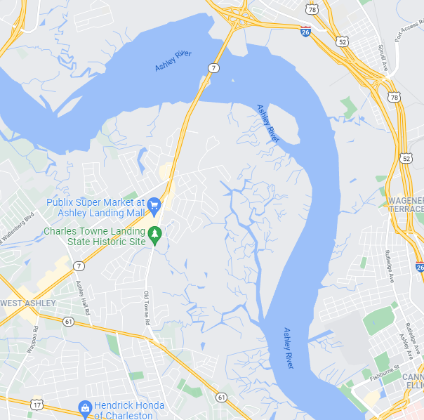

Sumar Street Redevelopment Parcel
Appox. 2.9 ac – ground lease
2021 Demographics | Trade Area | 3 Mile | 5 Mile | 10 Mile
Population | 108,591 | 67,410 | 154,942 | 364,804
Households | 44,680 | 28,498 | 66,378 | 151,426
Growth % | 8.4% | 1.0% | 1.1% | 1.2%
Median Age | 35.14 | 37.3 | 35.9 | 37.1
Ave HH Income | $77,600 | $56,677 | $59,523 | $69,232
True Trade Area
Notes:
Examples of information that commercial agencies are looking for: site location, acres & sq/ft, demographics within their true trade area
In addition to these types of metrics companies will look at traffic volume along a corridor, location of other businesses and how they are operating.
The example used here is the Sumar Street Redevelopment parcel. You can see that the trade area population is robust, and the growth rate indicated that additional commercial investment is good. When we look at the average household incomes they fluctuate but stay steadily in a good range.
Another way to measure the area is through Placer.ai information. They use mobile phone aggregated data to show the area that customers live who go to commercial operations.
In this case, the Sumar Street/Ashley Landing Plaza is most visited by residents in the dark purple.

Slide 10
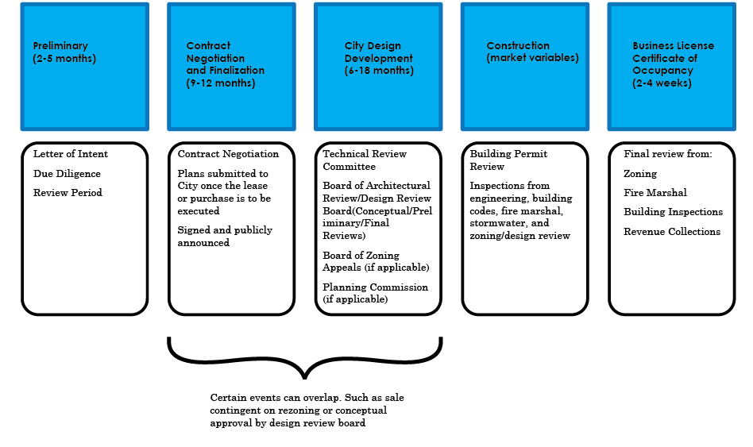
Real Estate Life Cycle
Notes:
A key thing to remember when dealing with retail recruitment is the amount of time that is placed into the overall real estate life cycle.
By the time a project arrives at the City for permit review (reactive) the private sector could have been negotiating for over a year.
This means by the time it arrives at the City there has been a significant investment. This is where City recruitment and working with property owners to achieve goals for commercial mixes is better in a proactive measure.
Many times the community only becomes aware of a project when it arrives at DRB, which could be as much as 18 months after site selection occurred. After city review and permitting, the construction and licensing portion can have another significate delay.
A prime example is Pokeburri and the Victory, the Victory entered into DRB April 2019. The first retail spot within it, Pokeburri, opened it’s doors to the public December 2021 (20 months after first review).

Slide 11
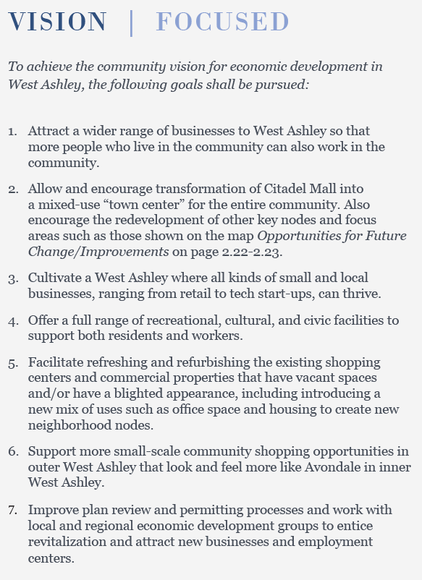
Plan West Ashley
Attract a wider range of businesses to West Ashley so that more people who live in the community can also work in the community Adoption and implementation of Plan West Ashley serves as a signal to businesses and developers that the area is ready for transformation and is a focus for investment in Charleston. Starting with this momentum, West Ashley should be repositioned within the region so that it is considered a viable office node and home of innovative businesses, in addition to continuing its role as a retail destination and medical hub.
Prepare informational materials highlighting West Ashley’s locational advantages for small businesses. Such information could include an inventory of buildings and property that are available for reuse or redevelopment. This effort must be jointly coordinated between the City and County, since not all commercial property in the West Ashley area is currently within the City, and some important sites remain in unincorporated areas. This effort will likely require dedicated City staff time, but could potentially be incorporated into other citywide efforts.
Promote West Ashley’s specific strengths through the region’s economic development promotional materials and networks. These strengths include: regional accessibility, proximity to the airport, lower costs than other competitive locations, easy access to other major job centers, and access to a large and educated workforce.
Notes:
Plan West Ashley focuses on ensuring the area has investment into the community that all members can benefit from.
When talking with developers and with property managers it is important to stress the need to ensure mixture of both local and regional/national chains when redeveloping the area.
A prime example of a location that has a good mixture of both is the newly constructed Harris Teeter plaza on Bees Ferry Boulevard, which has a mixture of local, regional, and national operations.
In attracting businesses to West Ashley we should look to recruit specific regional or national chains that companies look for as a quality of life.
This also helps to strengthen the community and the regions economic development potential for other locations.

Slide 12
Emerging Trends
Ghost Kitchens
Restaurant locations that have only delivery; typically operate out of small shared kitchens. Example in West Ashley: MrBeast Burger
Curb-side Pick Up
This can vary from pull up spaces such as at Target or WholeFoods to grab-and-go like at Chipotle or Charles Towne Fermentory
On-line to Brick and Mortar
Brands such as UNTUCKit & Warby Parker, located on King Street, started as on-line ordering only and have expanded to physical locations
Flexible Stores
Department stores such as Macy’s have been experimenting with smaller square footprints. Example for this is Burlington Coat Factory downsizing their store from 90,000 sq ft at Ashley Landing to a 40,000 sq ft store at St. Andrews Center
Shopping as an “Experience”
Creating an alternative way to reach customers, for example taking art lessons at Michaels or hosting terrarium building nights at Roadside Blooms (North Charleston)
Notes:
Now that we have been over how West Ashley looks for recruitment and what plan West Ashley says, lets talk about some emerging trends in the commercial world.
As much as the death of brick-and-mortar was predicted pre-pandemic it has since seen an resurgence in popularity. Though it now has a different use and view than what was considered brick-and-mortar pre-pandemic.
There are some aspects that are with us to stay, such as Ghost Kitchens and curb-side pickup, and some that are just starting.
One example for this is the emergence of formerly digital brands looking to have a physical presence in a market.

Slide 13
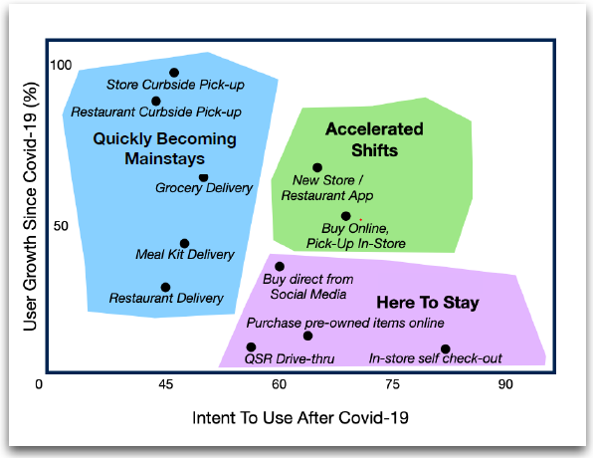
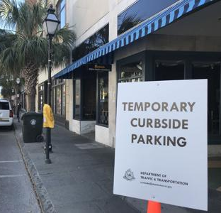
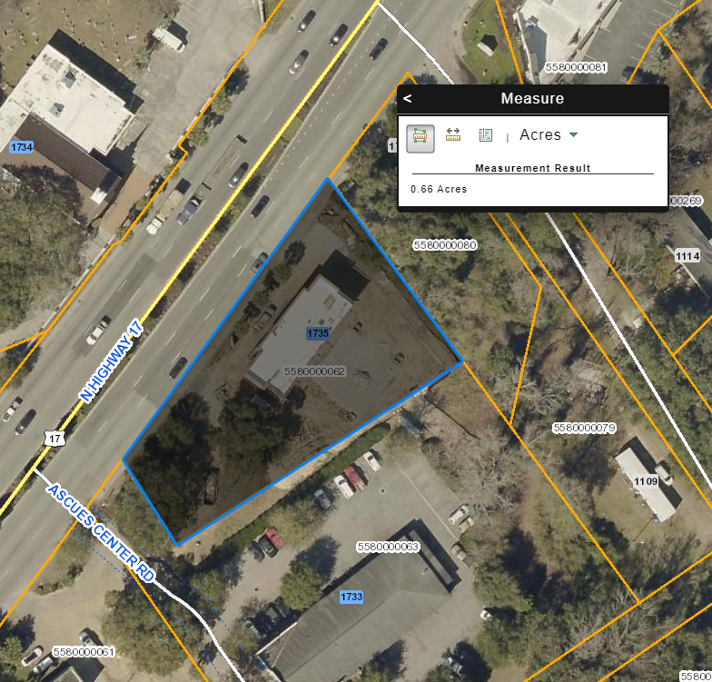
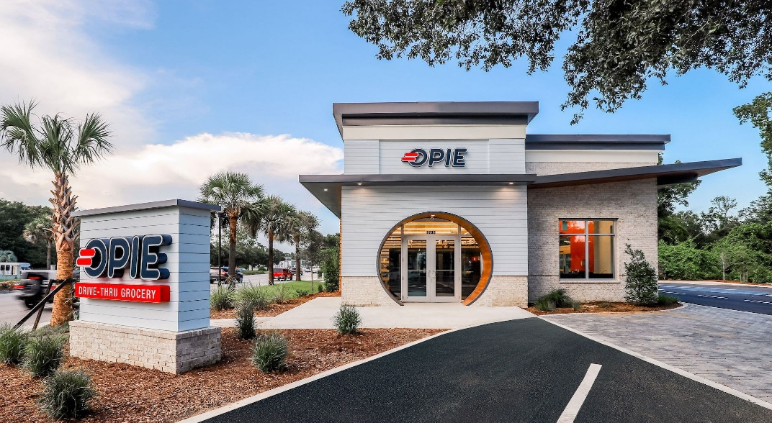
Retail Trends
Notes:
Some other trends such as drive-thru services are in a suburban experiment phase.
The current trend for fast food retailers is to shift away from indoor dining to a fully automated version. There is an experimental grocery story in Mount Pleasant which only has drive up/thru services.
OPIE is located on a vastly smaller parcel than traditional grocery stores.

Slide 14
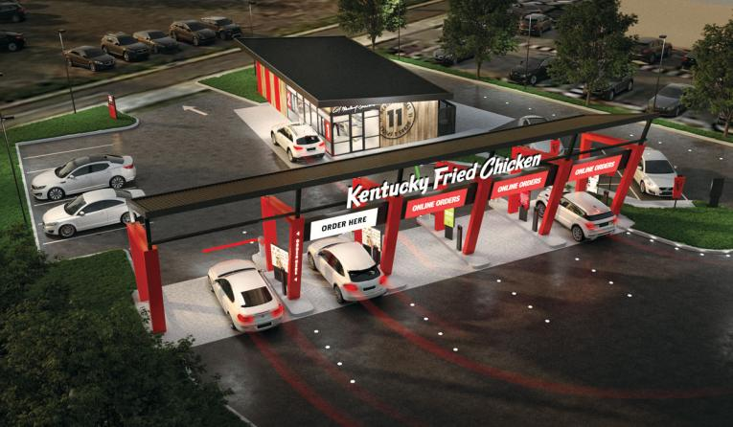
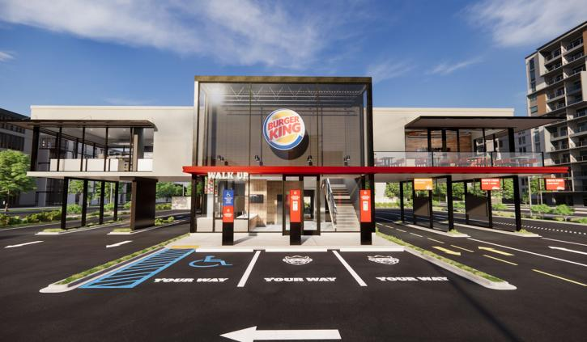
Retail Trends
Notes:
National fast food chains are planning an experimenting with locations that have additional kitchens but minimal service staff.
Instead they rely on on-line ordering or delivery pick ups for their clients.
The examples shown here are concepts that KFC and Burger King are working on. These examples would allow for smaller building and more drive area, compressing their site plans from 1.5 acres onto as small as half an acre.

Slide 15
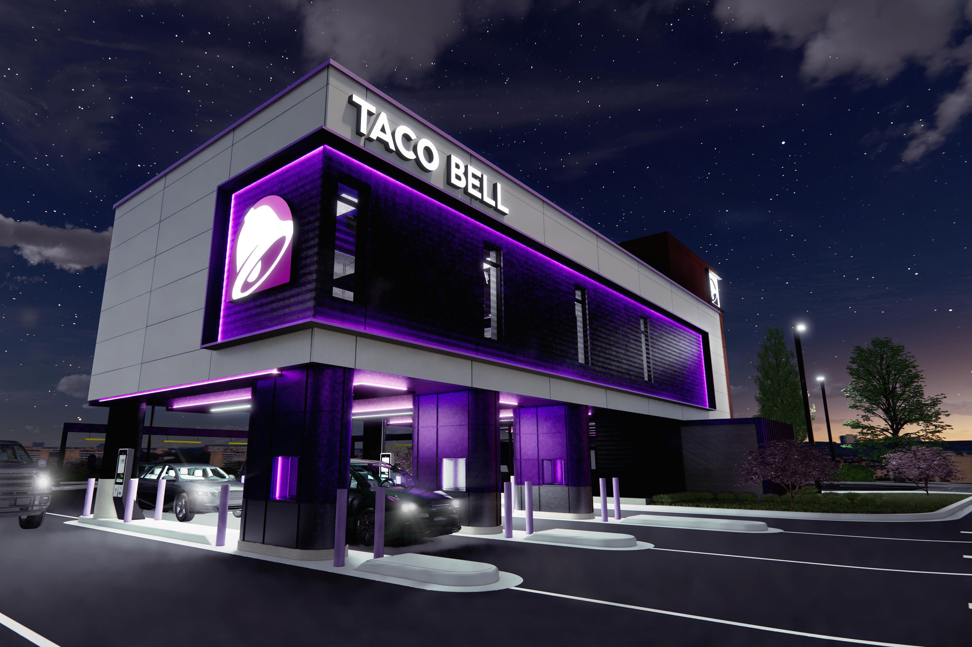
Retail Recruitment & Trends
Taco Bell Defy Concept
4 drive thru lanes
3,000 sf two story structure
Has “4 Kitchens” on 2nd story
QR codes for confirmation
“Propriety lift system”
Walk-up/bicycle window
No seating on site
Designed for smaller lots
Needs to be studied for the effect on stacking & drive thru regulations.
Notes:
Images are of a Taco Bell Defy concept under construction in Brooklyn Park, MN
Will be a test for if the new style operates in the expected way
Follows trend for drive thru and contactless pick up

Slide 16
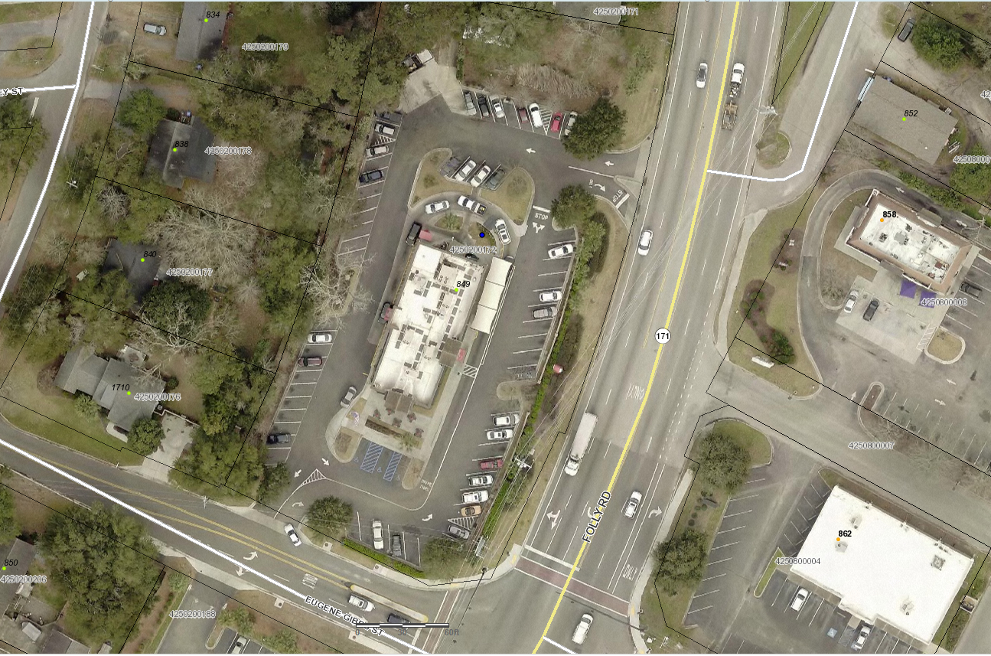
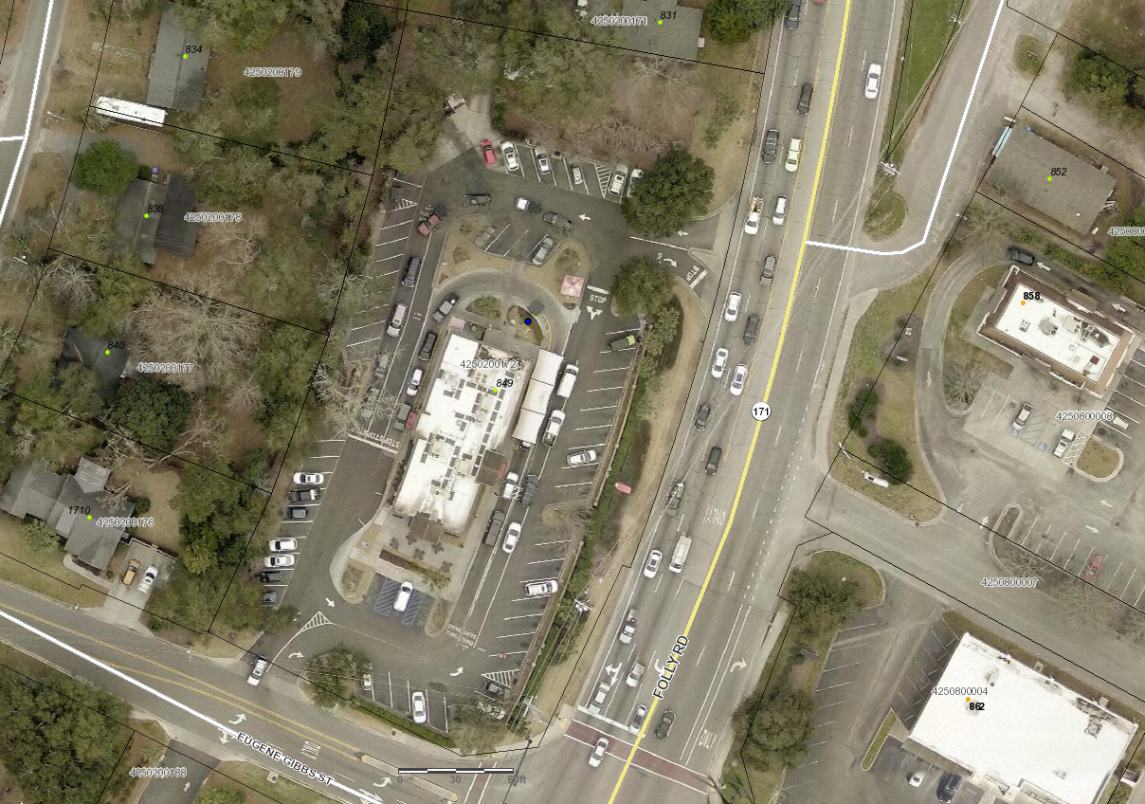
Retail Recruitment & Trends
Chick-fil-A, 849 Folly Rd, Charleston, SC 29412
2019
2021
Notes:
We can already see a trend towards this in Charleston with the existing Chic-fil-As and their rapid adjustment to drive thru only during COVID.

Slide 17
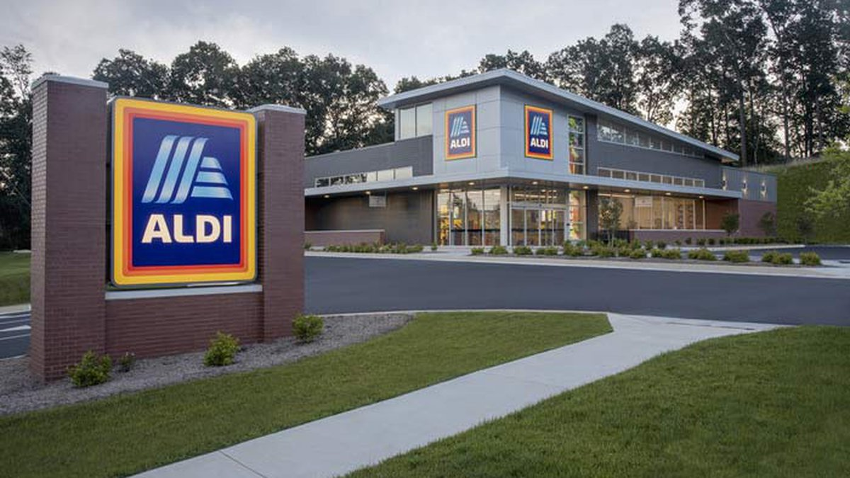
Retail Trade Area Analysis
ALDI Specific location criteria:
±22,000 sq. ft. with min. 95 parking spaces
2.5 acre pads for purchase and development
End-cap or inline with min. of 103’ of frontage
Signalized, full access intersection preferred
Dense trade area population within 3 miles
Sites located in community & regional shopping districts with convenient access
Sites zoned to allow grocery use
Daily traffic count of 20,000+ vehicles per day
ALDI sets opening date for 4th Charleston-area location
(Source: Live5 Aug. 2020 – Photo: Patrick Phillips)
Notes:
When recruiting specific businesses it helps to research their site selection requirements for placing a store.
Aldi has posted what they are looking for. This is typically their minimal threshold to even start talks with a property owner or manager for placing a branch.

Slide 18
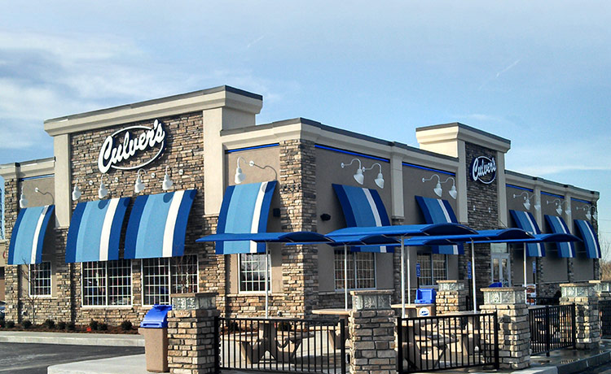
Retail Trade Area Analysis
Culver’s Specific location criteria:
Good visibility from all angles. Corner lots at signalized intersections are preferred.
Ease of ingress and egress—two entry and exit points are preferred.
Ability to make left-hand turns into and out of the site.
Proper zoning for drive-thru is required.
City codes should allow for construction of building and signage with no or few restrictions (changeable reader boards are preferred).
Availability to build up to 4,500 sf.
There should be no plans by government entities to alter traffic patterns in a manner that would have an adverse effect on your site.
One designated parking stall for every two restaurant seats (typically 55-60 stalls).
Culver’s Real Estate Site Criteria
(Source: https://www.culvers.com/franchise/real-estate)
Notes:
When recruiting specific businesses it helps to research their site selection requirements for placing a store.
Culver’s has posted what they are looking for on their website. This is typically their minimal threshold to even start talks with a property owner or manager for placing a branch.

Slide 19
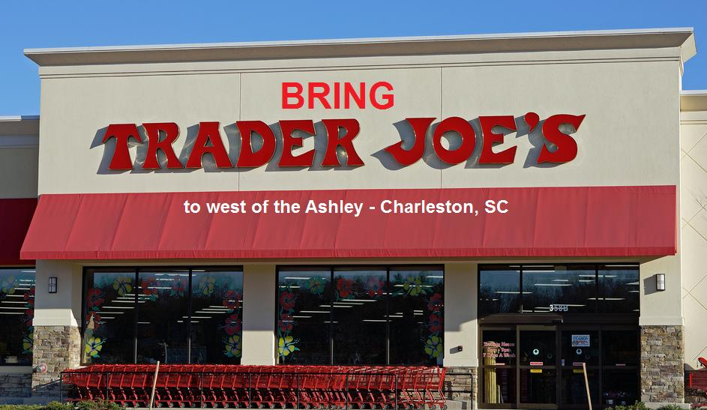
Retail Trade Area Analysis
Notes:
Some companies though are black boxes that keep their site selection and real estate departments secretive.

Slide 20
Tenants of Recruitment
Community development must precede economic development
Retail development strategies are place-based and must fit the community
A balance of independent, regional & national retail must be achieved
Retail must be recruited
Retail recruitment is a process- not an event!

Slide 21
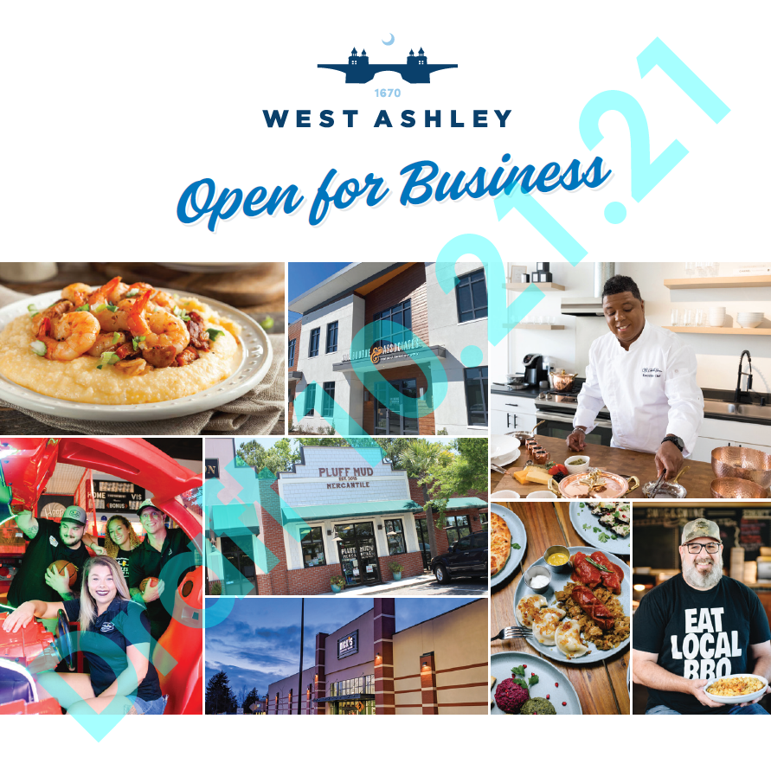
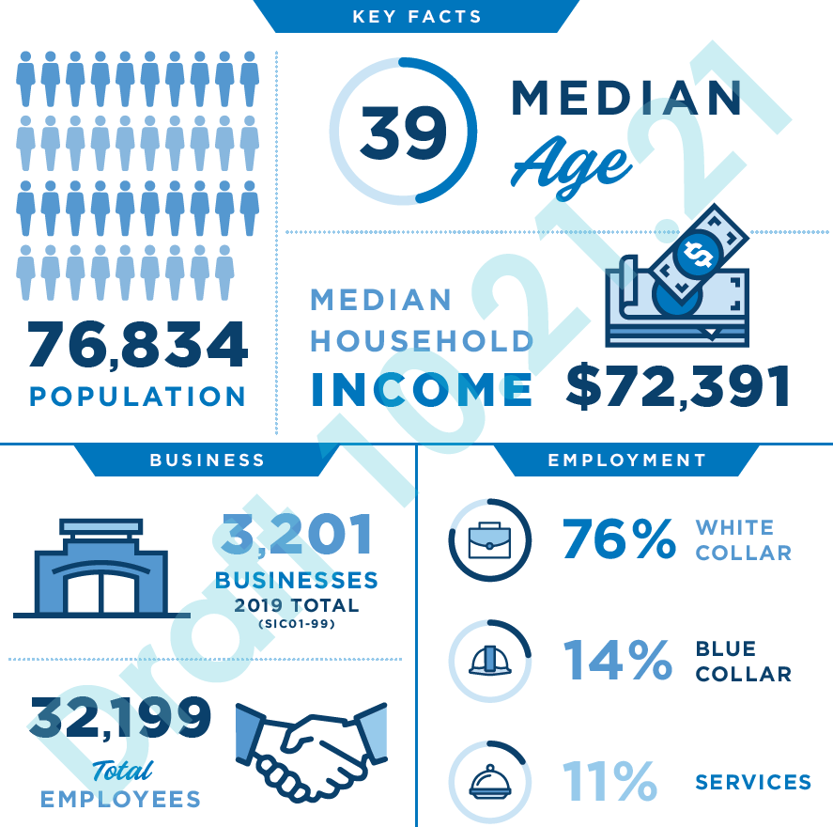
Current Recruitment Efforts
Notes:
Coming soon February 2022

Slide 22

Retail Live! Carolinas 2022 Event
Thursday, February 10, 2022 in Charlotte, NC
Retail Live! is similar to regional networking events; there is an exhibit part of the program as well as a reception. The key difference is that ONLY retailers are allowed to have an exhibit at the Retail Live!. In less than a day, participants get a chance to network directly with retailers actively expanding.
Comprised of real estate developers, commercial brokers, and retailers this is an excellent location to network and create interest in West Ashley commercial areas!
Notes:
Any brands in mind?

