Slide 1


City of Charleston
West Ashley Revitalization Commission DRB Principles Update
Eric Pohlman – West Ashley Coordinator
September 14, 2022

Slide 2
DRB Meeting August 1, 2022
Presented the WARC Workgroup DRB Principles at the August 1 meeting of DRB
Design Principles are Item 3 in the Implementation Matrix
  Develop a set of urban design principles for key sites and corridors. Based on the illustrative vision depicted for key sites in Plan West Ashley, a set of principles can be established to inform new development and public improvements
The smaller focus group of West Ashley Revitalization Commissioners drafted the principles to reflect the different characters of the area. (Members: Ashley Jackrel, Kenneth Marolda, Mary Peters, and Teresa Tidestrom)
2020-2021 held workgroup meetings to discuss the areas of West Ashley and the special character of them

Slide 3
Design Principle Limitations
City Design Review Board has limitations on purview
Principles had to be restrained to what the City Design Review Board could decide upon.
Could not:
Have right of way design criteria
Give or reduce height
Influence parking count
Decide stormwater design
Decide land uses allowed or not allowed
Also avoided:
Architectural styles or form-based code
Proscriptive language

Slide 4
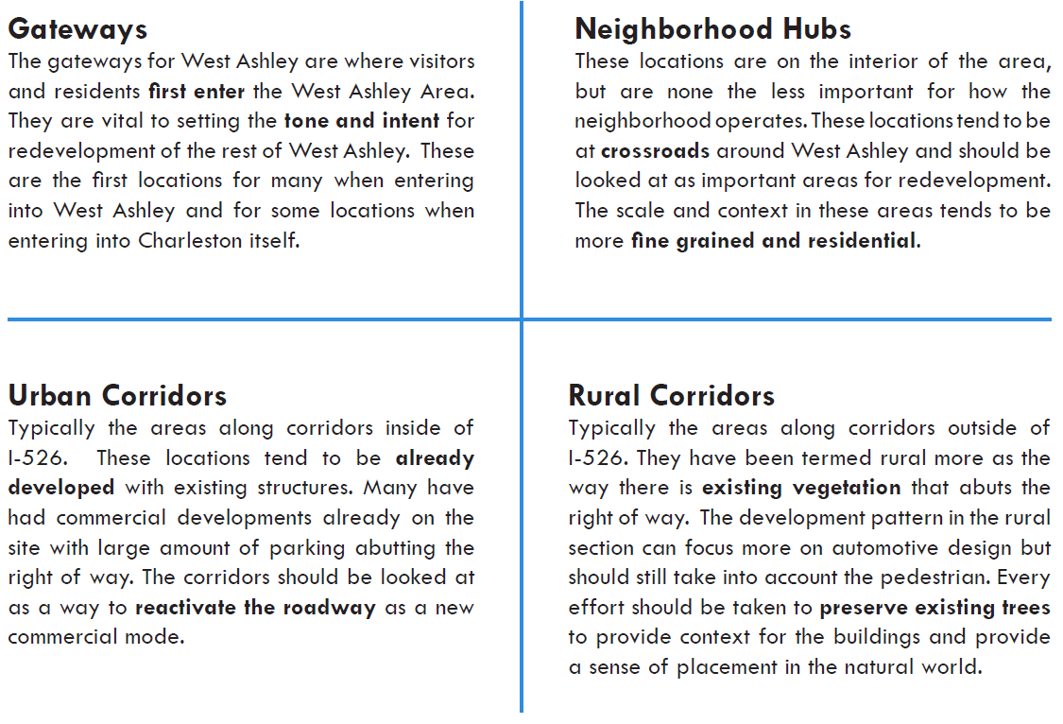
DRB Principle Areas

Slide 5
DRB Meeting August 1, 2022 Outcome
DRB wanted more definition for each Gateway and Neighborhood Hub
Refine the guidelines to ensure they are legally defensible (ie. Not refereeing to requiring additional sidewalk because of potential takings opposition)
Rethink terms Rural and Urban for corridors, restudy locations for Gateway and Neighborhoods Hubs (what are extents for them?)

Slide 6
DRB Principles Update
Tweaking and drafting new language
  Working draft 2 sent to Commissioners as example of direction
Will need a new workgroup to help refine the language and ensure it fits with the direction of WARC
  Volunteers
    Matt Moldenhauer
    Charlie Smith
    Kenneth Marolda
    Teresa Tidestrom

Slide 7
City of Charleston
West Ashley Revitalization Commission Workgroups Update
Eric Pohlman – West Ashley Coordinator
September 14, 2022

Slide 8
Elements to Focus (2022)
42 | COMM DESIGN & LAND USE | Improve/beautify West Ashley gateways with appropriate signage and landscaping | No update
115 | ECONOMIC DEVELOPMENT | Explore the introduction of a business license fee reduction as an incentive for investment in West Ashley | Meeting with Business Services Manager, edits proposed
143 | TRANSPORTATION | Implement a pedestrian/bike scale destination based wayfinding system | Meeting with City Parks on design options and materials. Additional details to follow.
5 | COMM DESIGN & LAND USE | Establish a West Ashley Community Brand & Identity Committee: organize private clean up efforts (Keep West Ashley beautiful) | No updates
32 | ECONOMIC DEVELOPMENT | Better integrate West Ashley within the efforts of the Charleston Digital Corridor initiative | Received marketing brochure; will start to set up meetings with different economic development groups in the area for West Ashley marketing push.

Slide 9
143
TRANSPORTATION
Implement a pedestrian/bike scale destination based wayfinding system
City Parks has a project to brand and create wayfinding along the West Ashley Greenway.
Steering committee comprised of:
  CM Ross Appel
  Devon Andrews (Charleston Parks Conservancy Program Manager)
  Katie Zimmerman (Charleston Moves)
  Donna Jacobs (Ashley Bridge District)
  Eric Pohlman (West Ashley Coordinator)
Have had three meetings to discuss options for branding logo and usage of wayfinding with Chase Anderson (City project manager) and graphic consultant
Have reviewed WA branding package, decided to create a new logo that could be used cross city on new trails.

Slide 10
32
ECONOMIC DEVELOPMENT
Better integrate West Ashley within the efforts of the Charleston Digital Corridor initiative
West Ashley economic development marketing brochure has arrived
Setting meeting with CRDA, Charleston MetroChamber, Charleston Economic Development, Lowcountry Local First, and Digital Corridor to present packet and develop relationship with companies
Placing PDF online for company recruitment
Document highlights the best aspects of West Ashley as a location to grow a business and a family

Slide 11

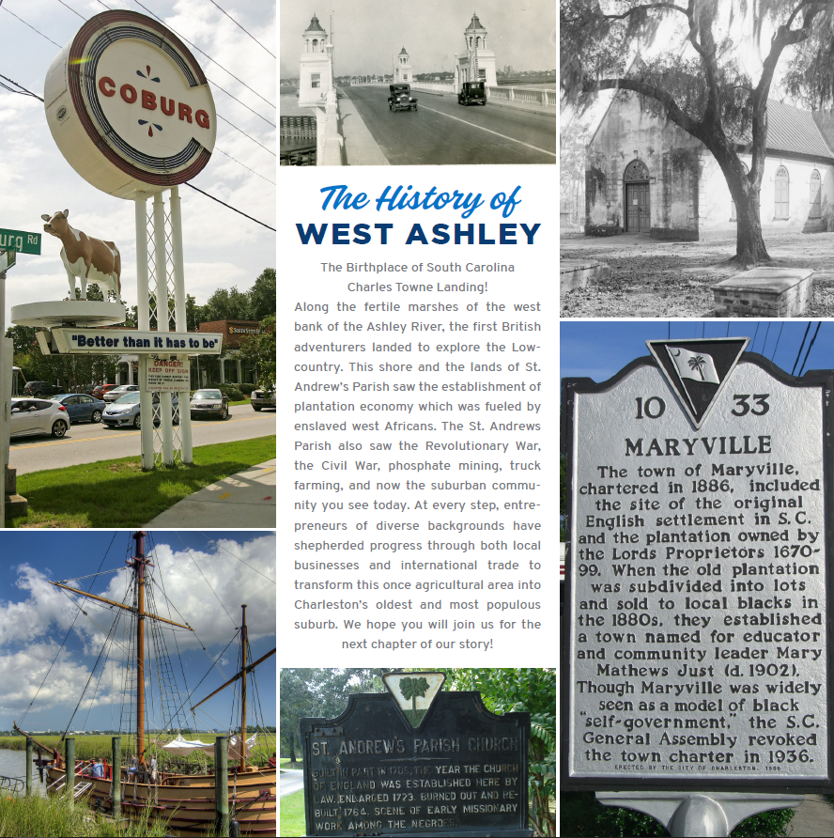
32
ECONOMIC DEVELOPMENT

Slide 12
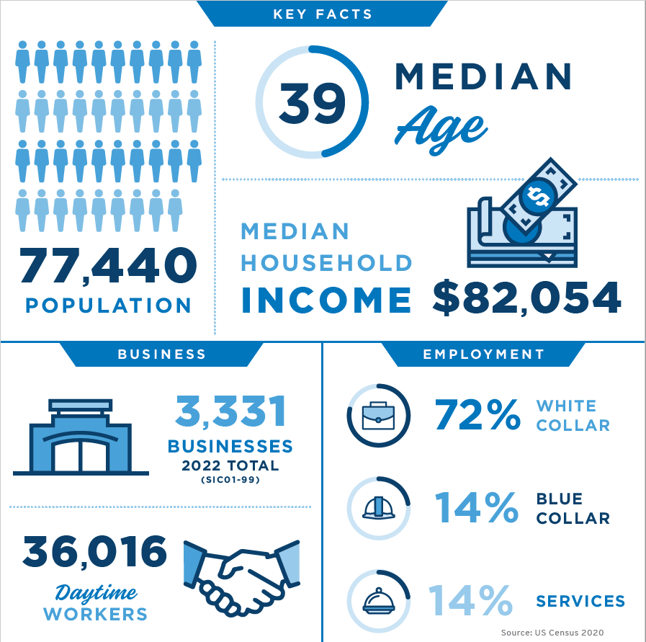

32
ECONOMIC DEVELOPMENT

