Slide 1
Glenn McConnell Parkway
Widening Project
Construction Update #1
November 3, 2022

Slide 2
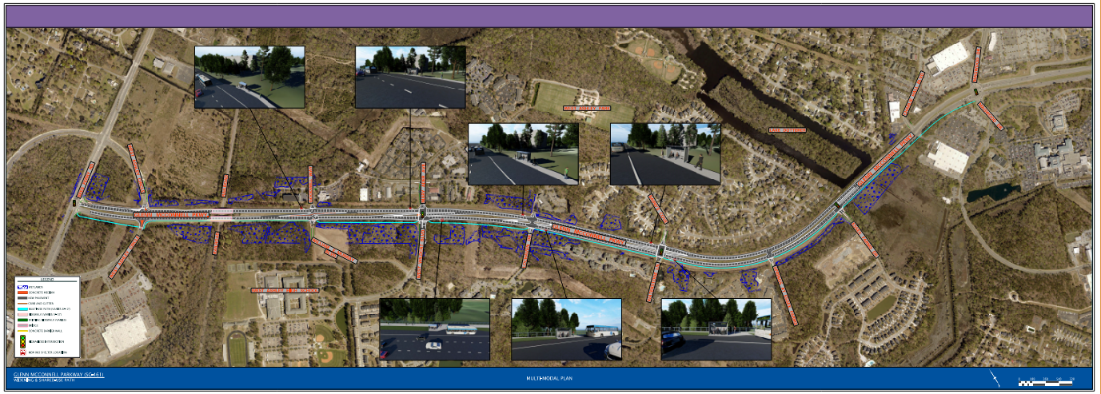
Project Description
Glenn McConnell Parkway Widening improvements extend from the intersection of Bees Ferry Road to the intersection of Magwood Drive.
Approximately 2.3 miles of roadway, drainage, and multimodal improvements.

Slide 3
Proposed
Improvements
Roadway widening from four-to-six lanes.
Installation of bike and pedestrian facilities by way of installing a 10-foot multi-use path along the eastern corridor of the project.
Multimodal improvements include the installation of 7 sheltered bus stops.
Intersection improvements and modifications throughout the corridor.
4-Mast Arm traffic signals (Bees Ferry, Mary Ader/W. Wildcat, Bairds Cove/Waterstone, & Essex Farm).
Installation of roadway lighting.
Landscaping and irrigation systems at all intersections.
New asphalt pavement the length of the project.

Slide 4
Phasing Plan
PHASE 1
Clearing of project limits (March 2022)
Westbound shoulder work from Bees Ferry Road to Magwood Drive:
  Installation of an additional travel lane.
  Minor storm drainage modifications.

Slide 5
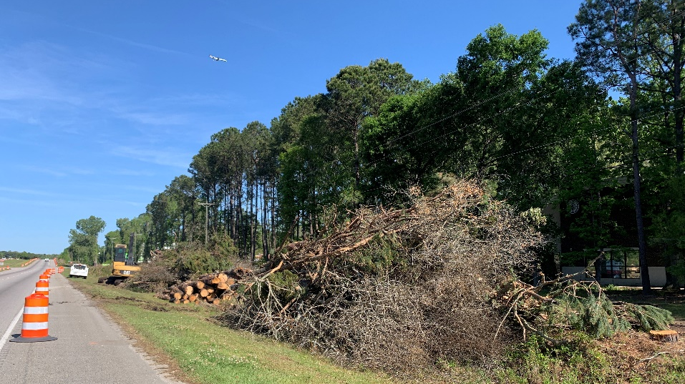
Clearing / Site Preparation

Slide 6
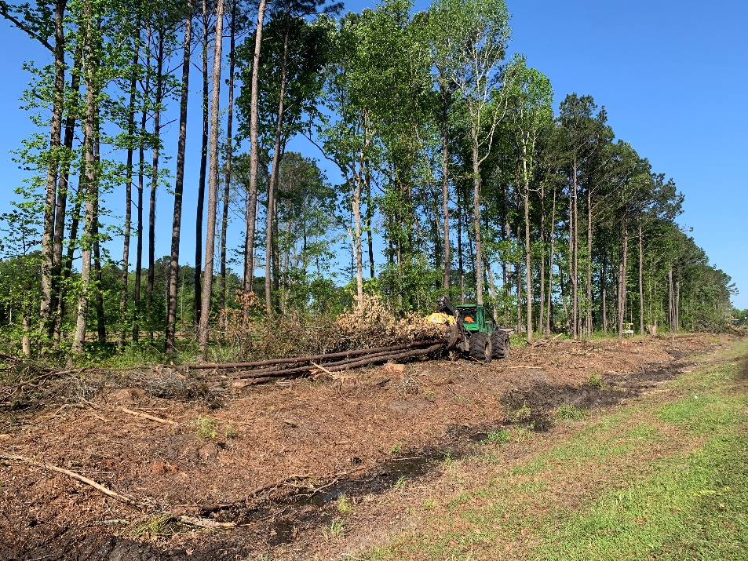
Clearing / Site Preparation
Clearing / Site Preparation

Slide 7
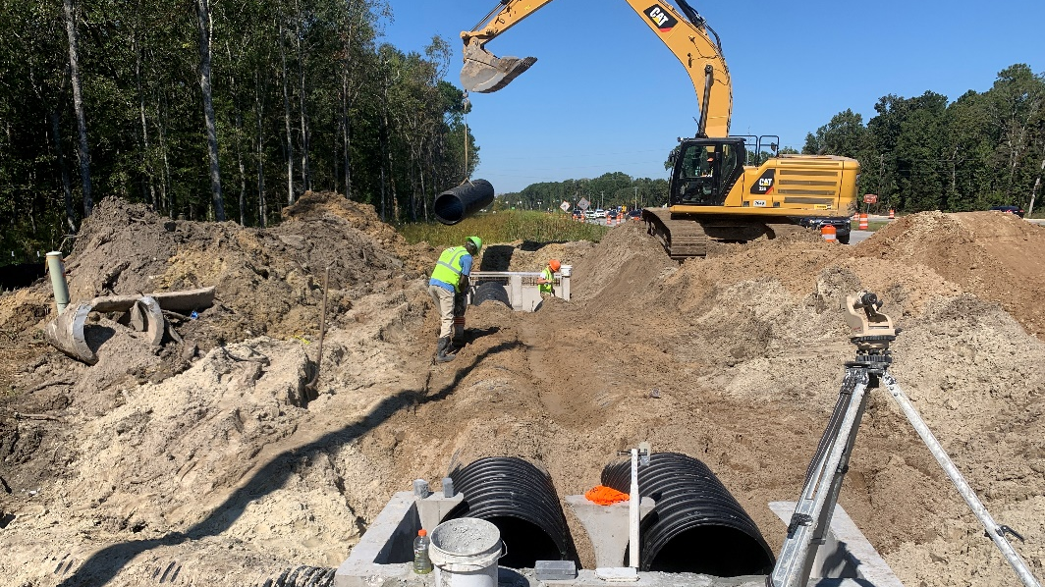
Storm Drainage Work

Slide 8
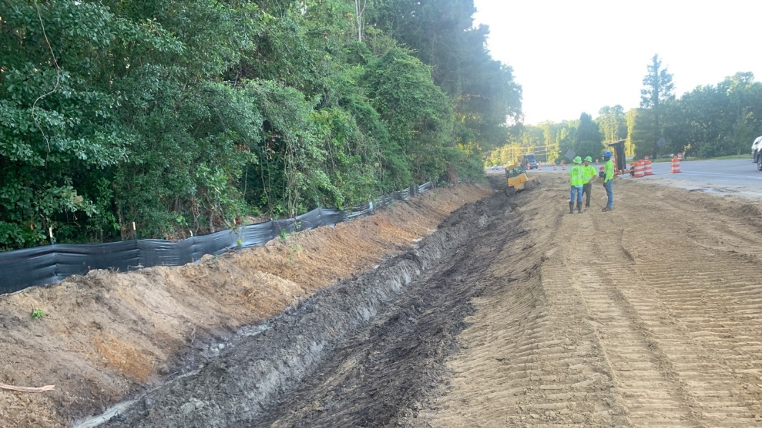
Storm Drainage Work

Slide 9
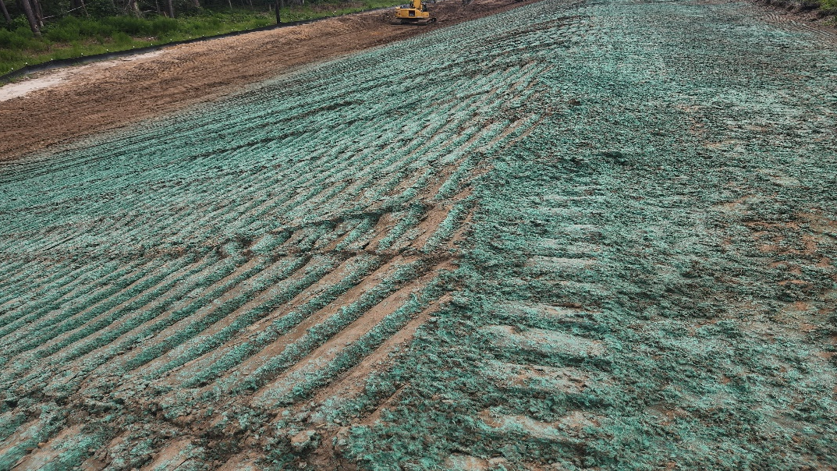
Erosion Control

Slide 10
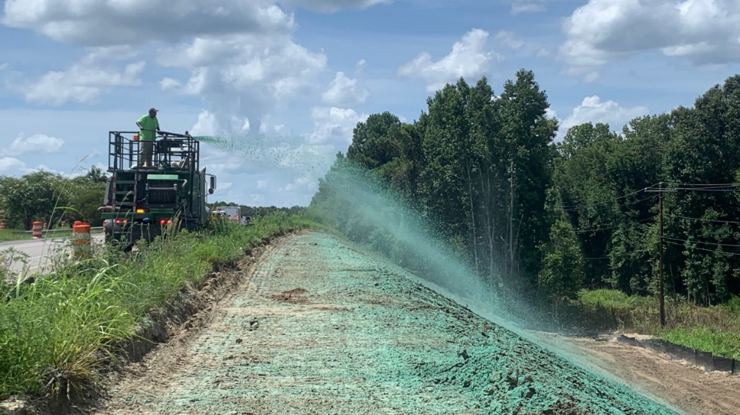
Erosion Control

Slide 11
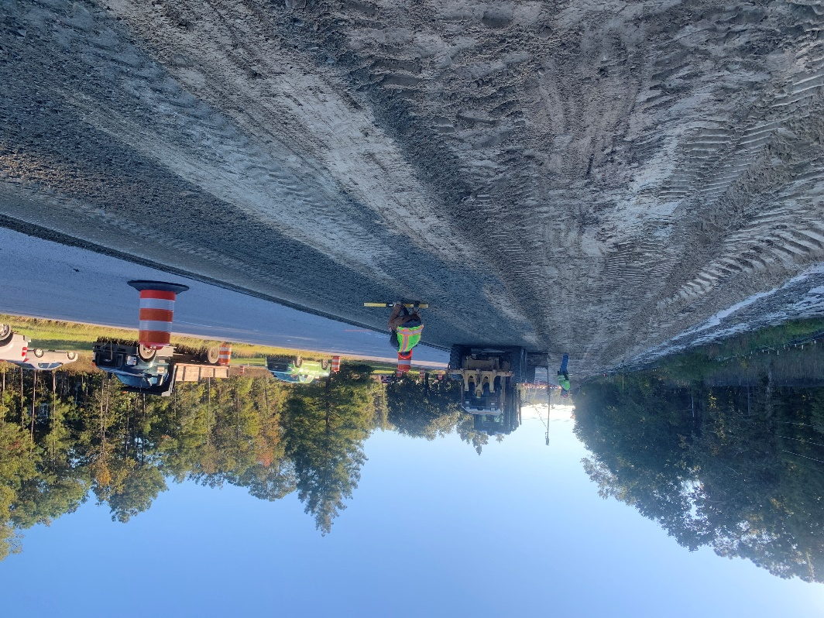
Roadway Widening

Slide 12
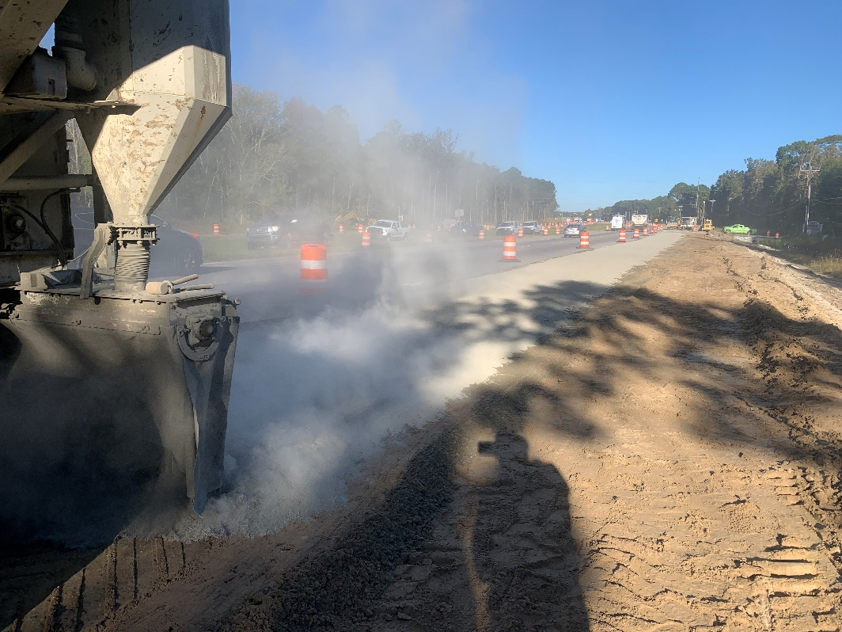
Roadway Widening
Roadway Widening

Slide 13
Phasing Plan
PHASE 2
Median and eastbound shoulder work from Bees Ferry Road to Magwood Drive:
  Installation of an additional travel lane eastbound.
  Intersection improvements.
  Minor drainage modifications.

Slide 14
Phasing Plan
PHASE 3
Lake Dotterer Culvert installation component.
(contingent on environmental permitting)
Shared-use path installation.
  Multimodal improvements (bus shelters).
  Landscaping and irrigations at intersections.
Main-line paving and striping.
New mast-arm traffic signals.

Slide 15
Current Status &
Path Forward
30% complete based on time.
Upcoming Construction Activities:
  New westbound travel lane paving.
  Drainage modifications (continued).
Projected Timeline:
  Phase 2 eastbound widening scheduled to begin January 2023.
  Phase 3 multi-use path and Lake Dotterer culvert installation scheduled to begin summer 2023.
  Substantial completion date March 2024.

Slide 16
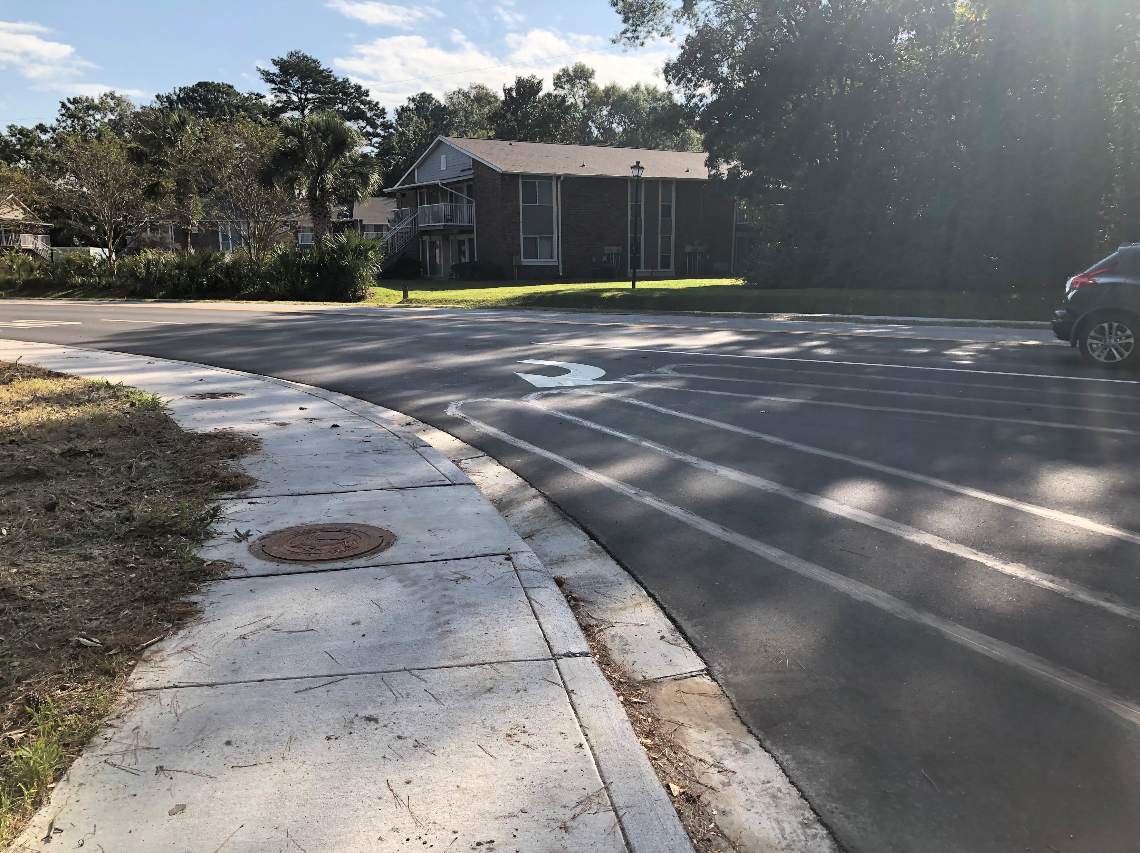
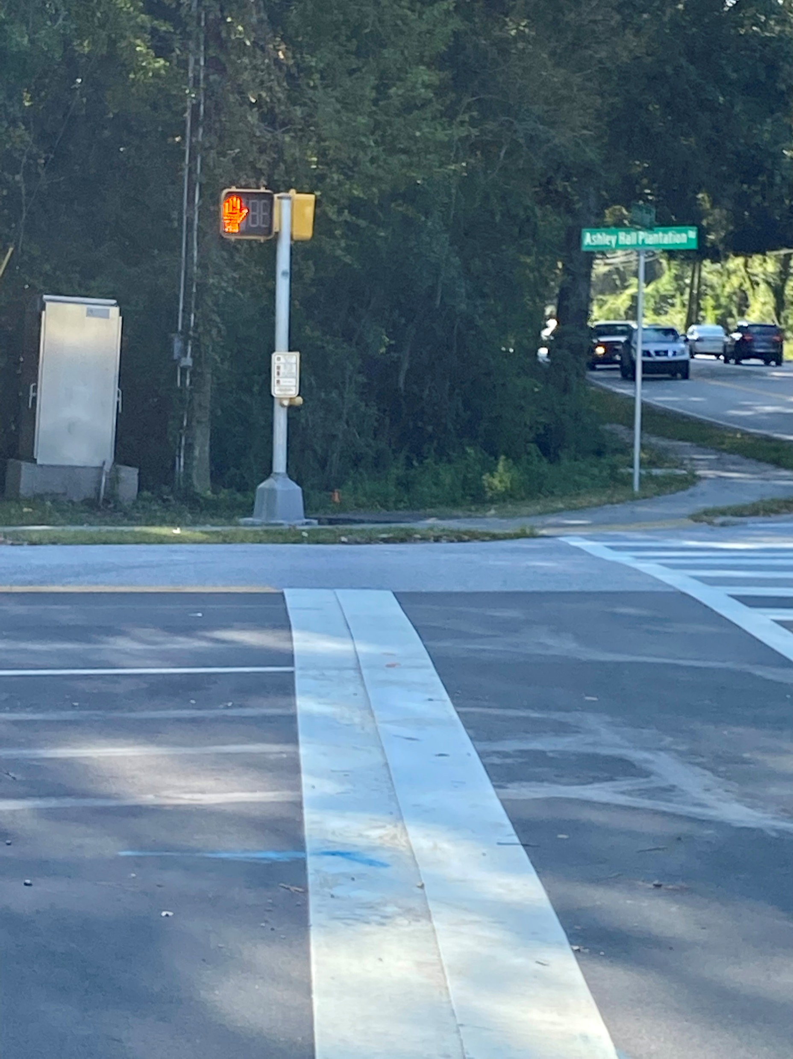
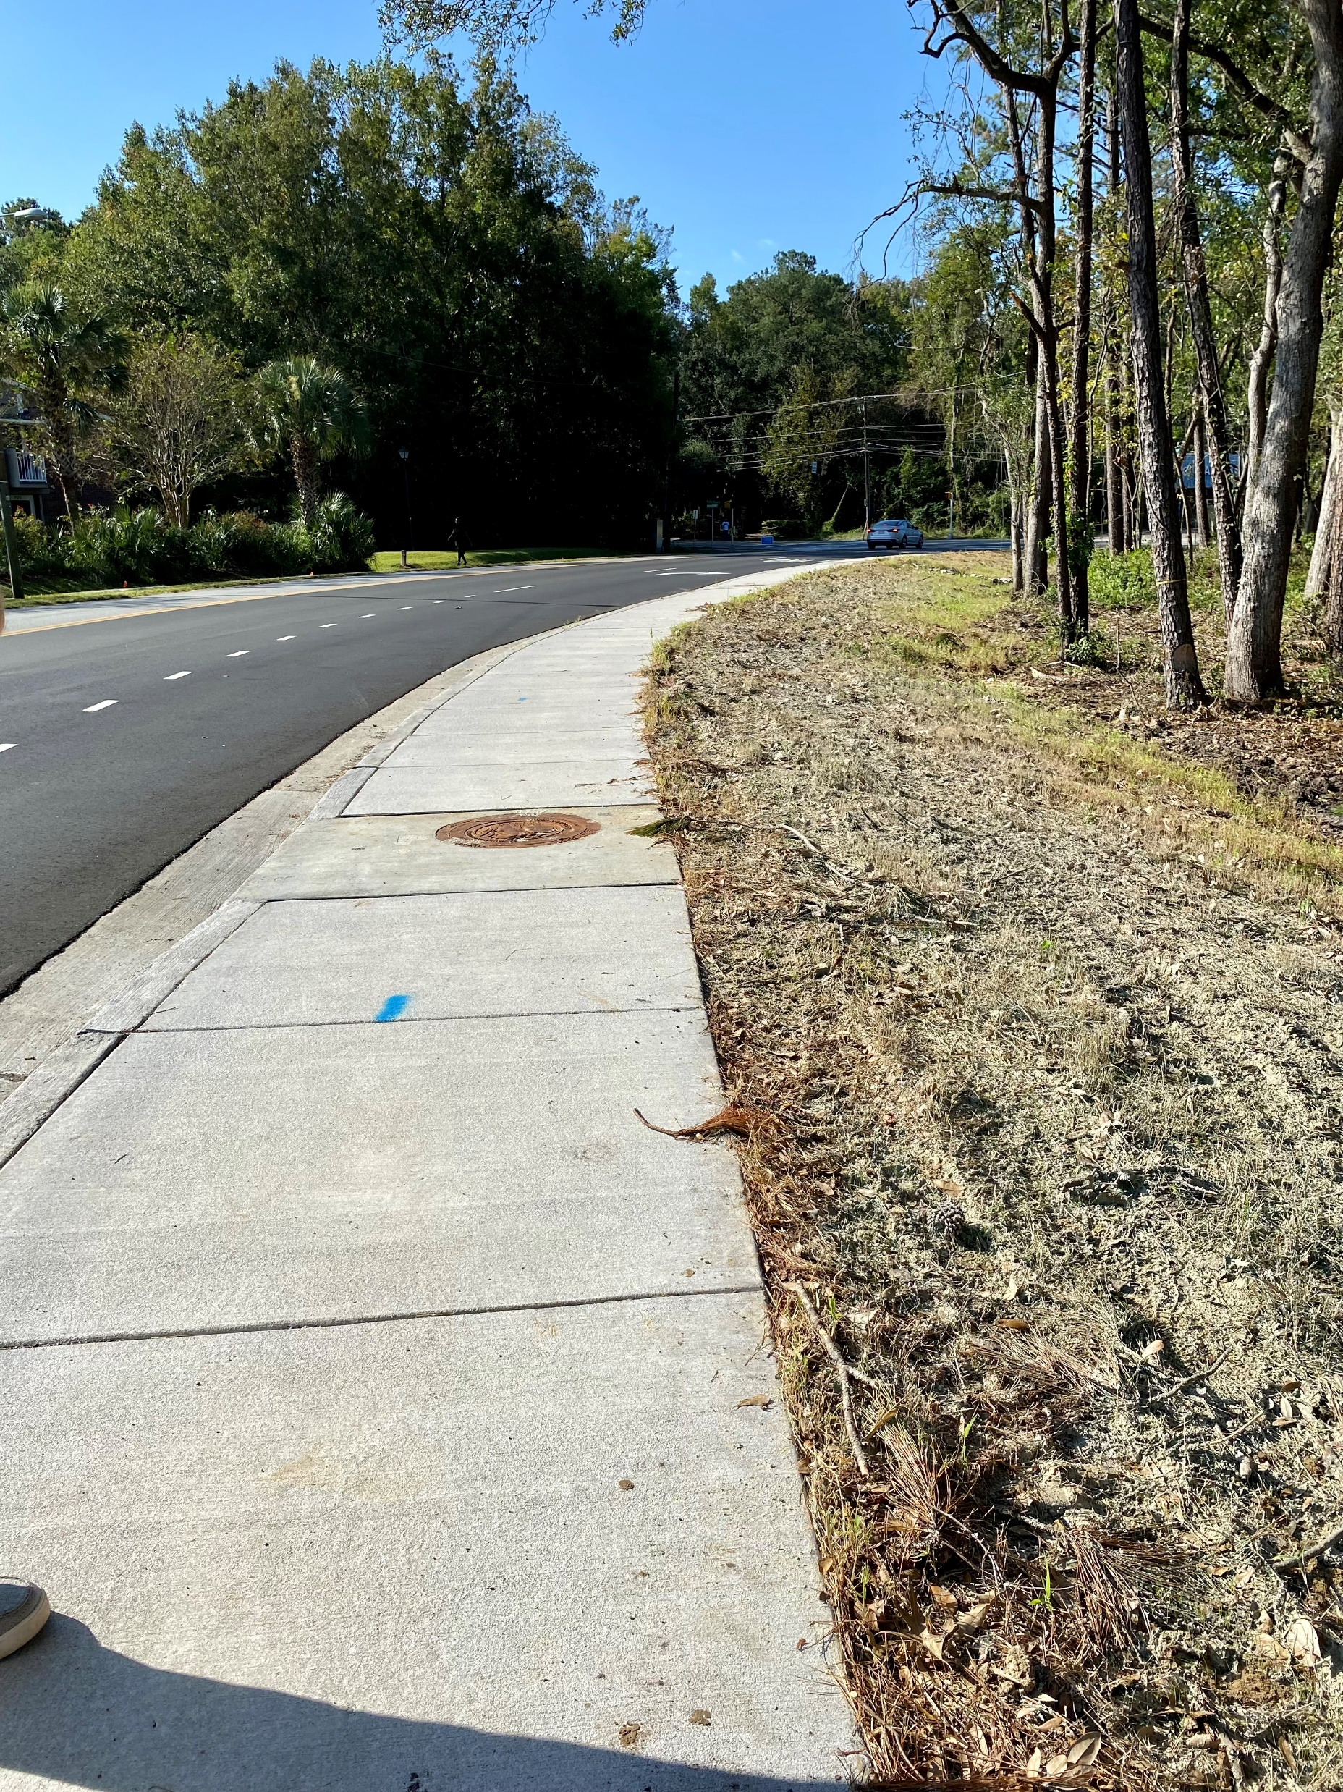
Ashley Hall Plantation Road Right Turn Lane
LOCATION: City of Charleston
DESCRIPTION: Installation of a right turn lane from Ashley Hall Plantation Road on to Highway 61. Upgrades included new sidewalk, pedestrian signals, signaling updates, two crosswalks, drainage improvements, and two concrete bus stop pads.
STATUS: Completed In October 2022.

Slide 17
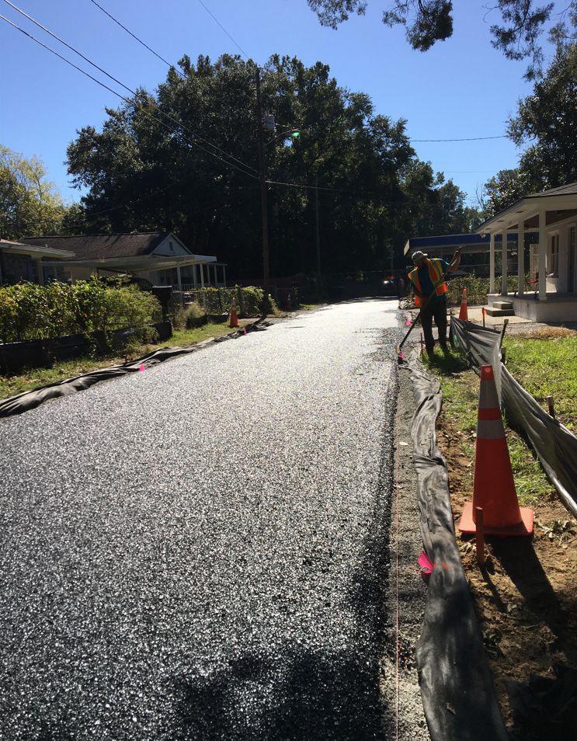
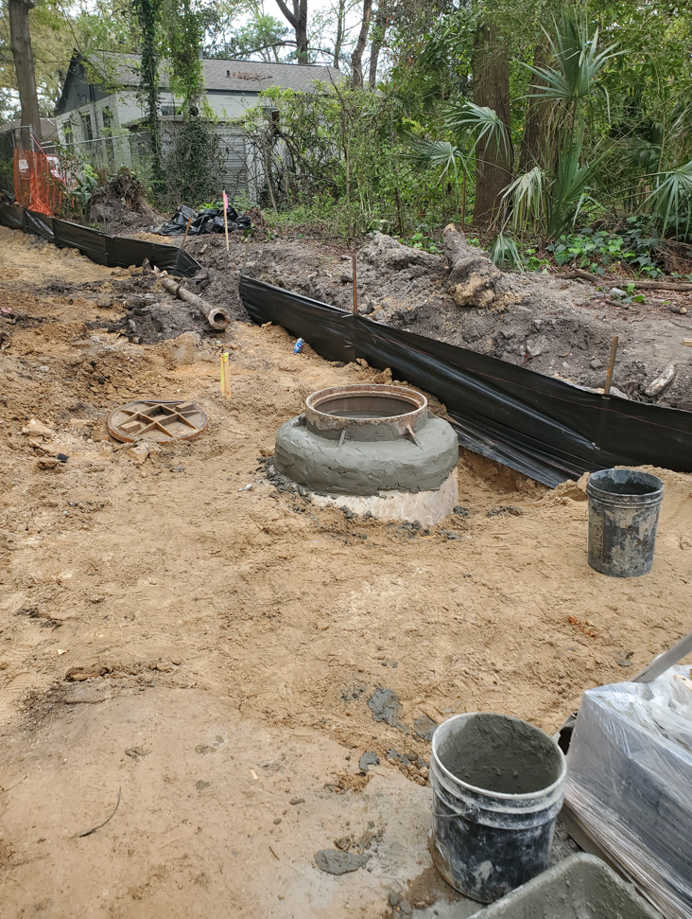
Adele Street
Paving
LOCATION: City of Charleston
DESCRIPTION: Pave the current street with pervious asphalt. Installation of new water and sewer upgrades.
STATUS: Substantially completed Fall 2022. Final inspection November 28.

Slide 18
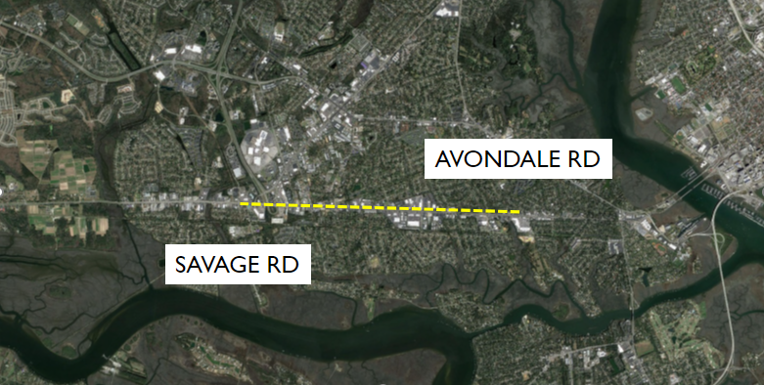
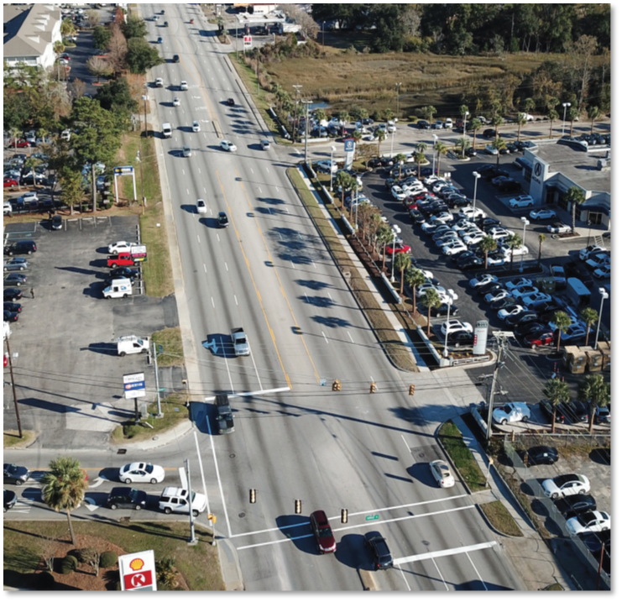
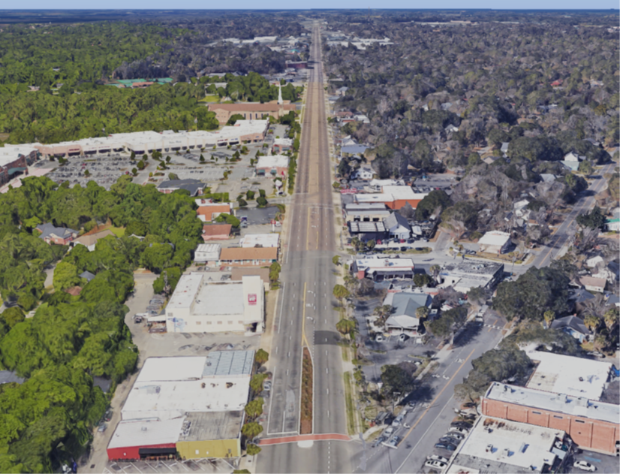
Savannah Hwy Capacity Improvement
Funding: TST
Scope: Project aims to reduce congestion and improve safety along the Savannah Hwy corridor. Study from Savage Road to Avondale Rd.
Status: Virtual Public Information Meeting comment period closed 9/23/22. Comments will be reviewed, and responses generated for public viewing. Public feedback will be considered in the project development process. Project currently in final design stage. https://www.savannahhighway.com/publicmeeting

Slide 19
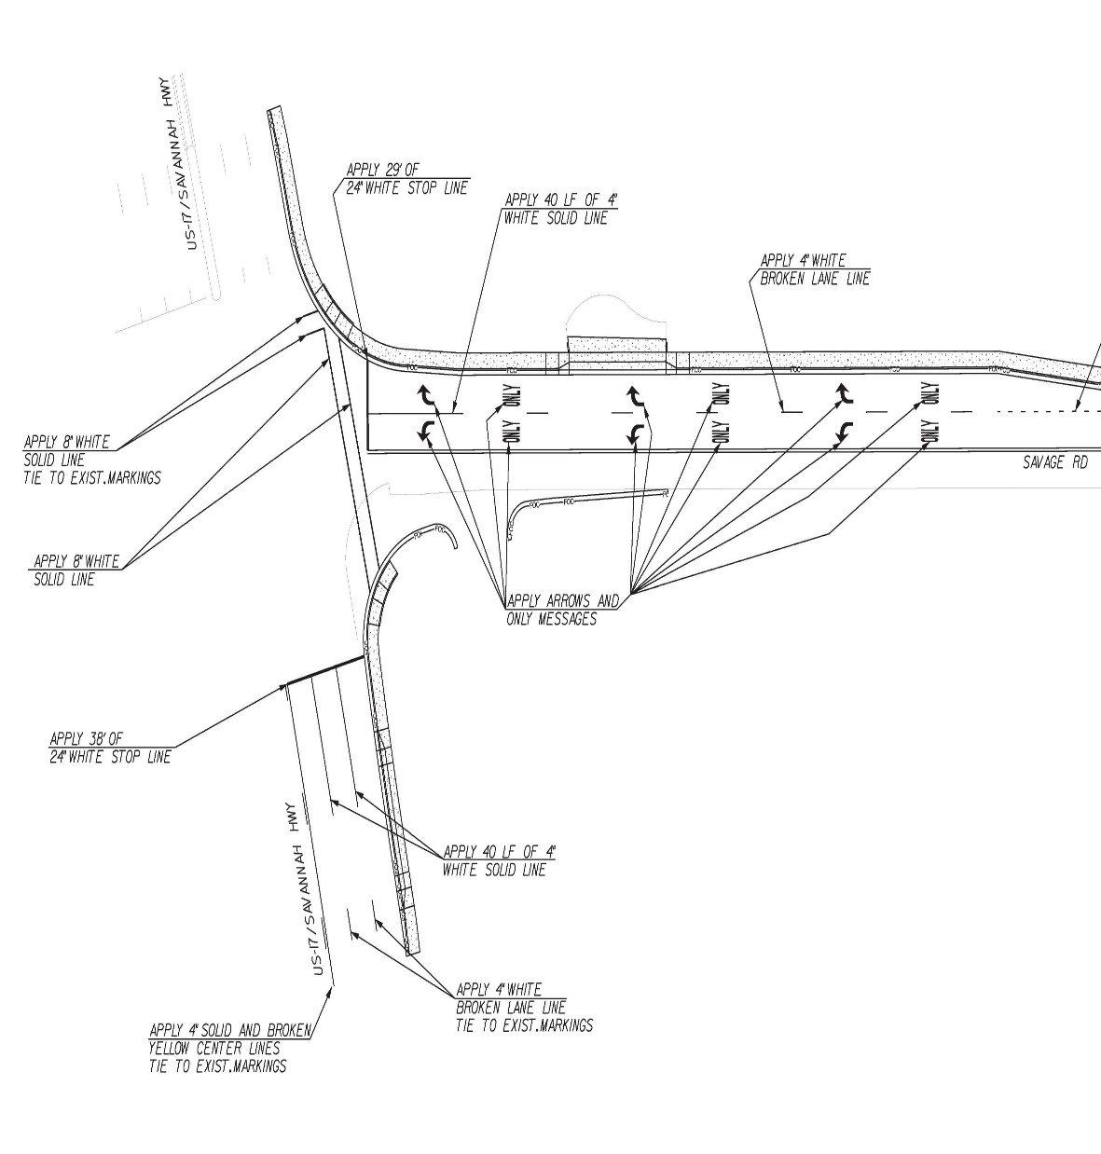
US-17 at Savage Road Intersection
Funding:
TST
Scope:
Improve the intersection of Savage Road and US-17 to accommodate truck turning movements and increase capacity of the right turn lane from Savage Road onto US-17.
Status:
Dominion finalizing Easement language to relocate transmission. Dominion claims prior rights; County is awaiting further justification from them.
Path Forward:
Projected advertisement to bid in the 1st Quarter 2023, pending power pole relocation.

Slide 20
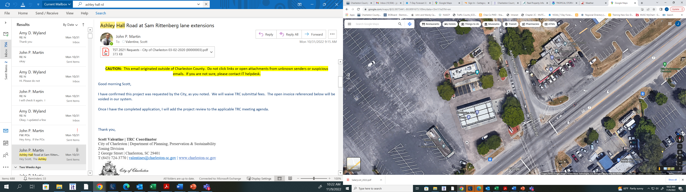
Ashley Hall Road at Sam Rittenberg Turn Lane Extensions
Funding: TST
Scope:
Increase the length of the turn lanes from southbound Ashley Hall Rd to eastbound Sam Rittenberg Blvd. The project will also include drainage improvements, curb and gutter, and moving the existing sidewalk on to an existing easement.
Status:
Project is under review with SCDOT and the City of Charleston’s TRC process. The project is also subject to a County encroachment permit for the drainage easement.
Path Forward:
Receive all permitting and then advertise project in 1st quarter 2023

Slide 21
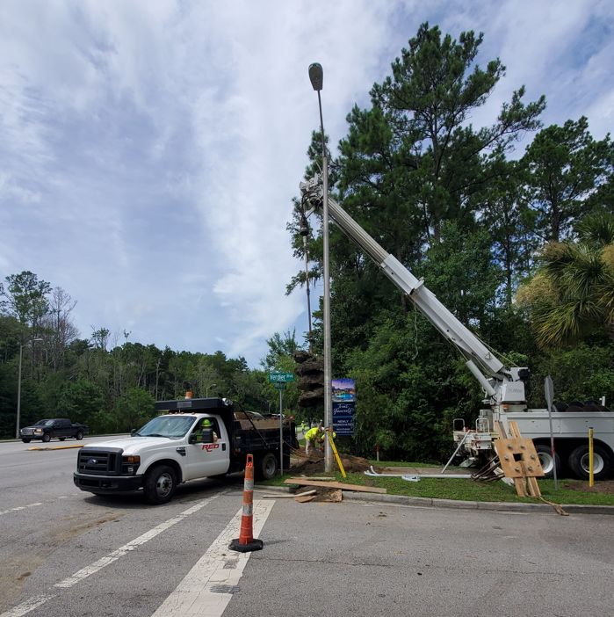
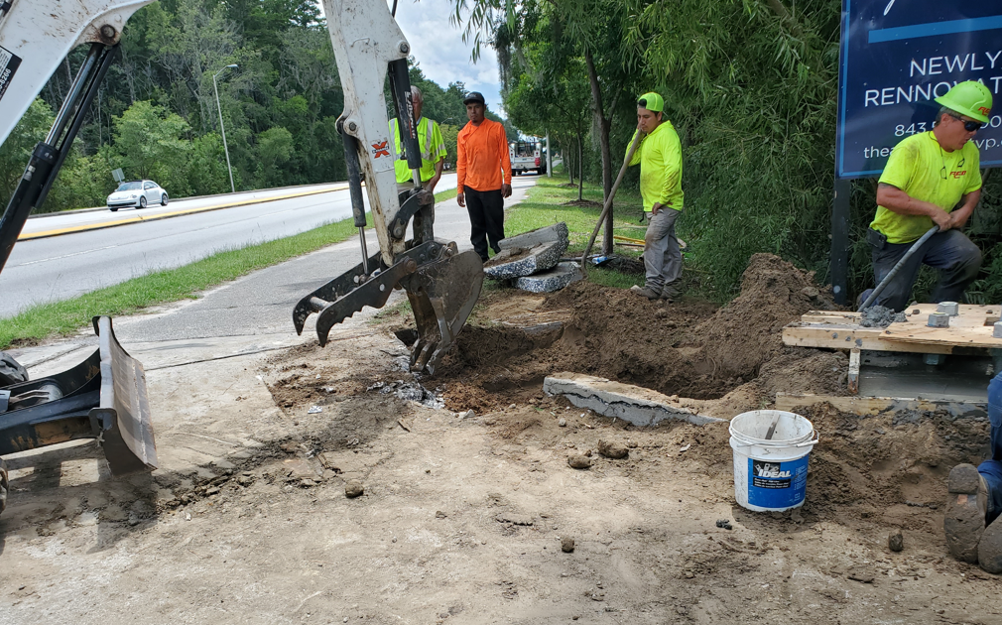
Bees Ferry and Sanders Road Traffic Light
Funding: TST
Status:
Construction in progress. Mast arm foundation and conduit is in the process of being installed. Pedestrian poles have been installed. Mast arm signals will be installed by the end of 2022.

Slide 22
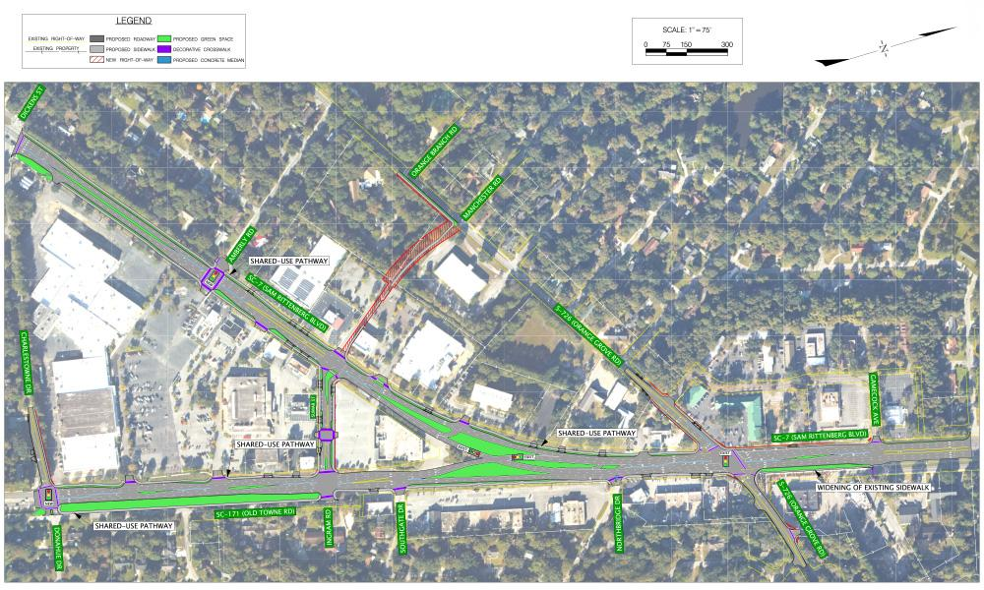
Old Towne District Improvements
Funding: TST
Status: Resubmitted 30% plans to BCDCOG and SCDOT and received comments back from both agencies. Revising plans currently. Began preliminary utility coordination.
Path Forward: ROW plans are expected in the next month for review. Project tentatively out for bid in 4th quarter 2023.

Slide 23
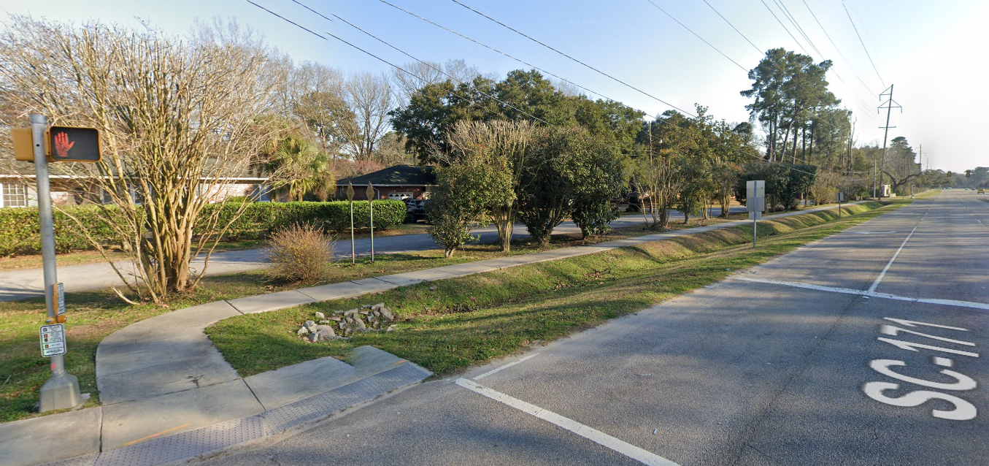
Old Towne Road Sidewalk
Funding: CTC
Scope: Widen existing sidewalk from five feet to ten feet between the entrance to Charles Towne Landing and approximately halfway between the Charles Towne Landing entrance and the new CCPRC park entrance.
Status:
In the permitting phase with SCDOT and the City of Charleston. Working with the City and State Park to obtain an easement for the sidewalk on the portion of the project that will be on Park property. A neighborhood meeting was held with the residents of Charlestowne Estates on June 30 to discuss the sidewalk project’s impact on the stretch of ROW along Ingram Road. The plans were revised due to design changes as a result of these comments and permitting requirements.
Path Forward: Obtain permits and easement. Complete final construction plans

Slide 24
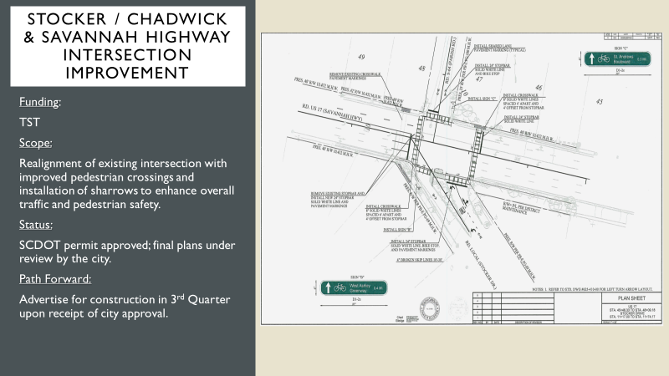
Stocker/Chadwick & Savannah Hwy Intersection Improvement
Funding:
TST
Scope:
Realignment of existing intersection with improved pedestrian crossings and installation of sharrows to enhance overall traffic and pedestrian safety.
Status: SCDOT permit approved, final plans under review by the City.
Path Forward: Advertise for construction in 4th Quarter 2022 upon receipt of City approval.

Slide 25
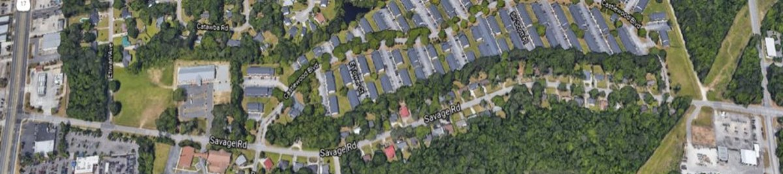
Savage Road Sidewalk
Funding: CTC
Scope:
  Segment A is from Henry Tecklenburg to North Castlewood entrance
  Segment B is from South Castlewood to Etiwan
A separate TST project will build sidewalk from Etiwan to US17.
Status: Dominion is conveying Right-of-Way to SCDOT. City of Charleston is reviewing MS4 permit submittal. Warrant study did not support CARTA request for mid-block crossing connecting NB and EB stops at Etiwan.
Path Forward: Projected advertisement to bid in the 1st quarter of 2023.
A
B

