Slide 1


City of Charleston
West Ashley Revitalization Commission
September 13, 2023
Eric Pohlman – West Ashley Coordinator

Slide 2
Design Review Board Demolition Overview
West Ashley Historic Preservation presented at the March 8, 2023 Meeting
Motion made to ask Council to consider reviewing procedures within the existing boards that we have to expand protections and creating an inventory or creating a subcommittee or subgroup within this Commission to quantify exactly what should be preserved and what we want to preserve.
Design Review Board (DRB) and staff have been working with Legal on this request from Council to look at ways to make this more predictable and provide clearer guidance to property owners and board members concerning demolition requests
This amendment seeks to:
Create clear standards for the review of demolition requests and introduces a test to determine whether a structure contributes to the historic character of the area
Provide the board guidance for older structures that don’t rise to the above test but are greater than 50 years of age

Slide 3
DRB Demo Highlights
Alters wording for the standards for demolition section and adds additional time for public posting.
Current wording for review:
In reviewing an application to demolish in whole or in part, or remove or relocate any existing structure applicable to paragraph 10 or 11 above, the Design Review Board shall consider, among other things, the following factors:
1. The architectural and aesthetic features of the structure, the nature and quality of the structure, including its architectural fabric, any historical significance, the nature and quality of the surrounding area and the structure's contribution to the overall streetscape of the area.

Slide 4
DRB Demo Highlights
Draft wording for review:
In reviewing an application to demolish in whole or in part, or remove or relocate any existing structure applicable to paragraph 10 or 11 above, the Design Review Board shall first determine whether the structure contributes to the historic character of the areas:
1. The structure will be deemed to contribute to the historic character of the area if the structure is at least fifty (50) years old and any one of the following apply:
a. The structure possesses integrity of location, design, setting, materials, workmanship, cultural significance, and association;
b. The structure is associated with events that have made a significant contribution to the broad patterns of our history;
c. The structure is associated with the lives of significant persons in our past;
d. The structure embodies the distinctive characteristics of a type, period, or method of construction, or that represents the work of a master, or that possesses high artistic values, or that represents a significant and distinguishable entity whose components may lack individual distinction
e. The structure has yielded or may be likely to yield, information important in history or prehistory; or
f. The structure has achieved significance within the past fifty (50) years if it is of ‘exceptional importance’ as defined by the National Park Service.

Slide 5
DRB Demo Highlights
Draft wording for review:
2. If the structure is at least fifty (50) years old and none of the above apply, the Design Review Board may consider:
a. Whether the physical integrity of the structure is compromised to such a degree that it is no longer salvageable, and presents a hazard to adjacent properties.
b. Whether good faith efforts to prevent deterioration of the structure have been undertaken, and the present condition of the structure indicates those efforts were significantly and materially frustrated by circumstances beyond the owner’s control.
Draft Wording for posting requirements
Posting requirements
In all applications involving the demolition, partial demolition, removal or relocation of a structure, provision shall be made for a public hearing as set forth in this article, and the property upon which the structure is located shall be posted with notice of the application to demolish or relocate at least fifteen (15) days prior to the consideration by the Design Review Board.

Slide 6
DRB Demolition Update
Was presented to Community Development Committee (August17, 2023) for direction
Questions raised for if we should include language on economic factors.
Comparable cities (Columbia/Savannah) do have exceptions for if the rehabilitation was greater than potential value.
Some felt the economic hardship could lead to conflict due to no other board having that criteria in the City.
Appreciated how it would make the process clearer for applicants.
Concerns about affordable housing and conflicts with demolition. Possible need for study to identify the most important to save.
Next Steps:
Planning Commission Review of draft ordinance October 2023
City Council November 2023 for first reading; December for second/third reading.

Slide 7
Sumar Street Update
Presented April 4 2023 at City Council Ad Hoc group
Majority of meeting was held as an executive session regarding business discussion
Presented June 20 2023 at City Council
Had three alternatives for design
Underground parking deck
Above ground parking deck
Surface parking only
Vote was taken for support of underground deck and failed
Vote was taken to support options 2 (above ground deck)
Vote was Deferred and sent to Community Development

Slide 8
Sumar Street Update
Presented July 20 2023 at Community Development Committee
Voted recommendation to City Council for staff to look at Plan West Ashley to develop an option that includes a civic center and green space
Report out of Community Development Committee August 15 2023 City Council Meeting
Voted on motion as reported out from CD Committee (send to staff) passed
Council Communications in City Council September 12 2023
Has been requested to go back to Community Development Committee (September 21 2023) for further clarification on direction to staff
May also be sent to Transportation and Real Estate Committees in the future

Slide 9
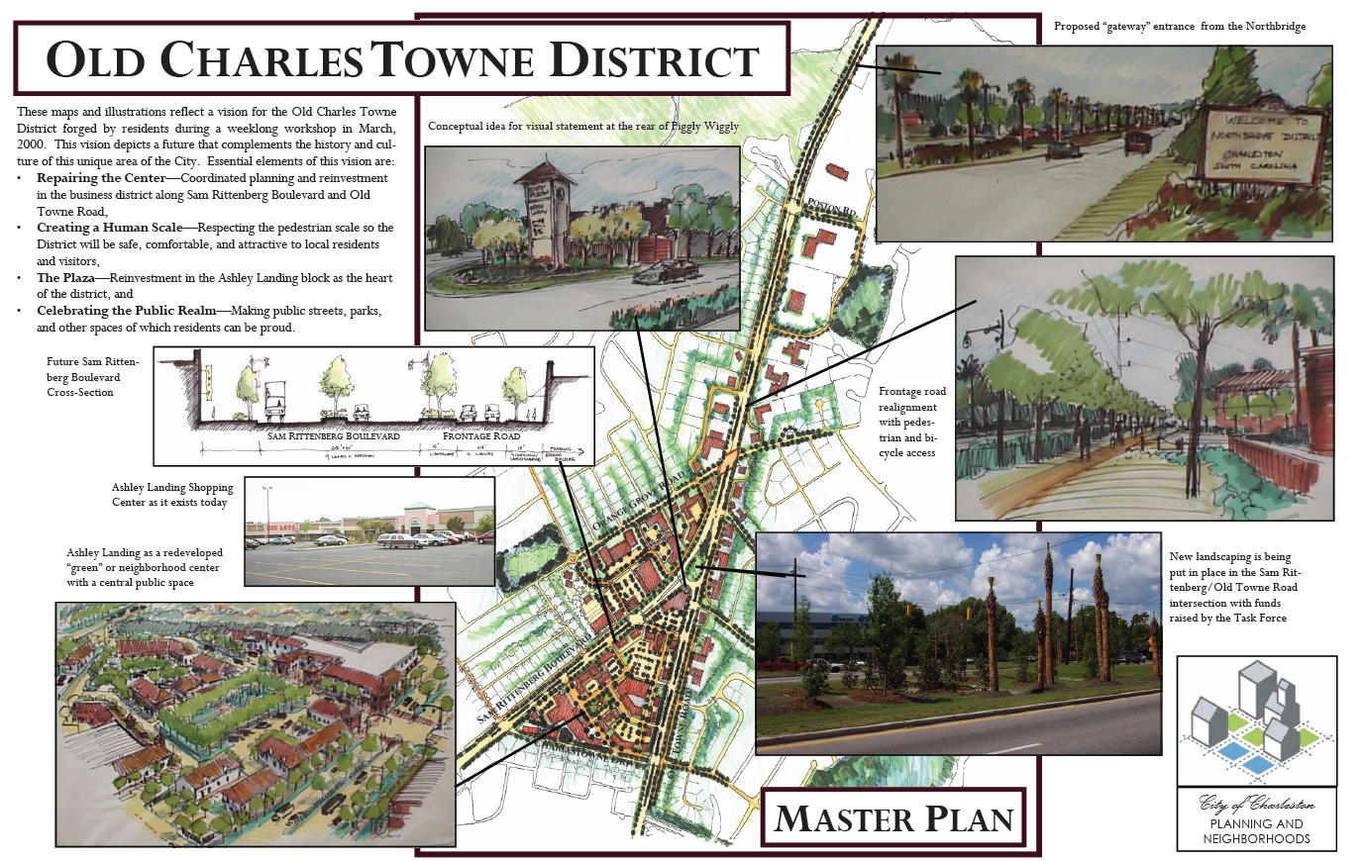
2000 Old Charles Towne District
Elements of vision:
Repairing the Center
Creating a Human Scale
Plaza at Center
Celebrating the Public Realm

Slide 10
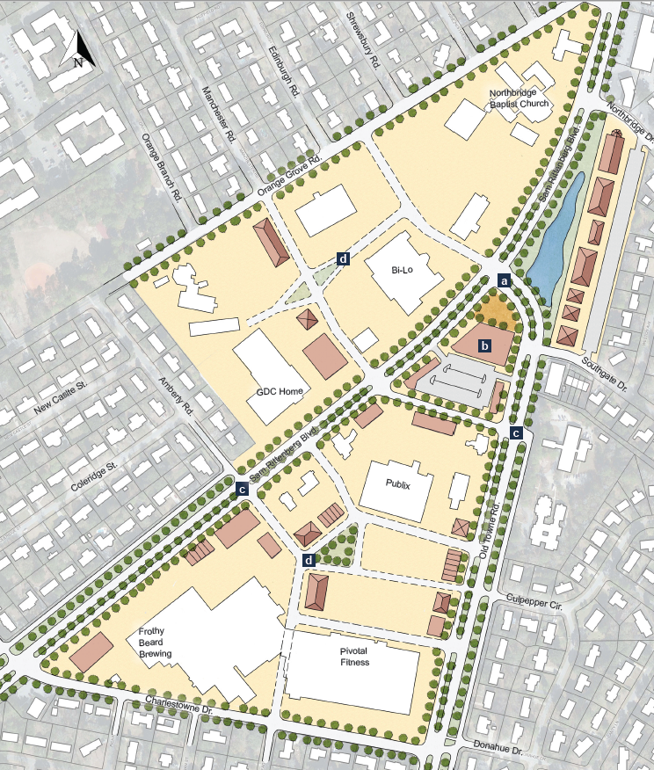
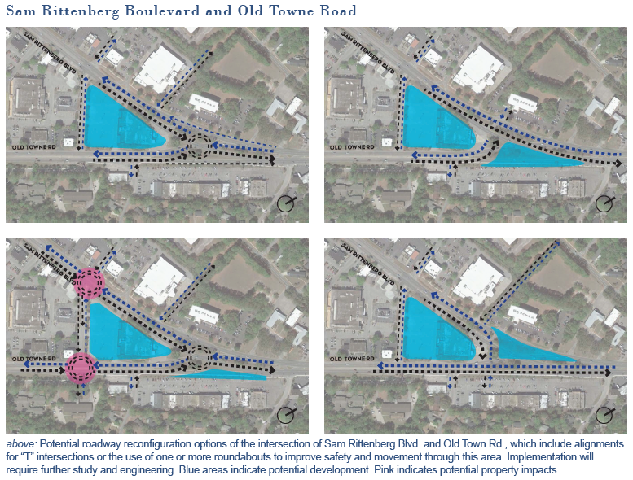
2018 Plan West Ashley

Slide 11
2018 Plan West Ashley
Community participants described the Sam Rittenberg / Old Towne intersection as the “suicide merge” - uncomfortable for motorists, and unsafe for pedestrians and cyclists. Rather than merging together, these streets can meet at a signalized intersection, regularizing traffic flow and allowing for safer movement. Details for this idea, including additional design options, can be found in Chapter 3.
The City recently acquired the site of the vacant Piggly Wiggly; future use of this site should benefit the community, and given the prominent location positively contribute to West Ashley identity. A portion of the property is proposed to be used to facilitate intersection improvements. This sketch shows a new building and public space to front the improved intersection. Parking (which could include a parking structure) is lined from view of pedestrians on the street. This new building can be the architectural centerpiece to an improved entry district; special attention should be given its design.

Slide 12
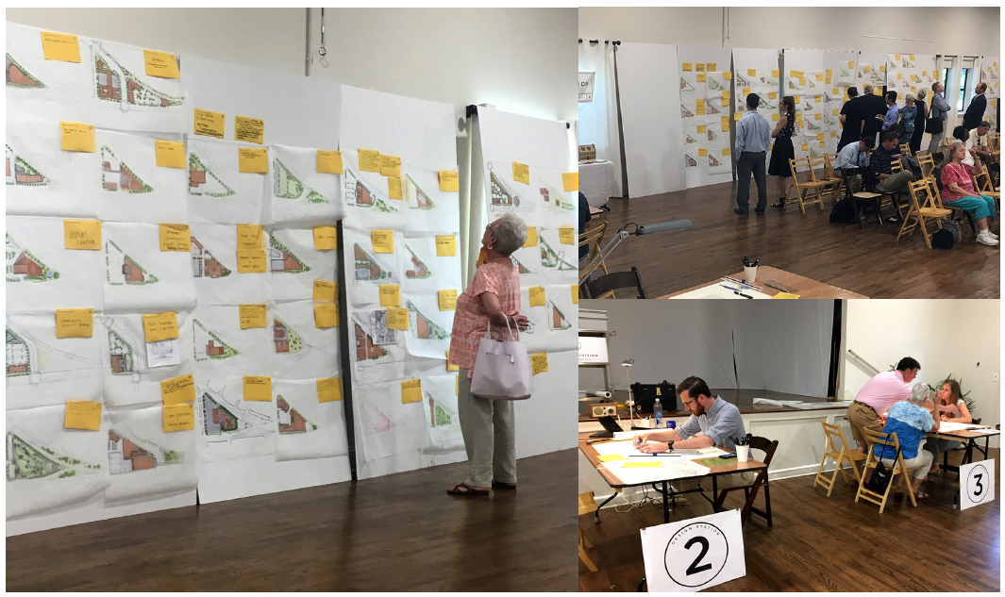

Slide 13
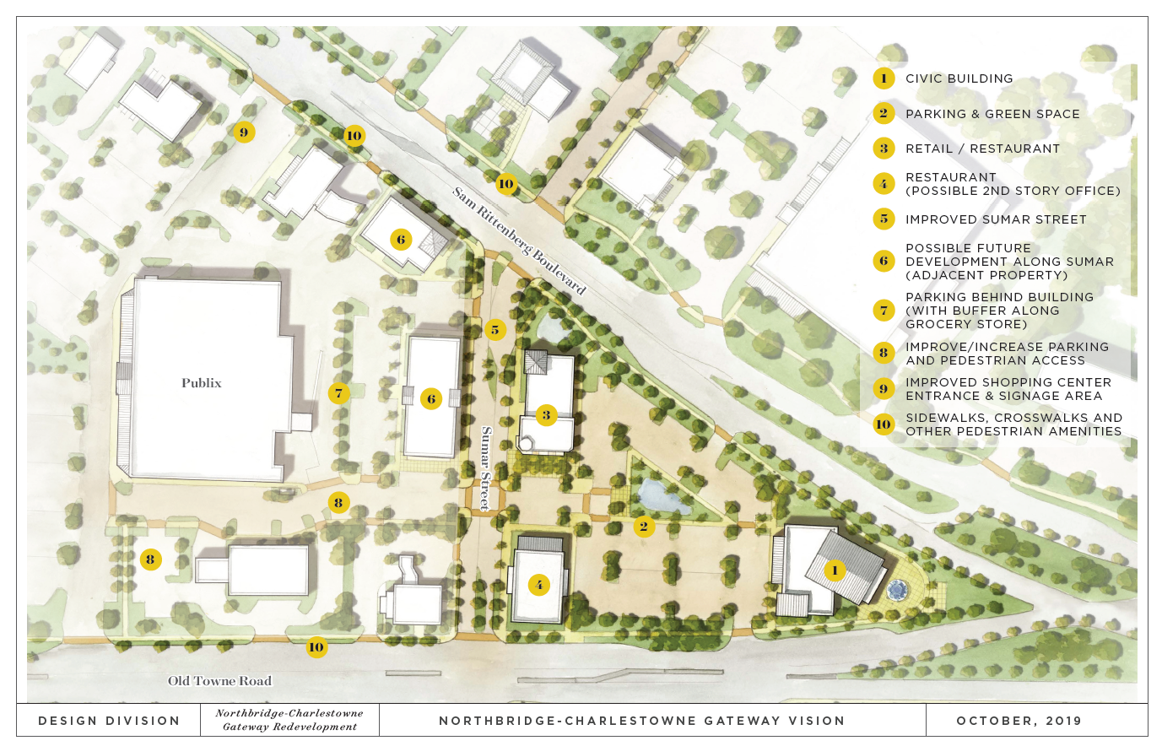

Slide 14
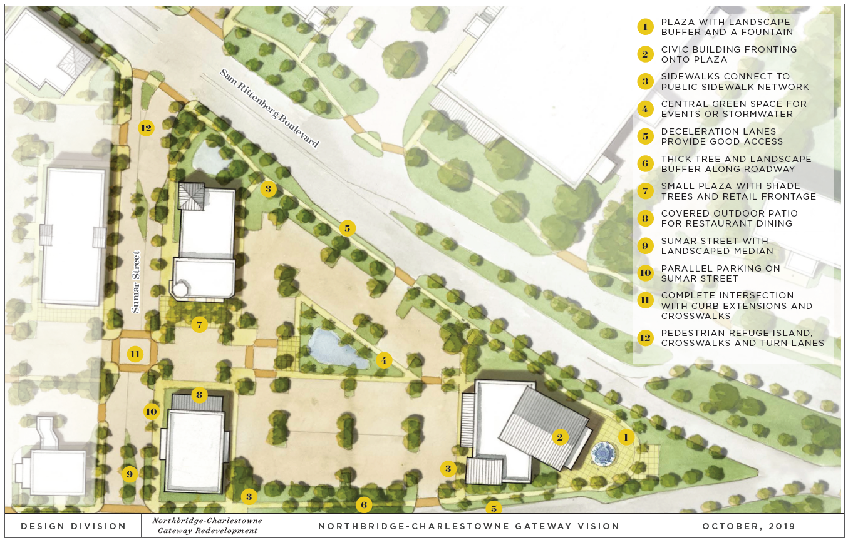

Slide 15
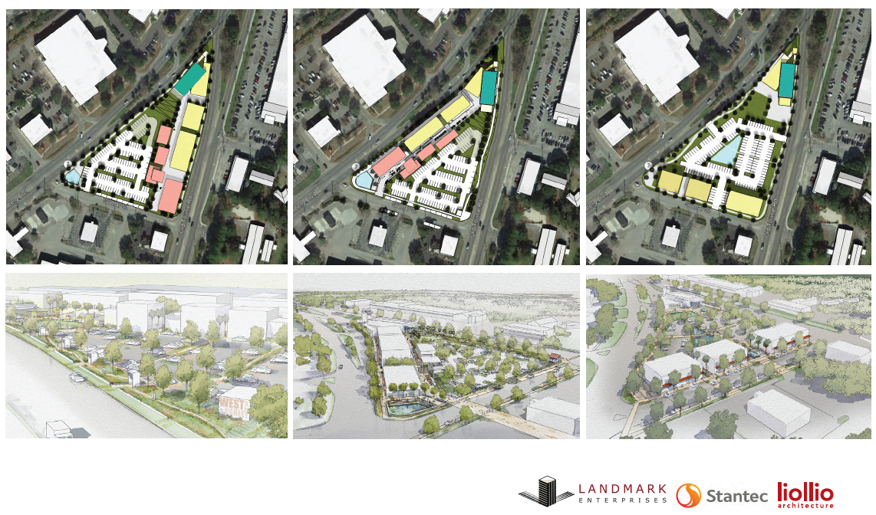

Slide 16
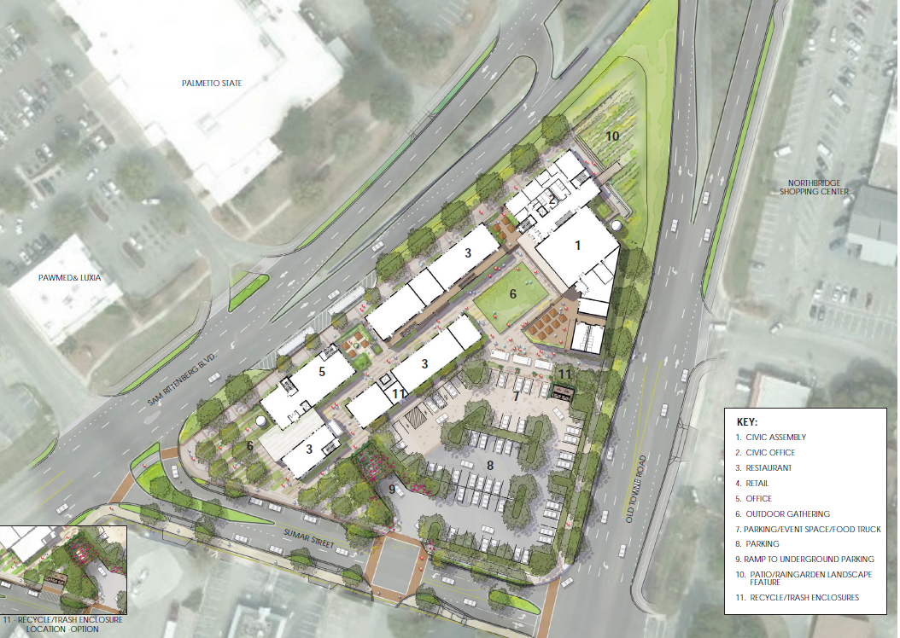

Slide 17
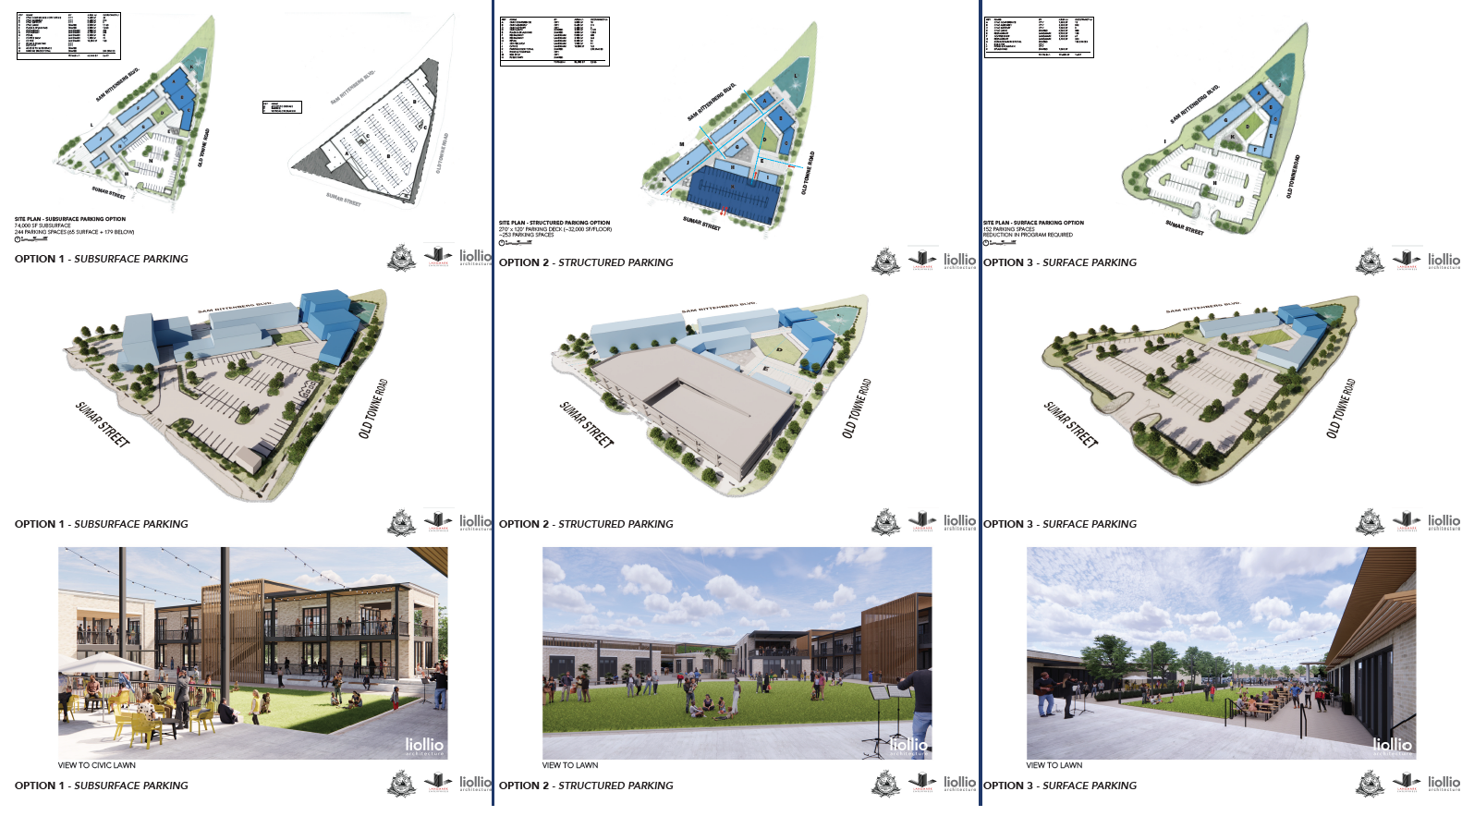

Slide 18
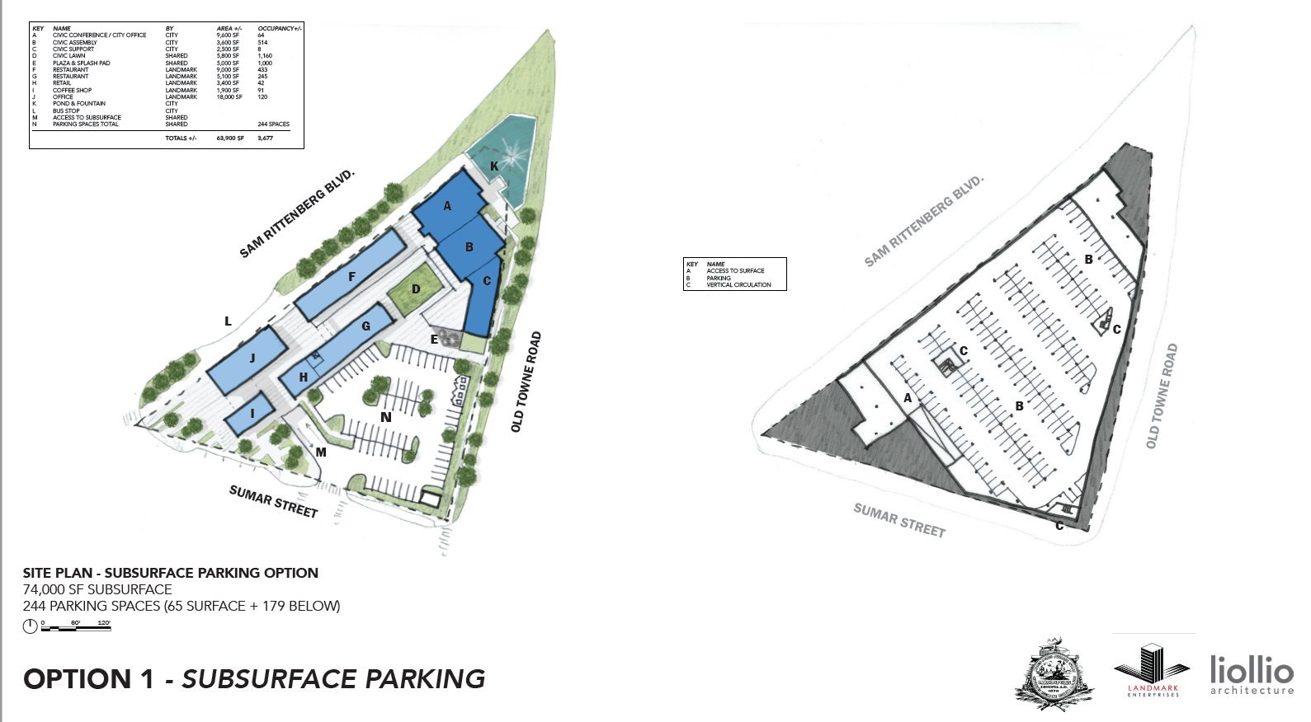
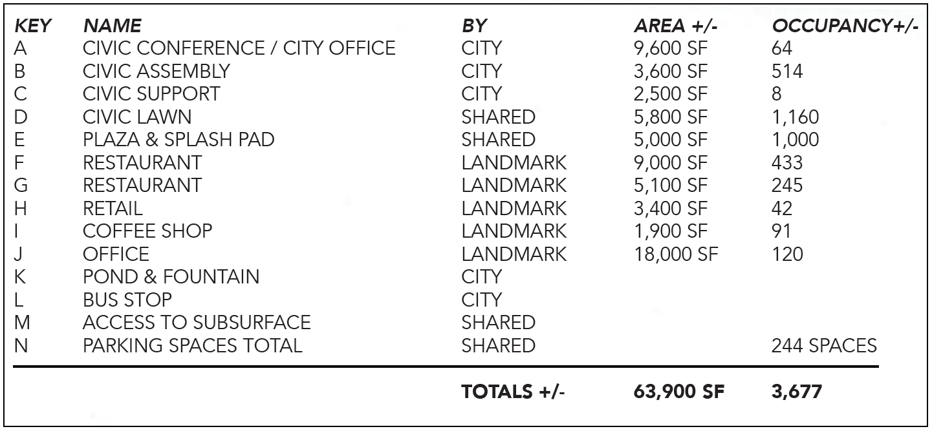

Slide 19
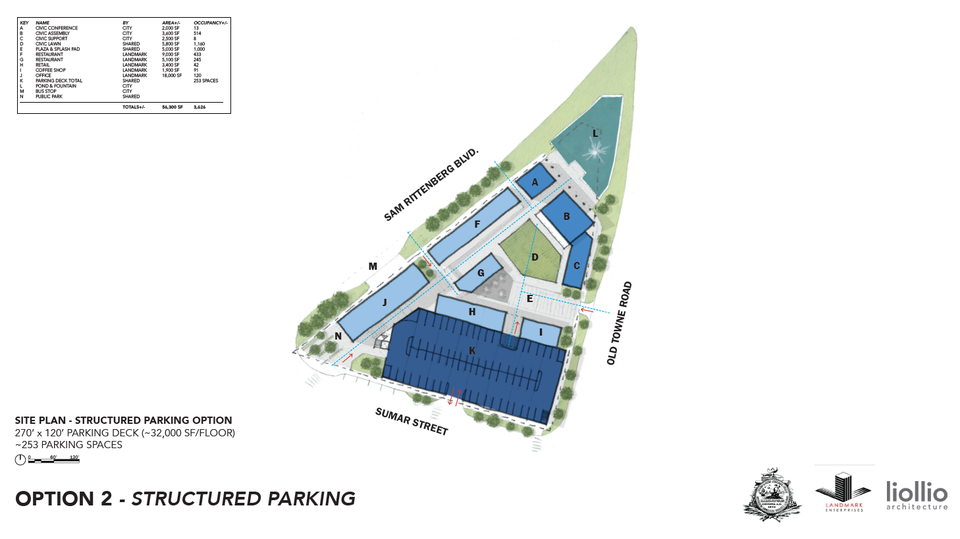
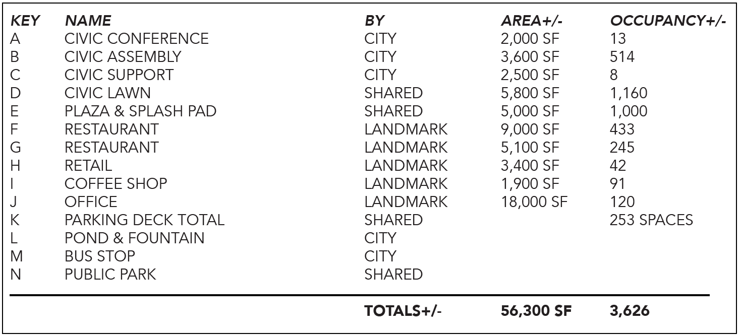

Slide 20
